Slide 1
Writing a Chain Story

Slide 2
What is a Chain Story?
It’s a story where students each add a different segment or part.

Slide 3
Here is your gameplan:
Divide your class into groups of four or five.
Within your group, number off….one, two, three…….to see who will be writing first, second, etc.

Slide 4
Your teacher will give you a “starter” sentence or two. Read it aloud as a group.
Brainstorm and discuss!

Slide 5
Things to Remember……
If you are waiting for your turn to write, quietly be thinking about what you would like to add to the story.
When it is your turn to write, you will have 60 seconds to add one or two sentences.

Slide 6
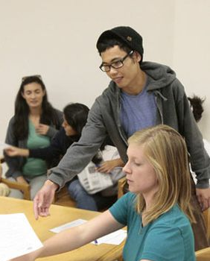
Write quickly but legibly so it will be easy to read.
When you have finished your sentence(s), fold the paper over to cover everything on the paper except what you have just written.
Pass your paper on to the next person who will add to the story.

Slide 7
Pass the story around your group two times so everyone has a chance to write twice.
The last person in your group will write a sentence that finishes the story
Now unfold the paper and read your story aloud!

Slide 8
As a group, rewrite your story to make it flow so that it is connected and logical.
Make additions to the story but keep the basic storyline intact.
Review your story for sentence structure, spelling, punctuation, and grammar.
When you are satisfied with your story, sign it and hand it in.

Slide 9
Congratulations!!
Great job working together as a group to share ideas and write your story!

