Slide 1
Training To Be A History Detective
Digging Deep and Uncovering the Clues

Slide 2
There are thousands of books, movies, and TV shows that feature detectives who uncover information or solve crimes.
CSI….Sherlock…..Fargo….Poirot…..Monk…..True Detective …..Castle…..Columbo…..Criminal Minds…..Elementary….. Luther…..Midsomer Murders…..Death in Paradise…..Dexter ….The Mentalist…..Murdoch Mysteries…..Inspector Morse …..Reacher…..The Blacklist…..Blue Bloods….. Breaking Bad …..NCIS…..Scandel…..Blindspot….. Hawaii 5-0…..The Good Wife…..How to Get Away With Murder…..Rizzoli & Isles …..Bones…..White Collar…..Law & Order…..Body of Proof

Slide 3
To be good at their jobs, detectives must analyze and process information, connect clues, and reach conclusions based on the information they put together.

Slide 4
They have good “people skills” they use in conducting interviews to gather information, follow trails, and find and use resources.

Slide 5
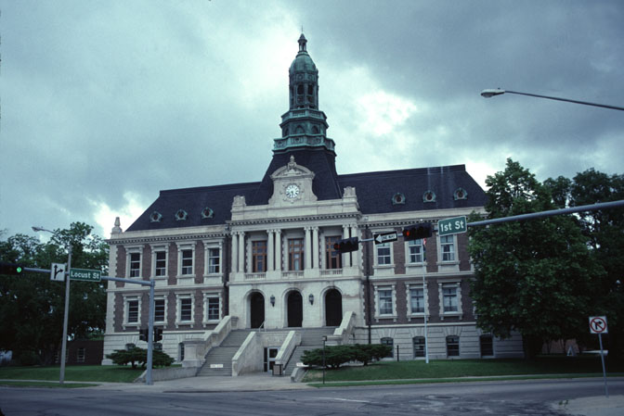
A good detective pays attention to even the smallest detail and is curious, persistent, and determined.
As an historic detective, you will each pick a site in Nebraska and uncover as much information about it as you can.

Slide 6
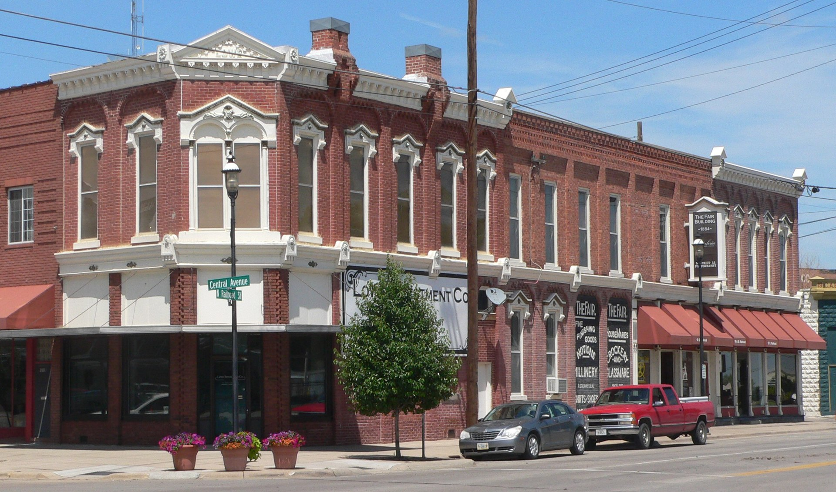
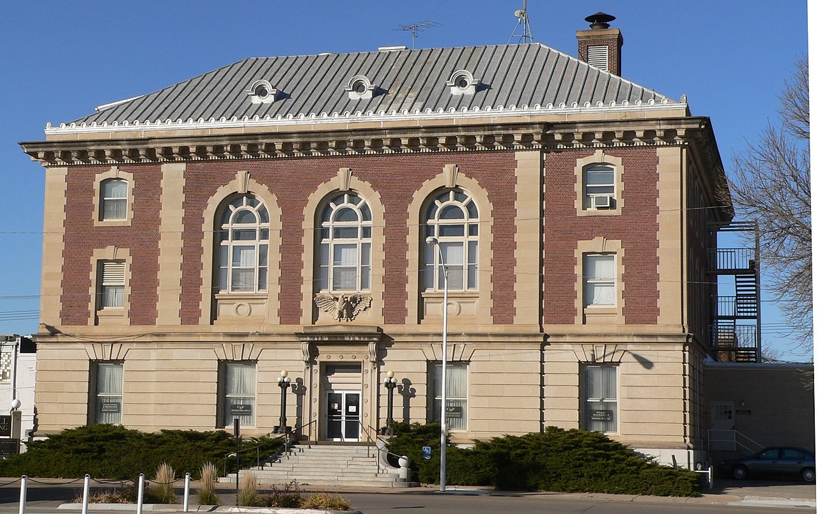
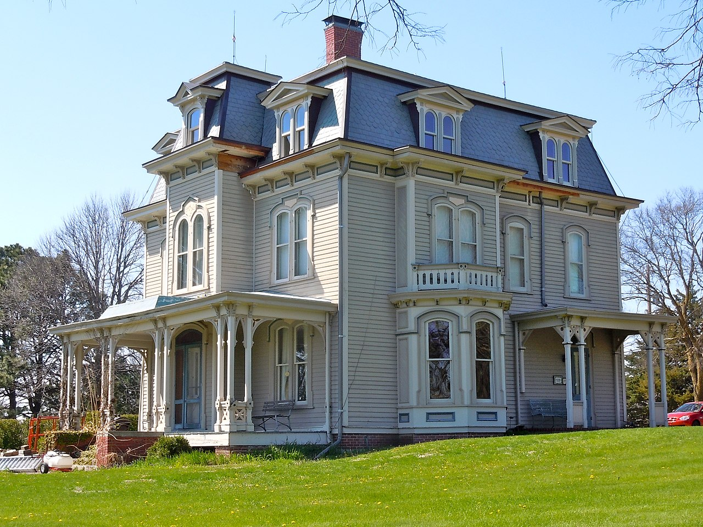
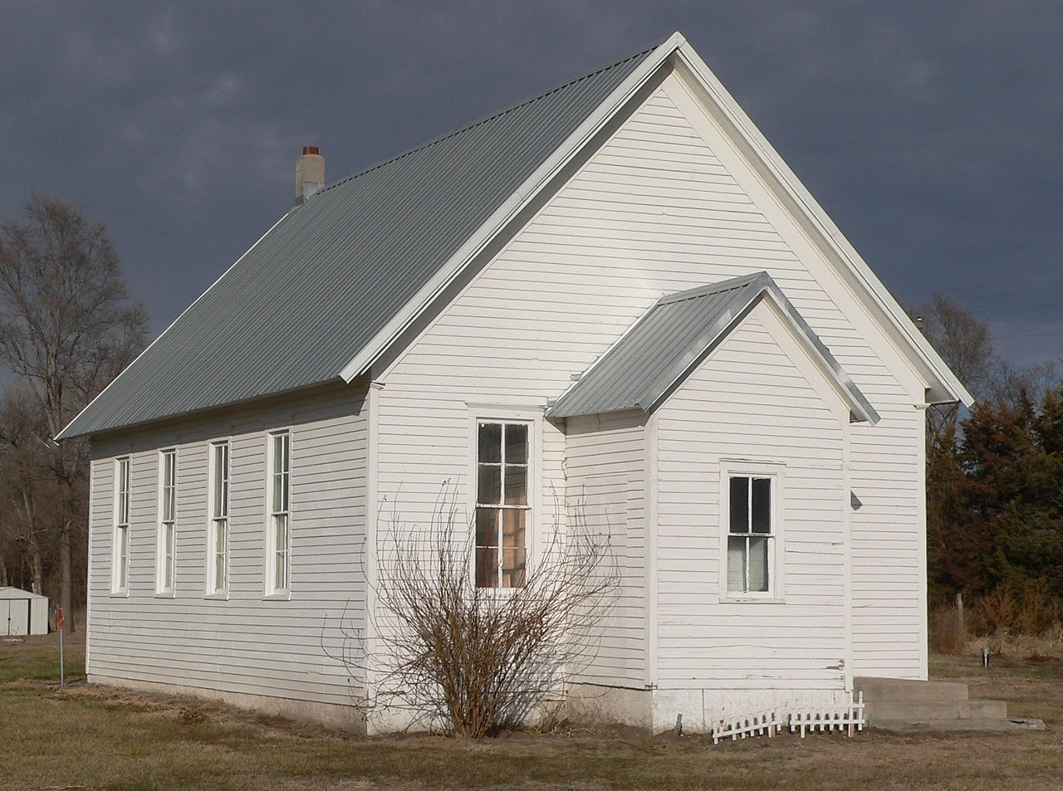
Nebraska currently has over 1,000 properties throughout the State listed on the Register—everything from private residences to county courthouses to archeological sites.
You will be picking one to investigate. But where to start?

Slide 7
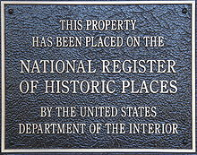
There are lots of places for researching historic sites on-line.
A real “gem” is found with the National Register of Historic Places.

Slide 8
Authorized by the National Historic Preservation Act of 1966 (during the presidency of Lyndon B. Johnson), the National Park Service’s National Register of Historic Places is part of a national program to coordinate and support public and private efforts to:
identify, evaluate, and protect America’s historic and archeological resources.

Slide 9
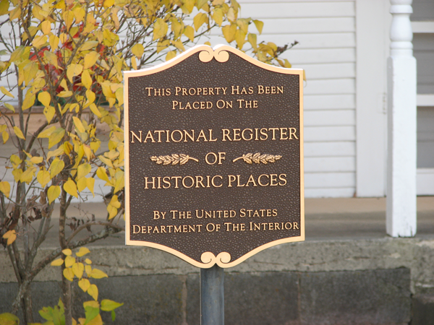
The Register is a treasure trove for historians, scholars, travelers, and anyone who wishes to delve into American history.
As of the end of 2023, more than 98,000 properties were listed on the National Register.
This is a great place to start!

Slide 10
You can also find information about historic preservation programs listed on the websites of these agencies found under the Department of the Interior:
Interior Museum Program
Natural and Cultural Resources Recovery Support
The National Park Service and Historic Preservation
NPS Archeology Program
NPS Technical Preservation Services
Bureau of Land Management Cultural Heritage
Fish and Wildlife Services Historic and Cultural Treasures
Bureau of Reclamation: Cultural and Paleontological Resources

Slide 11
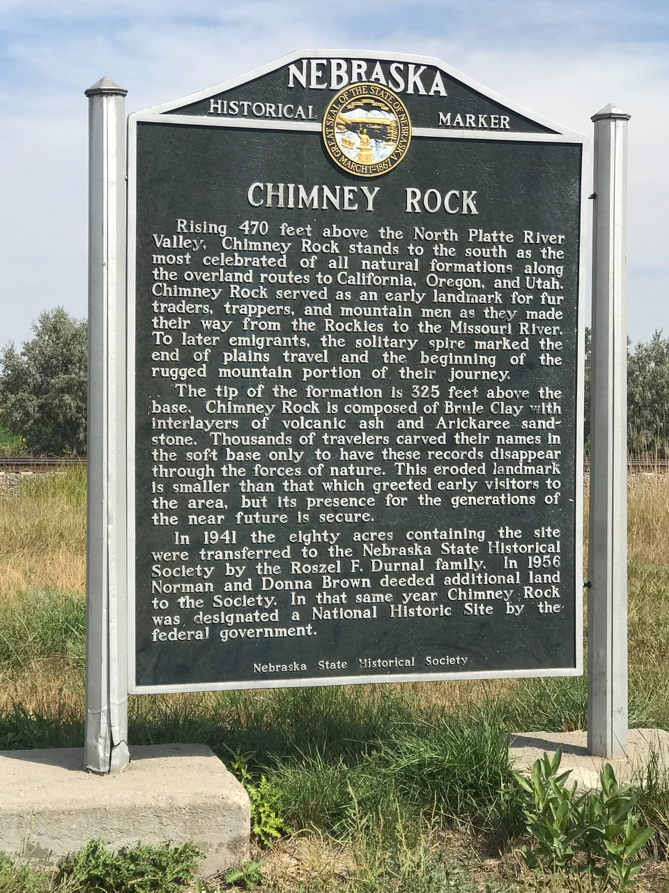
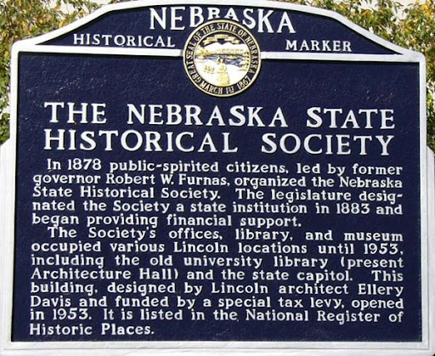
“Architects and Prominent People: Historic Nebraska - People, Places and Landscapes” has information on a variety of topics throughout the State including information about Nebraska architects and historic markers.

Slide 12
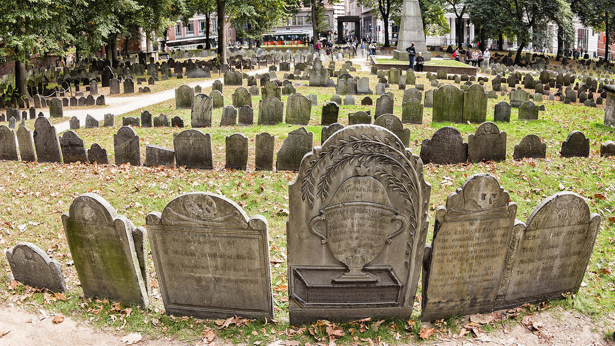
A good detective does more than research on the computer. There are lots of valuable places to explore and investigate in your own back yard!
County and city historical and genealogical societies Historic
Cemeteries
Museums
Libraries
Archives at Newspaper offices
History Nebraska in Lincoln (Nebraska’s Historical Society)

Slide 13
Once you pick the site you want to investigate, uncover as much information
as you can.
For instance, if you are researching an historic building, see if you can find answers for questions such as:
How old is the building?
Who was its architect or builder?
Were there special materials or construction techniques used in its building?
Are there any architectural features that make this building unique?

Slide 14
See what facts you can uncover:
What is the history of this building and/or the community?
Did any interesting events or activities take place here?
Who were the people who lived or worked here?
Did this building play a special role in the community?

Slide 15
If possible, visit the site yourself.
Take a tour.
Interview anyone who might have additional information, like the owner or a family member, care taker, tour guide, etc..
Take photos.
Gather any literature that may be at the site like pamphlets or postcards.
Walk through the building and grounds, if possible, and take notes of what you see and questions you might have.

Slide 16
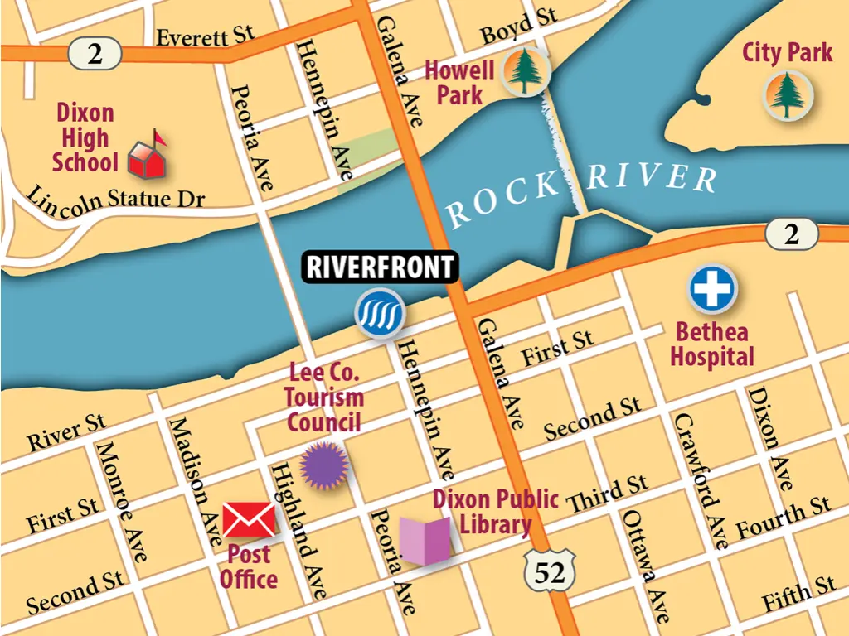
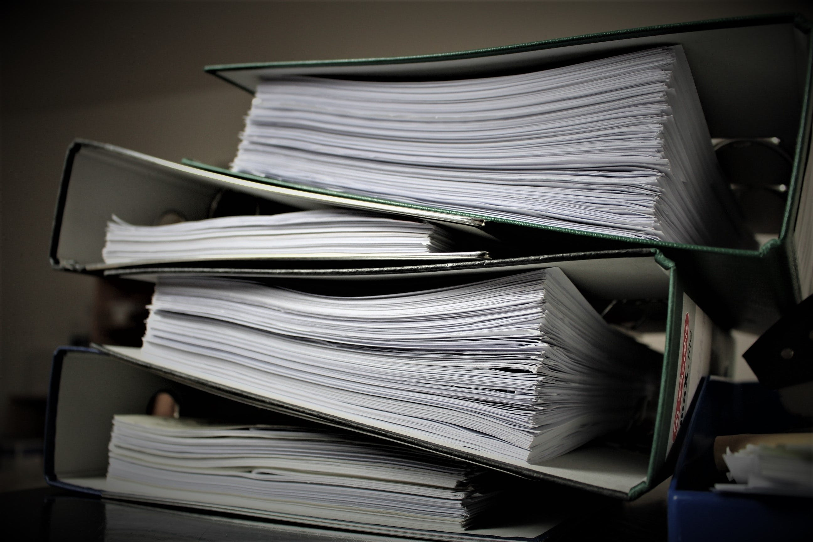
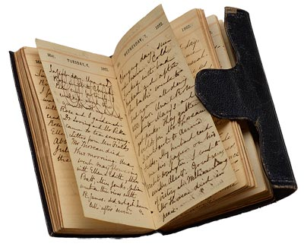
Gather as much “evidence” as you can:
Photos
Documents
Maps
Posters
Newspaper articles
Historic accounts
Diaries
Construction dates and information
Architectural styles and features
Real-life stories of those who lived or used the site
An historical record of the site, how it evolved, and people associated with it

Slide 17
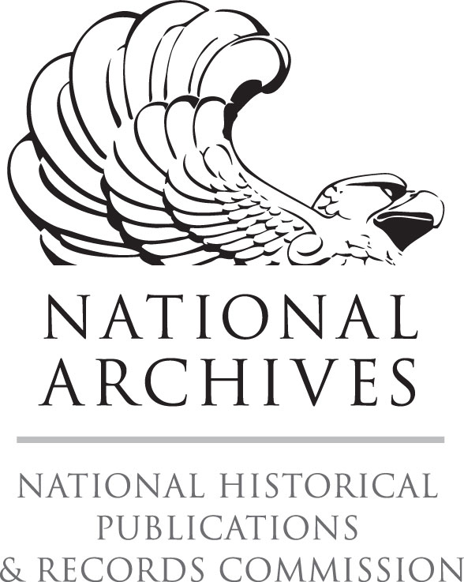
The more you dig, the more you will find!!
Once you gather as many artifacts, documents, photos, clippings, etc. as possible, it is time to analyze the evidence you have uncovered.
The National Archives and Records Administration has some great
Tips for you in analyzing your discoveries.

Slide 18
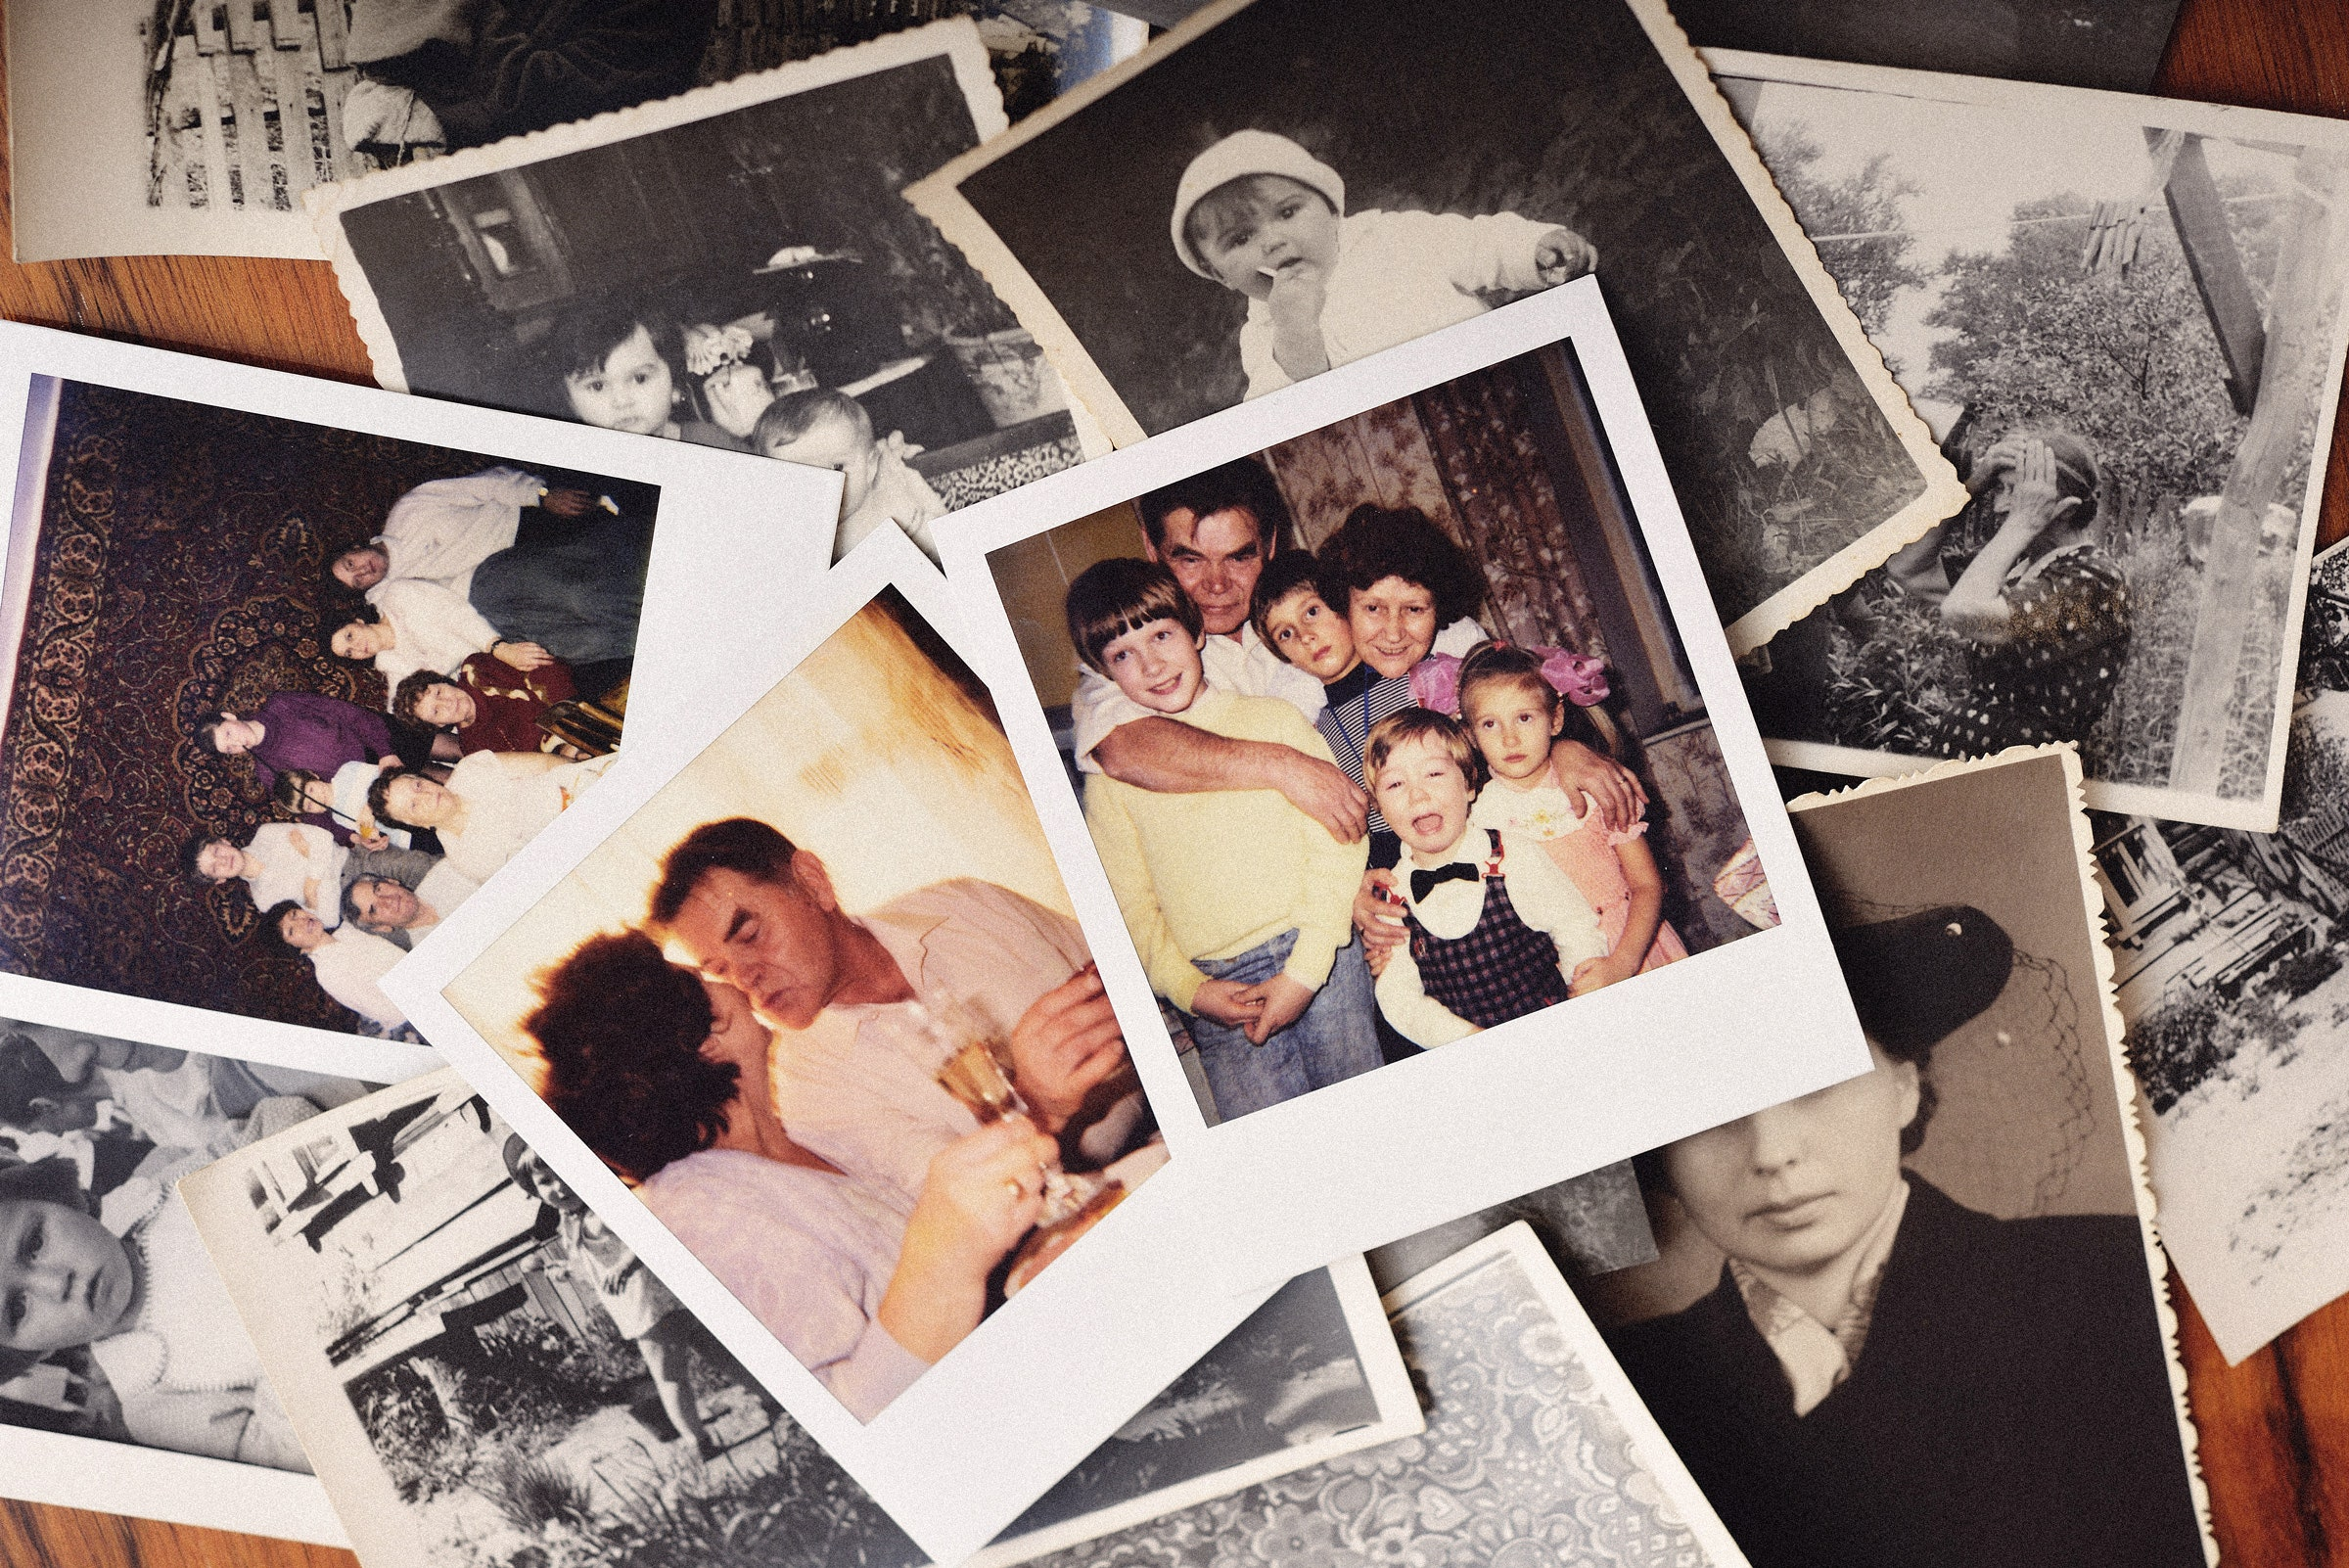
For instance, here is how the National Archives suggests you “Meet the Photo”
Select a photo to analyze.
Quickly scan the photo.
What do you notice first?

Slide 19
Check all that apply for the type of photo
you are analyzing.
Portrait
Landscape
Aerial/Satellite
Action
Architectural
Candid
Event
Family
Panoramic
Posed
Documental
Selfie
Other

Slide 20
Observe its parts.
Try to make sense of it. Answer as best you can.
Note: the caption, if available, may help.
List the people, objects, and activities you see.

Slide 21
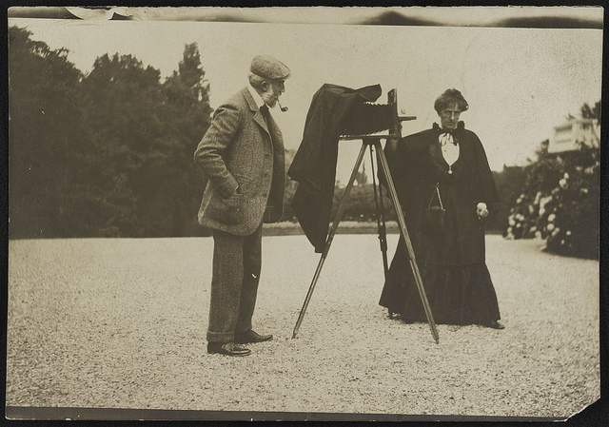
Try to determine:
Who took this photo?
Where is it from?
When is it from?
What was happening at the time in history this photo was taken?
Why was it taken?
List evidence from the photo or your knowledge about the photographer that led you to your conclusions.

Slide 22
Now use the photo as historical evidence.
What did you find out from this photo that you might not learn anywhere else?
What other documents or historical evidence are you going to use to help you understand this place, the people associated with it, or events that took place there?

Slide 23
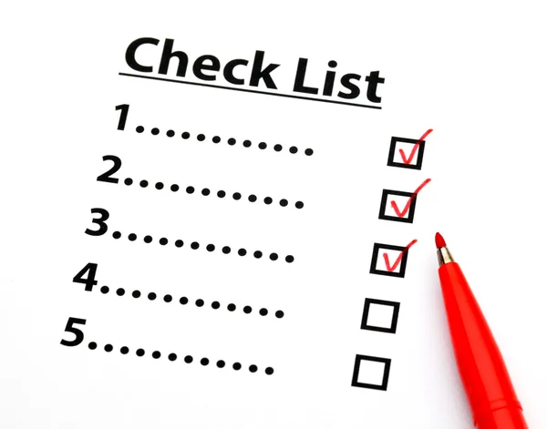
Use this format to investigate everything you have gathered about your site and the events and people associated
With it.
Memorandum
Reports
Emails
Identification documents
Congressional documents
Blue prints
Birth/marriage certificates
Passport
Bills of sale
Contracts
Letters
Speeches
Patents
Telegrams
Court document
Charts
Newspapers
Advertisements
Press releases
Receipts

Slide 24
Once you have compiled and analyzed all your research materials, you will make a chronological timeline of the site’s “lifespan” to visualize its history.
Make a scale of the timeline, lay it out in segments (5-year, 10-year, 20-year, etc.), and insert the events that transpired in the appropriate sections.

Slide 25
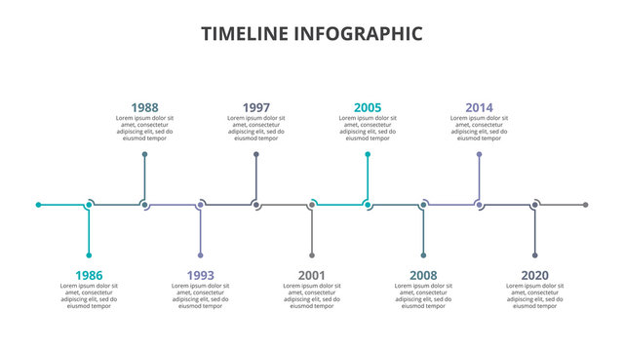
The timeline will list events affecting the site and/or its owners (births, deaths, additions, fires, storms, etc.) as well as major events (local, state, national and international) which occurred during the existence of the site.
It will help to understand how the history of the site fits into larger patterns of history.

Slide 26
Now it’s time to write a final report.
Your report should:
Identify the site you investigated, including any pertinent information from the National Registry
Explain the process and resources you used in conducting your investigation
List all the articles/artifacts you gathered during the investigation and any pertinent details
Notations about your observations, anecdotes, or intriguing aspects of the case
A summary of your findings about your site, its history and relevance, and why the site should continue to be preserved

Slide 27
The last step is to gather all your findings, articles, artifacts, etc., and put them together in an orderly an orderly fashion in your case folder.
These labeled case folders should include: An inventory of everything that is included in the file:
Every item, artifact, photo, article, etc. you have discovered, carefully labeled with notations
A chronological timeline
A final report

Slide 28
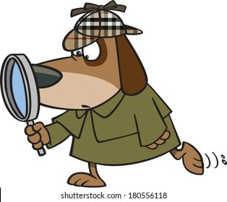
Now that you have all the tools of a detective, it’s time
to start your history sleuthing!!

