Slide 1
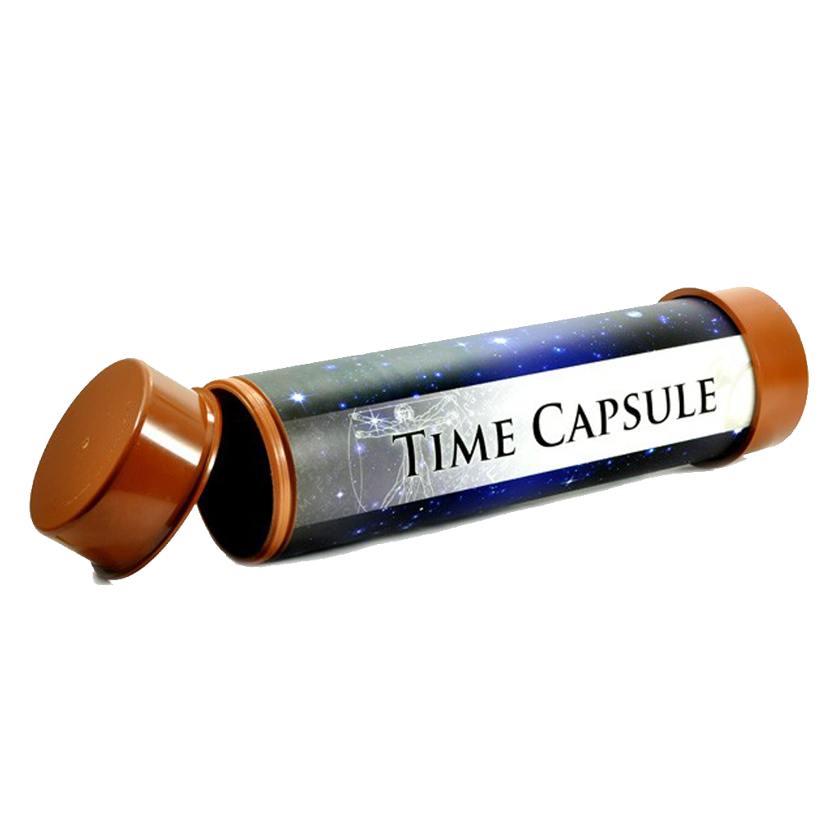
Time Capsules
Preserving the past for the future

Slide 2
On May 4, 1959, a 190-pound steel tube time capsule was buried in the sidewalk by the Pershing Auditorium.

Slide 3
The goal was for the time capsule to remain encased until 2059 when it would be opened 100 years later to celebrate Lincoln’s Bi-centennial.

Slide 4
In 2023 when Pershing Auditorium was slated for demolition, the time capsule was removed 36 years ahead of schedule and opened.

Slide 5
Inside was a letter from Bennet Martin (Mayor of Lincoln from 1956-1959) who wrote directly to those in the future who would open the capsule.
Among the contents of the capsule were documents such as a centennial newspaper, Gooch’s Best scrapbook, promotional items from local businesses, photos, and a drawing of the city.

Slide 6
Time capsules are meant to preserve objects to commemorate an event or to capture a moment in time for future generations to see.

Slide 7
They are an historic collection of articles, artifacts, information, mementos, and memorabilia that are meant to communicate with future people.

Slide 8
They are helpful for archaeologists, anthropologists, and historians to understand a past way of life.

Slide 9
These capsules may be buried, placed in vaults or safety deposit boxes, or enclosed in a specially-designed cavity in a building.

Slide 10
To endure the elements and keep the contents safe and intact, a time capsule needs to be constructed from strong, water-proof materials that can be sealed, especially if it is to be buried or enclosed a building.

Slide 11
One of the oldest time capsules uncovered in the United States was opened in Boston in 2014.

Slide 12
More than two centuries earlier, in the year 1795, Samuel Adams and Paul Revere placed items in a cowhide-covered time capsule which was encased in a corner stone of the Boston State House while it was under construction.

Slide 13
In 1855 when repairs were made to the State House building, the original Revere and Adams time capsule was removed from the cornerstone, opened and additional items were added to the capsule.

Slide 14
To better preserve its contents, it was resealed in a copper box no bigger than a cigar box and was re-encased until it was recovered and opened in 2014.

Slide 15
What was inside the time capsule?
Silver and copper coins dating from 1652 to 1855
Newspapers
A medal depicting George Washington
A silver plaque believed to be engraved by Paul Revere.

Slide 16
After being on display at the Boston’s Museum of Fine Arts for some time, the two-hundred-plus year-old capsule was reburied with some modern currency added for a future generation to discover and enjoy.

Slide 17
A very special time capsule was launched into space by NASA to be carried on Voyager 1 and 2.

Slide 18
The message in the capsule used a 12-inch gold-plated copper disk containing sounds and images to showcase the diversity of life and culture on Earth.

Slide 19
Carl Sagan (American astronomer and science writer), who played an integral part in the project noted,
“The spacecraft will be encountered and the record played only if there are advanced spacefaring civilizations in interstellar space. But the launching of this bottle into the cosmic ocean says something very hopeful about
life on this planet.”

Slide 20
Back on Earth, the largest time capsule in the word on record in the 1977 Guinness Book of World Records can be found buried in Seward, Nebraska!

Slide 21
With his grandkids in mind, store owner Harold Davisson had a 45-ton vault buried under a mound of dirt in front of his furniture store. He wanted his grandchildren to know what his life was like in 1975.
Harold entombed some 5,000 items, including two cars, telephone books, packages and gifts from local citizens, statuary, clothing, and trinkets from the disco era.

Slide 22
So, for centuries, people have been using time capsules to send messages to future generations.

Slide 23
Those who open these “treasures” find everything under the sun:
newspapers, clippings, letters, postcards, recipes, keepsakes, toys, packaging from a favorite snack, videos, documents, coins, artifacts, family photos, advertisements, autographs, blueprints, receipts, brochures, team jerseys, ticket stubs, postage stamps, movie reviews, essays, diaries, family trees

Slide 24
All are useful in giving us a unique view into the past as we continue on into the future!

