Slide 1
The History and Art of Mosaics

Slide 2
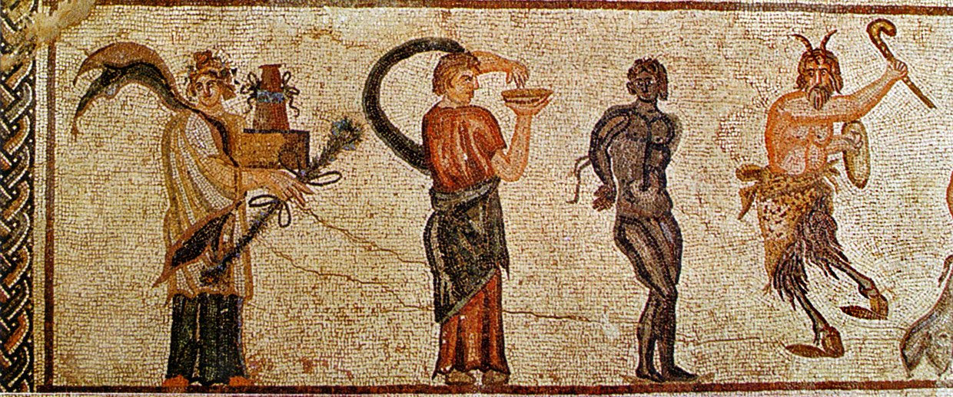
Mosaics have a long history.
They were created in ancient times and have brought art and color to humanity for thousands of years.

Slide 3
Some of the fabulous historic mosaic works were so detailed they looked like paintings.
Their hard-wearing nature has earned them the nickname ‘eternal pictures.’

Slide 4
Mosaic designs have been found all over the world and are one of the oldest and most beautiful forms of art in the history of mankind.
Mosaic art can be dated back more than 5,000 years to ancient Mesopotamia (modern-day Iraq).

Slide 5
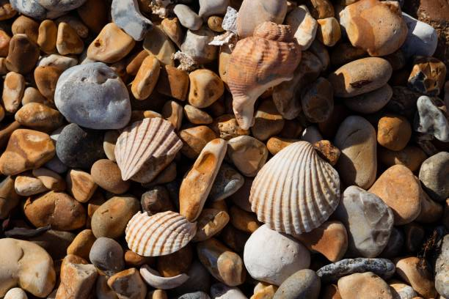
Early examples of mosaics were used for amorphous (unrecognizable) decorative work used in flooring and pavement.
These decorative, abstract designs were made up of ivory, seashells, small pieces of stone or rounded pebbles.

Slide 6
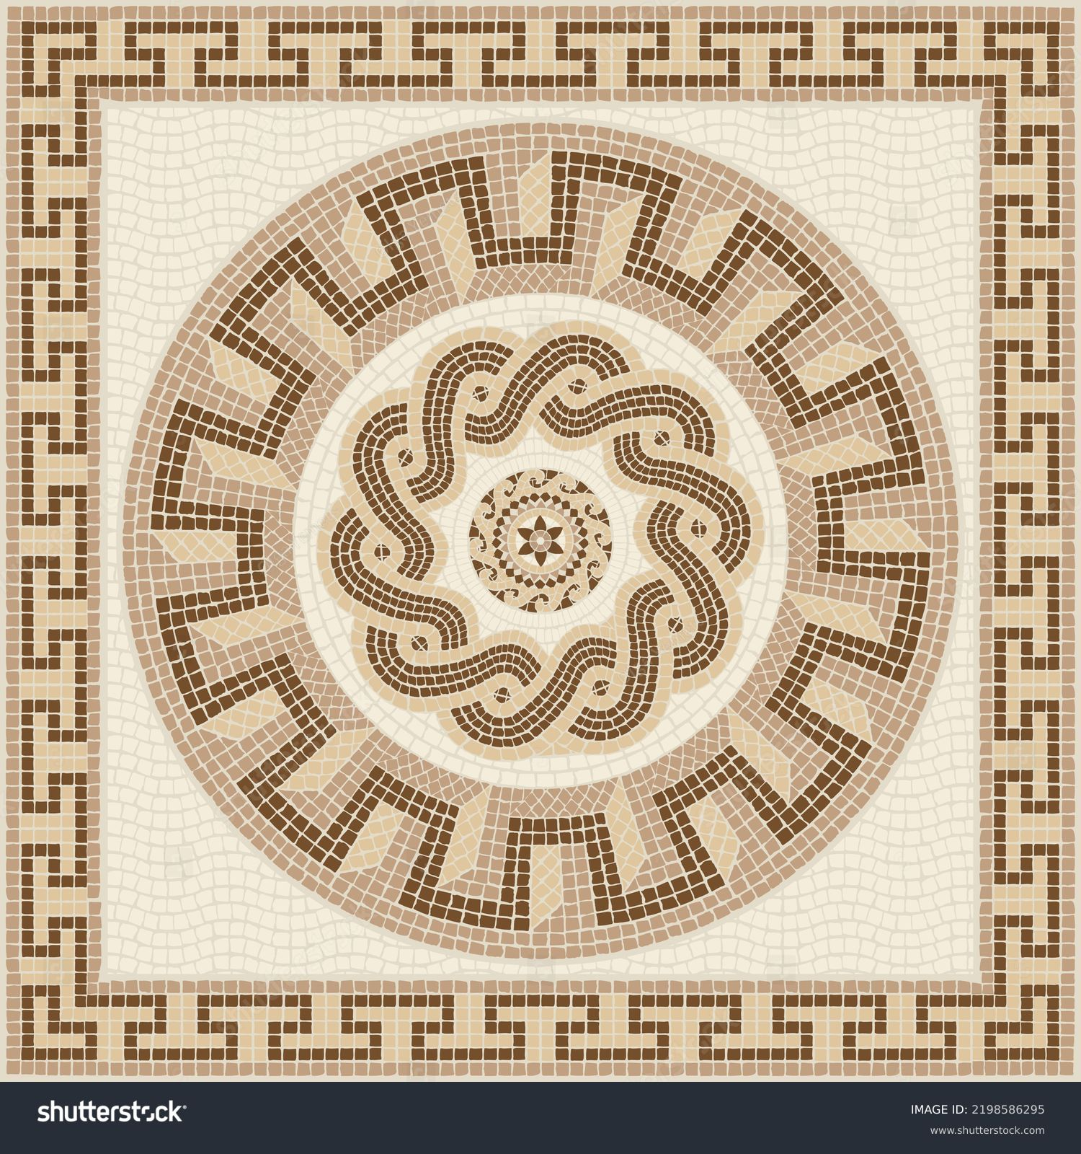
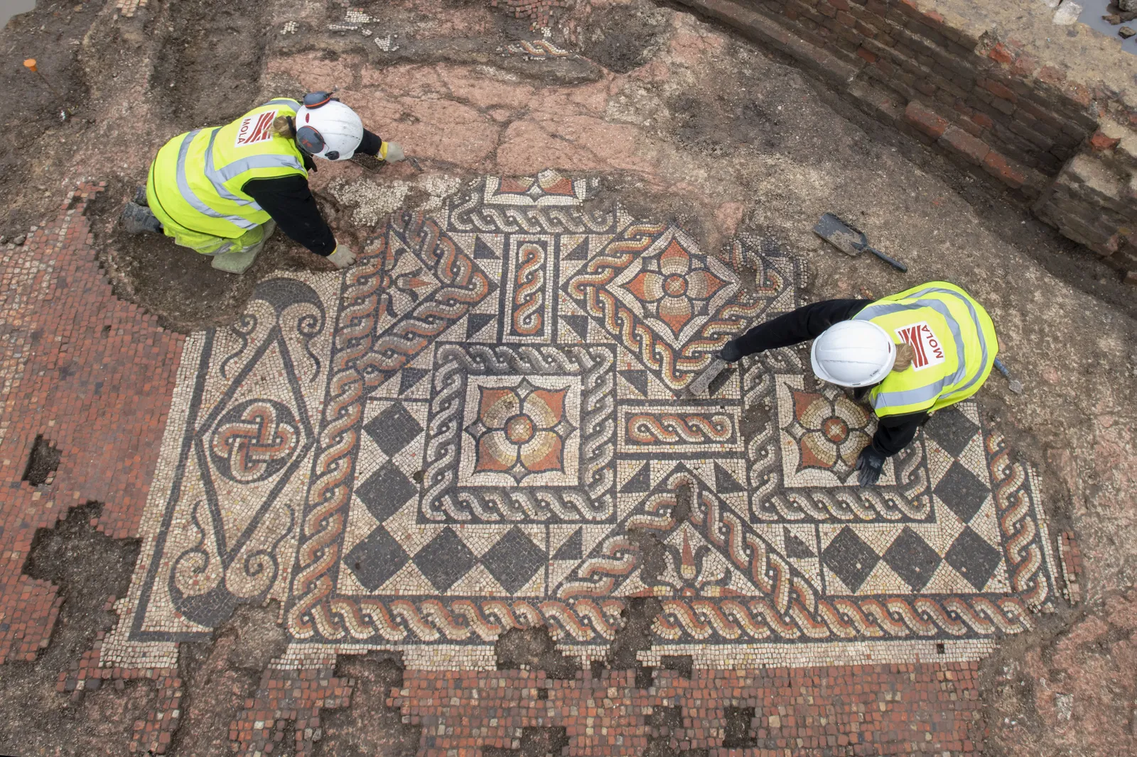
The Mesopotamians laid the groundwork for mosaics made thousands of years later by Classical (Greek and Roman) artists who chose to create pictures, patterns and motifs in their mosaics.

Slide 7
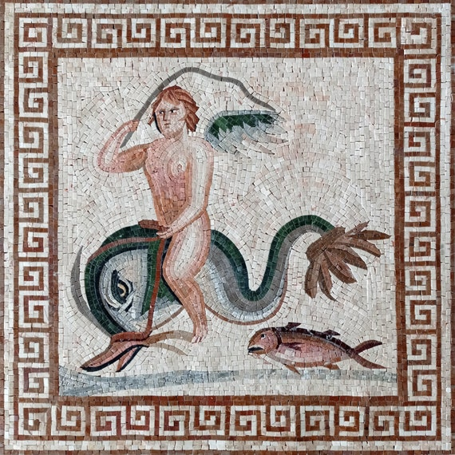
Mosaics became an artform in the 4th Century BC by the Greeks to decorate floors and walls, initially creating patterns using black and white pebbles.
Later, their mosaics evolved into a sophisticated art form illustrating myths and legends as well as pastimes of their lives and times.

Slide 8
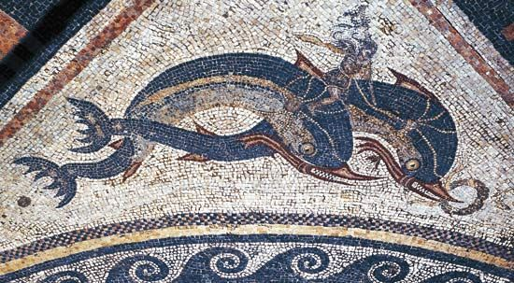
During that time, mosaics were produced using precise geometric patterns to skillfully display people and animals.

Slide 9
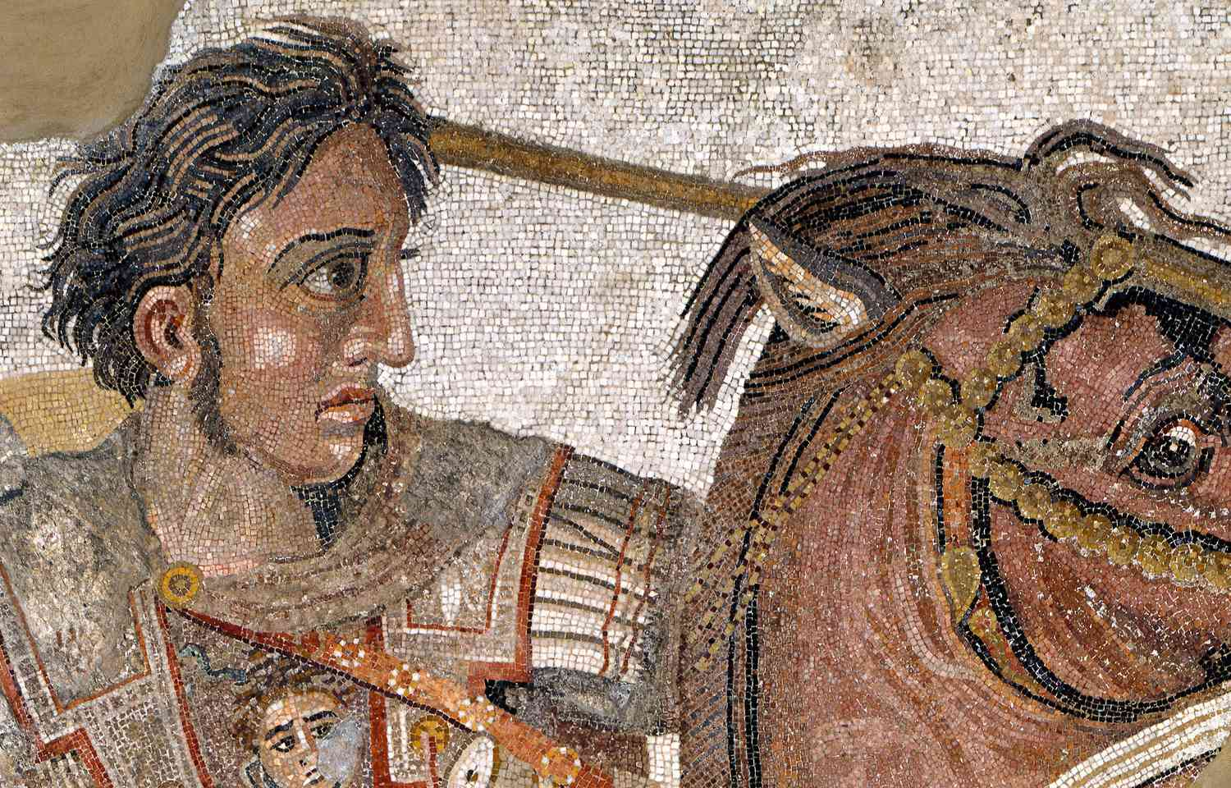
The ancient Romans’ interest and enthusiasm in mosaic art transformed the use of mosaics from only the privileged few into a more main-streamed decorative medium.

Slide 10
By the 8th century, glass tiles and stones in different colors were used to depict gods and create decorative pathways, religious scenes, everyday themes and geometric designs.

Slide 11
Smalti (glass from northern Italy), became popular, backed by a silver or gold leaf allowing light reflection and refraction, providing an entirely new texture and feel to the mosaics created.

Slide 12
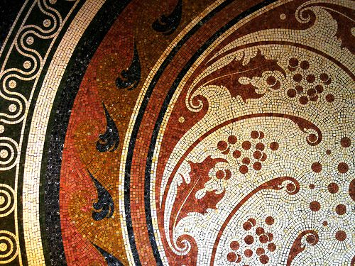
Modern Mosaics
Interest in mosaics were revived during the Art Nouveau movement of the 20th century—represented by curved, organic lines and shapes.

Slide 13
As a result, new techniques were introduced, such as the use of purpose-made and waste tiles to cover large surfaces of buildings.

Slide 14
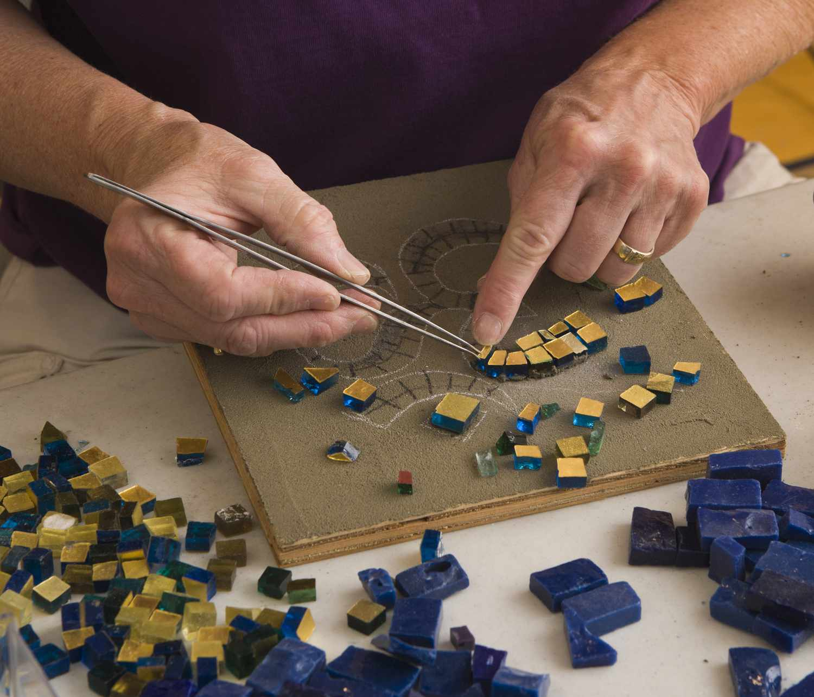
Today, designs created with mosaics are made by professional artists or by anyone as a popular craft.

Slide 15
The availability of mosaic tiles creates unlimited options for their use in a variety of environments: homes (bathrooms, kitchens, etc.), churches, businesses and public buildings (Murals), adding interest, creativity, color and elegance.

Slide 16
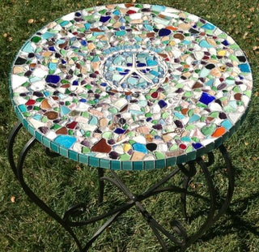
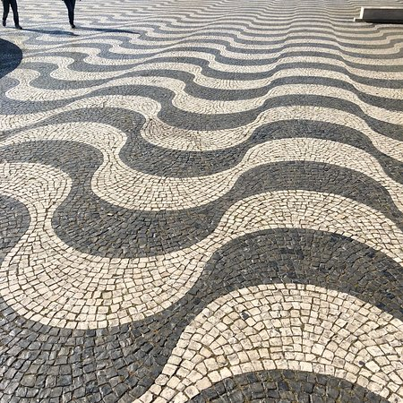
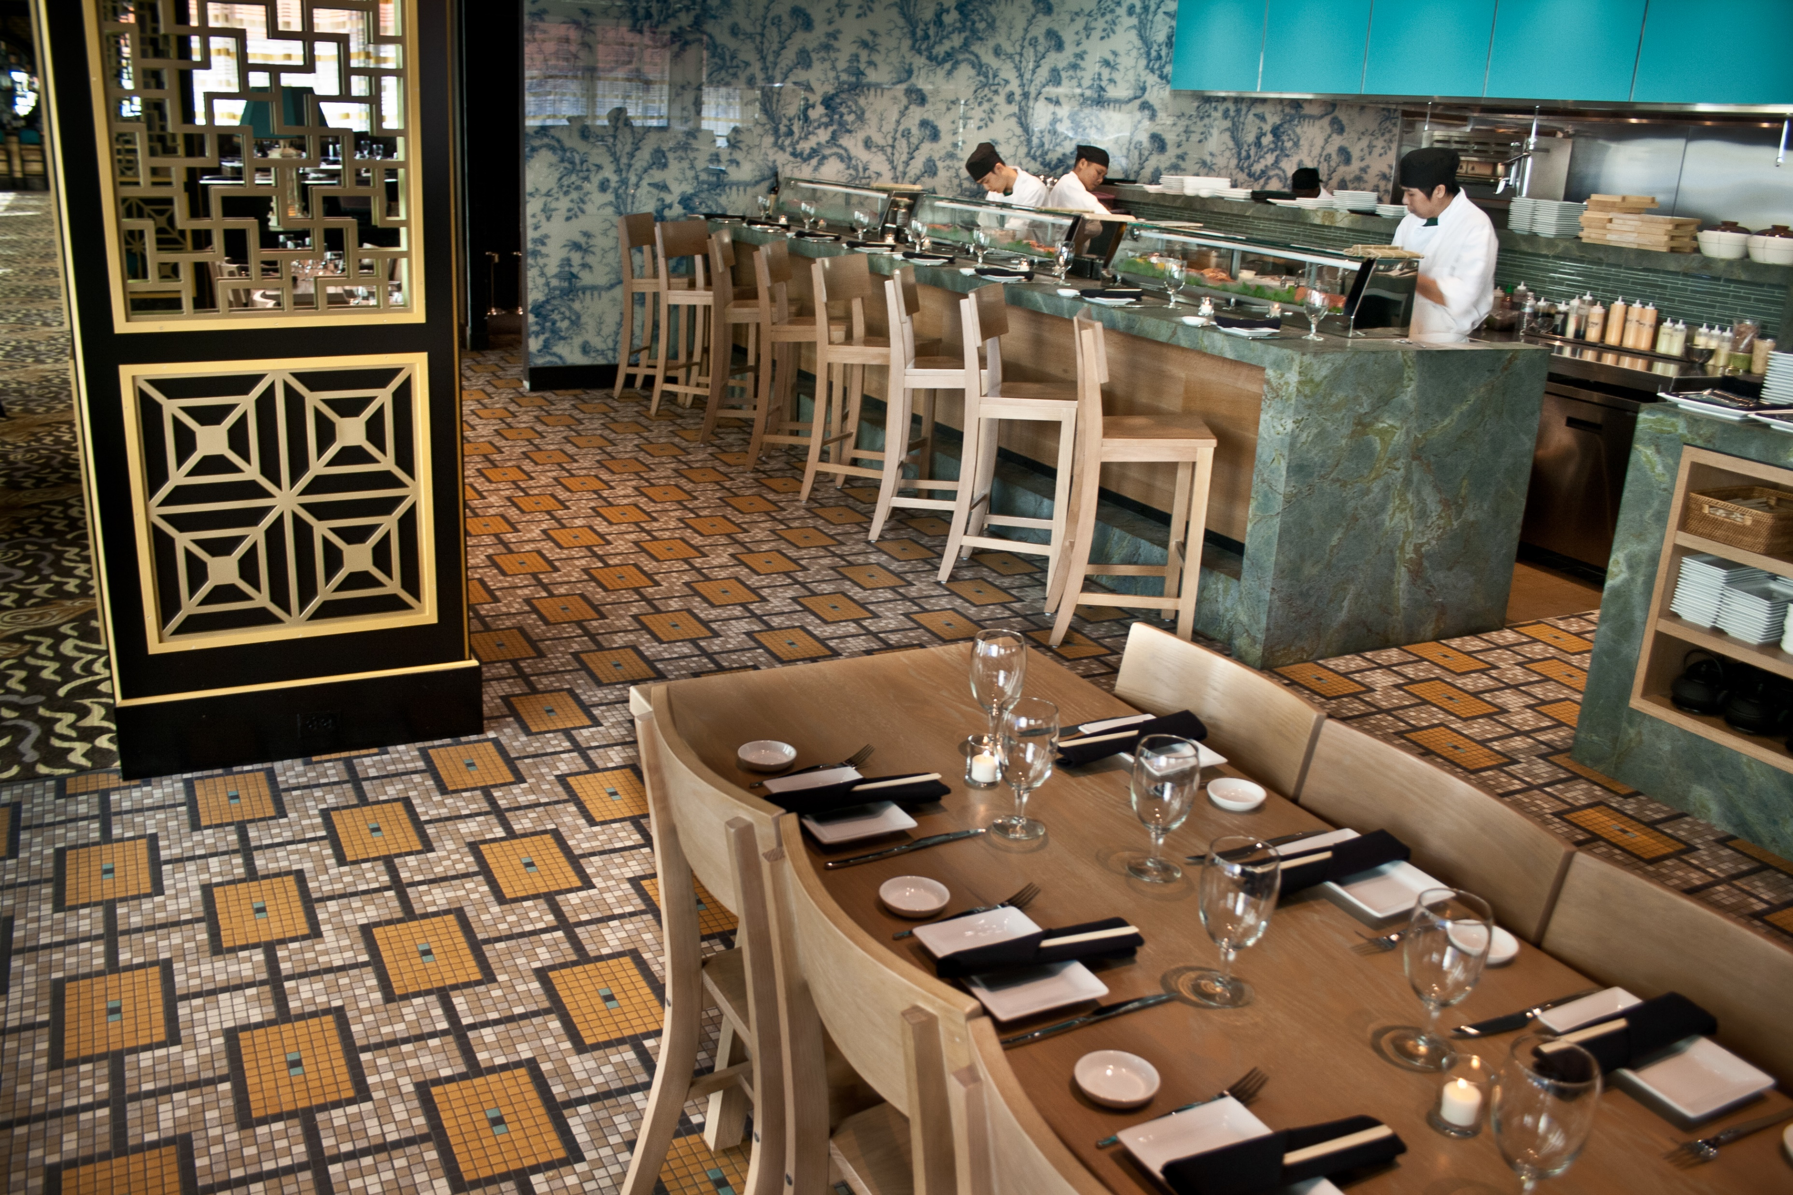
Modern mosaics can be found everywhere and are used to decorate: *buildings *subways *floors *ceilings *walls *benches *tables *sidewalks *restrooms *restaurants *parks *churches *public buildings *homes

Slide 17
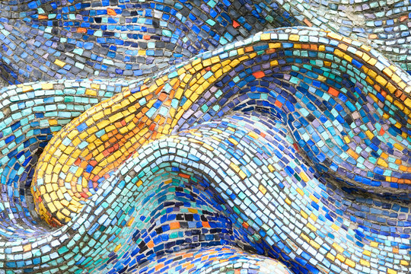
Mosaics allow individual expression to add unique and artistic touches in making personal choices to express one’s unique and innate creativity.
They can be very complex, with many colors and shapes creating intricate patterns and pictures, or very simple in design.

Slide 18
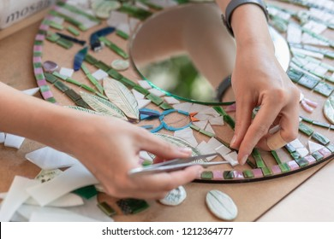
Mosaic-making requires precision, skill, spatial awareness, hand-eye coordination and fine motor skills.

Slide 19
Creating mosaics allows us to add unique and artistic touches to spaces that are beautiful as well as functional.
They enhance the spaces in which we live.

