Slide 1
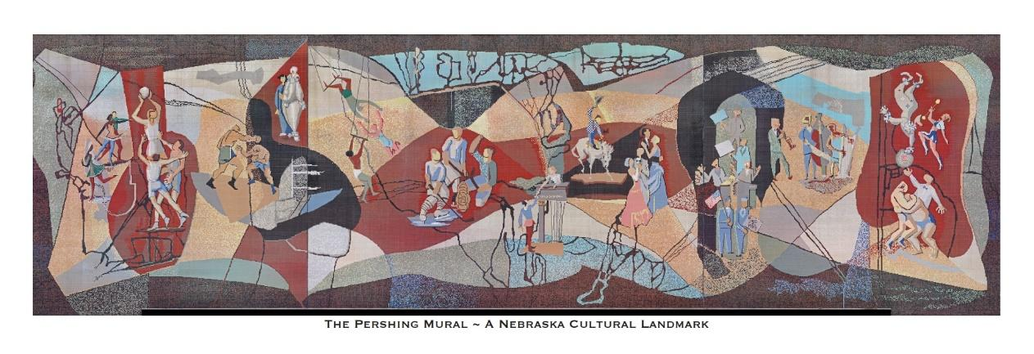
Quick Facts About the
Pershing Mural

Slide 2
The idea of constructing the Pershing Auditorium was first put forth in the late 1930’s, but it took nearly two more decades for it to be finally approved, funded and built.

Slide 3
It was named for the highly-decorated and famous military leader, General John Pershing, who once lived in Lincoln and taught at the University of Nebraska from 1890-1895.

Slide 4
Completed in 1957, the 50,000-square-foot building with seating for 4,526 invited all to attend concerts, sporting events, conventions, performances, meetings, competitions and celebrations.

Slide 5
The Pershing Auditorium would become Lincoln’s main venue to host a variety of events for citizens from across the State.

Slide 6
A mural, designed by artists Leonard Thiessen and Bill Hammon, was commissioned, created, and installed on the west side of the Pershing Auditorium in 1957.

Slide 7
It was a montage-type of work depicting the many activities that would be seen in the building.

Slide 8
The Mural measured 140’ 8” wide and 38’ 3” high and was the largest mounted ceramic-tile mosaic in the Western Hemisphere at the time of its installation.

Slide 9
It was made up of more than 763,000, one-inch ceramic tile pieces in 40 different shades/colors.

Slide 10
The design was intricate and detailed and some of the tiles had two colors within a single one-inch tile.

Slide 11
The Mural would be seen by thousands of people entering through the Auditorium doors, strolling along Centennial Mall or visiting the State Capitol.

Slide 12
It remained mounted on the Auditorium for almost 70 years.

Slide 13
The Pershing Mural and Auditorium were located at 226 Centennial Mall, approximately 4 blocks from the Nebraska State Capitol Building in Lincoln.

Slide 14
The Nebraska State Capitol Building is where the Legislature (our elected officials) meets. Much debate takes place during legislative sessions.

Slide 15
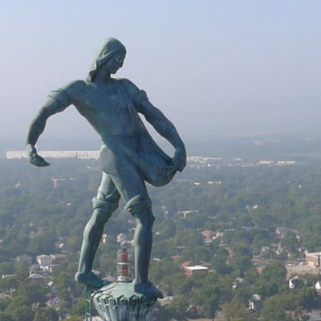
Atop the 400’ tower of the Capitol Building is a 12 ½’ pedestal upon which is located a 19 ½’ sculpture of a barefoot man in rolled up shirt sleeves and pant legs at work sowing his field.

Slide 16
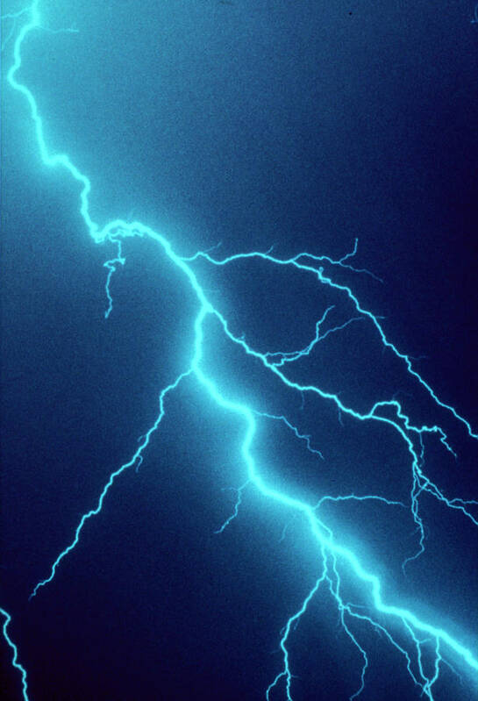
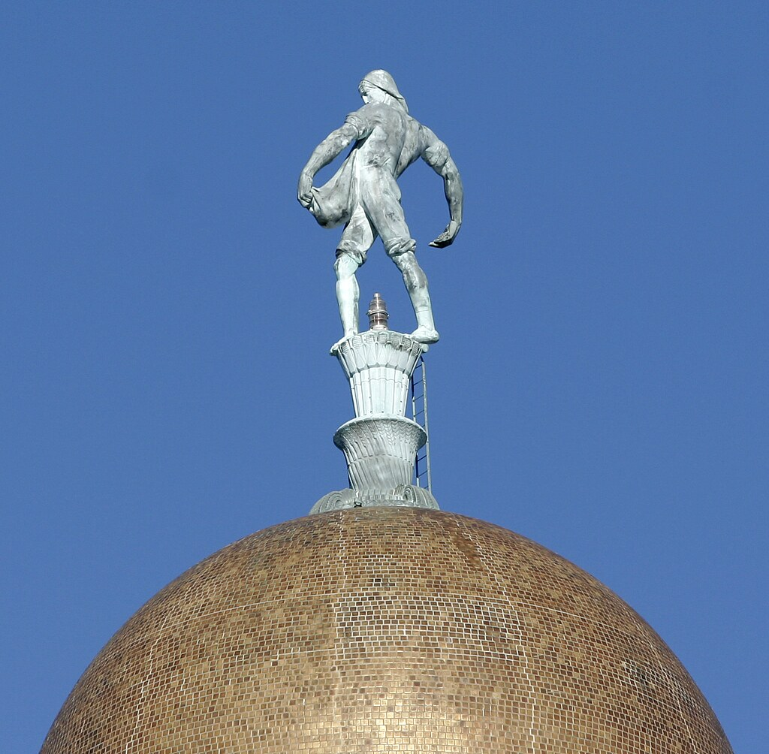
This sculpture is called “The Sower” and is not only a work of art but also a lightning rod.

Slide 17
The Pershing Auditorium was used for 57 years until it was permanently closed in 2014 and stood empty until 2023.

Slide 18
After much debate, it was decided that the Auditorium would be demolished.

Slide 19
Many decision makers were against saving the iconic Mural and thought it should also be demolished,

Slide 20
but a group of people who recognized the importance of the Mural raised the funds to save it.

Slide 21
The mural was carefully dismantled, labeled, and saved just days before the auditorium was scheduled to be leveled.

Slide 22
After its removal, the Mural was placed in storage where each tile was cleaned and laid in a numbered grid for later reassembly.

Slide 23
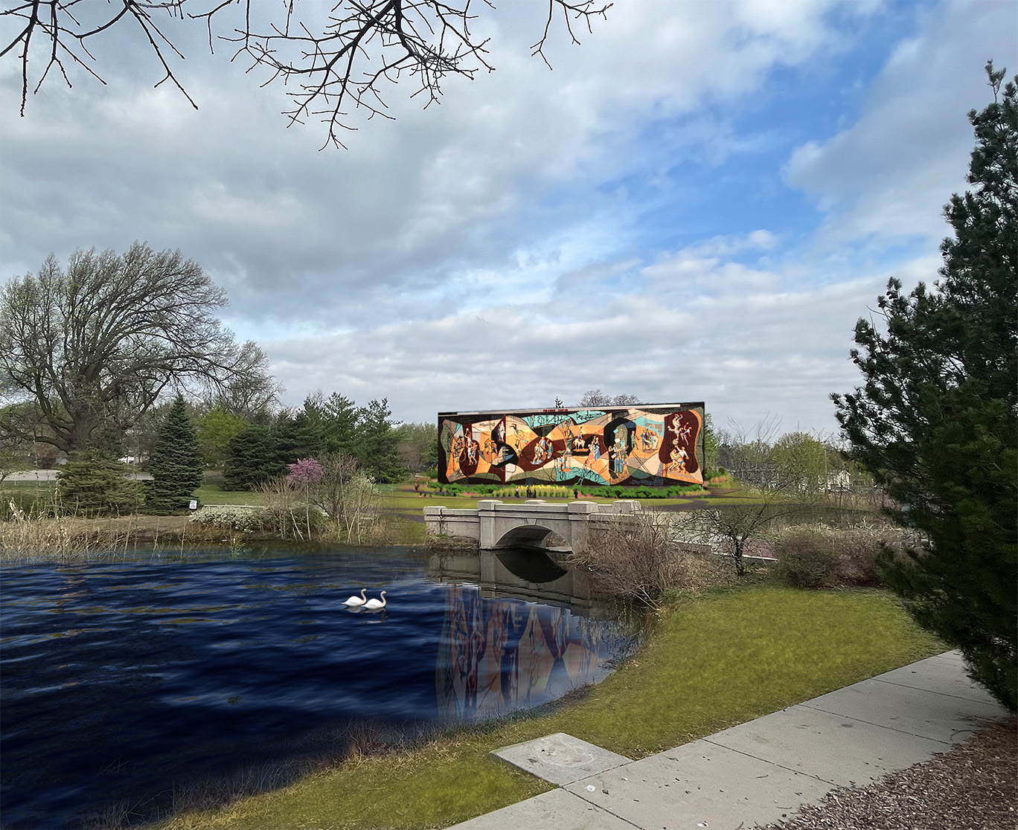
Because it was saved by historians and art lovers in 2023, the Mural found a new home at Wyuka Park.

Slide 24
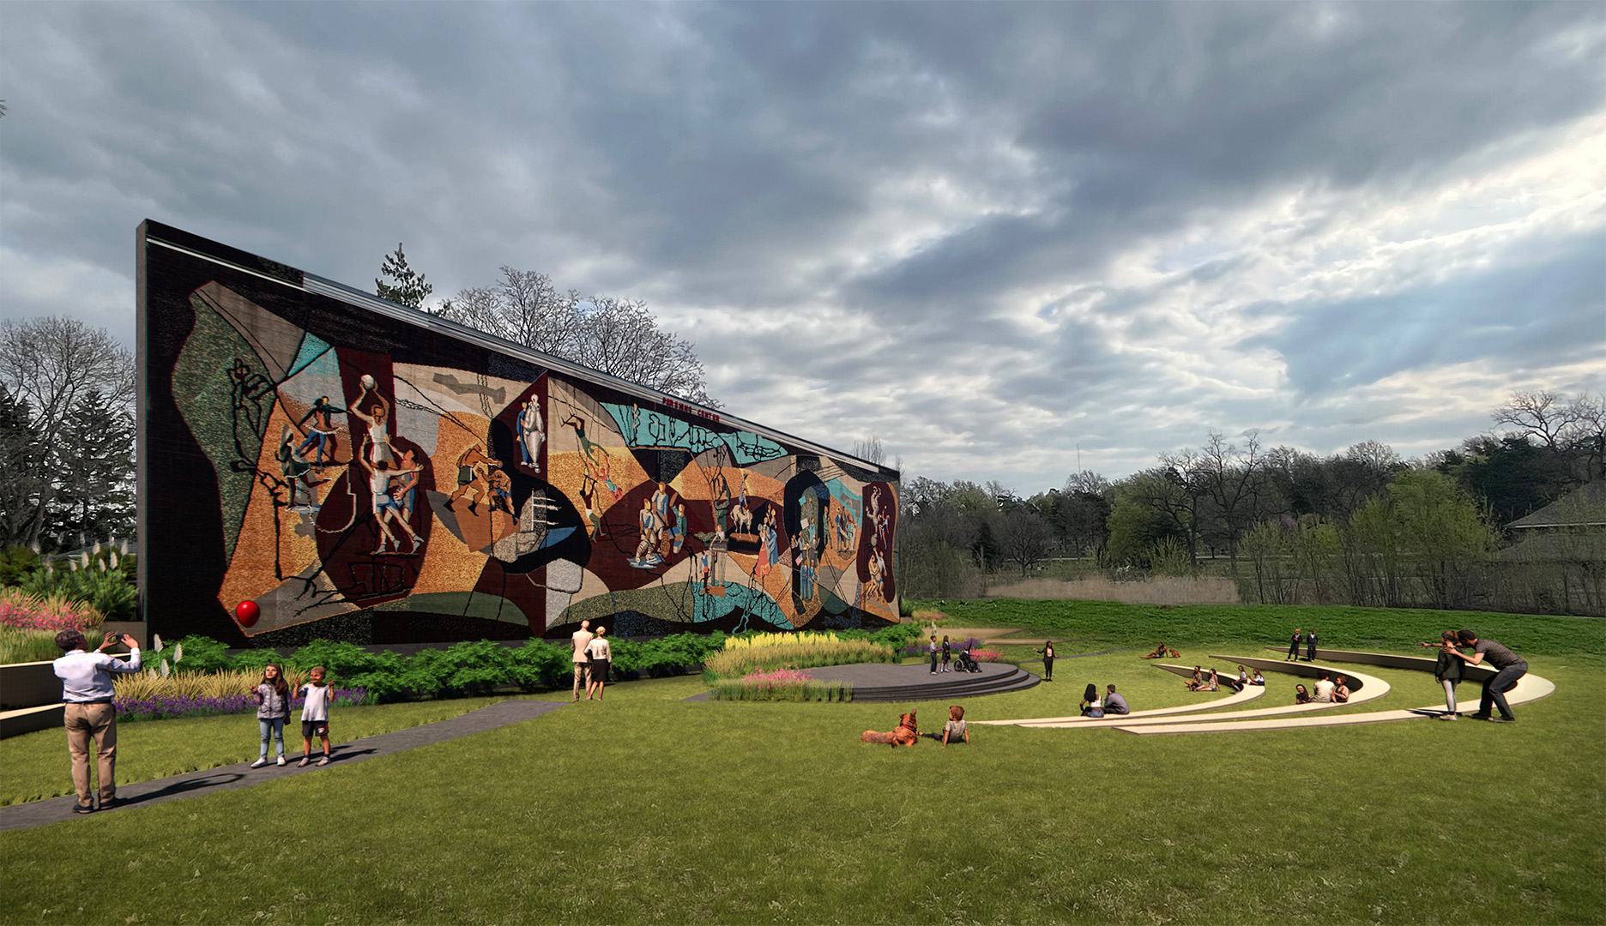
Once reinstalled, the Mural has become a place for gatherings and enjoyment for generations to come.

