Slide 1
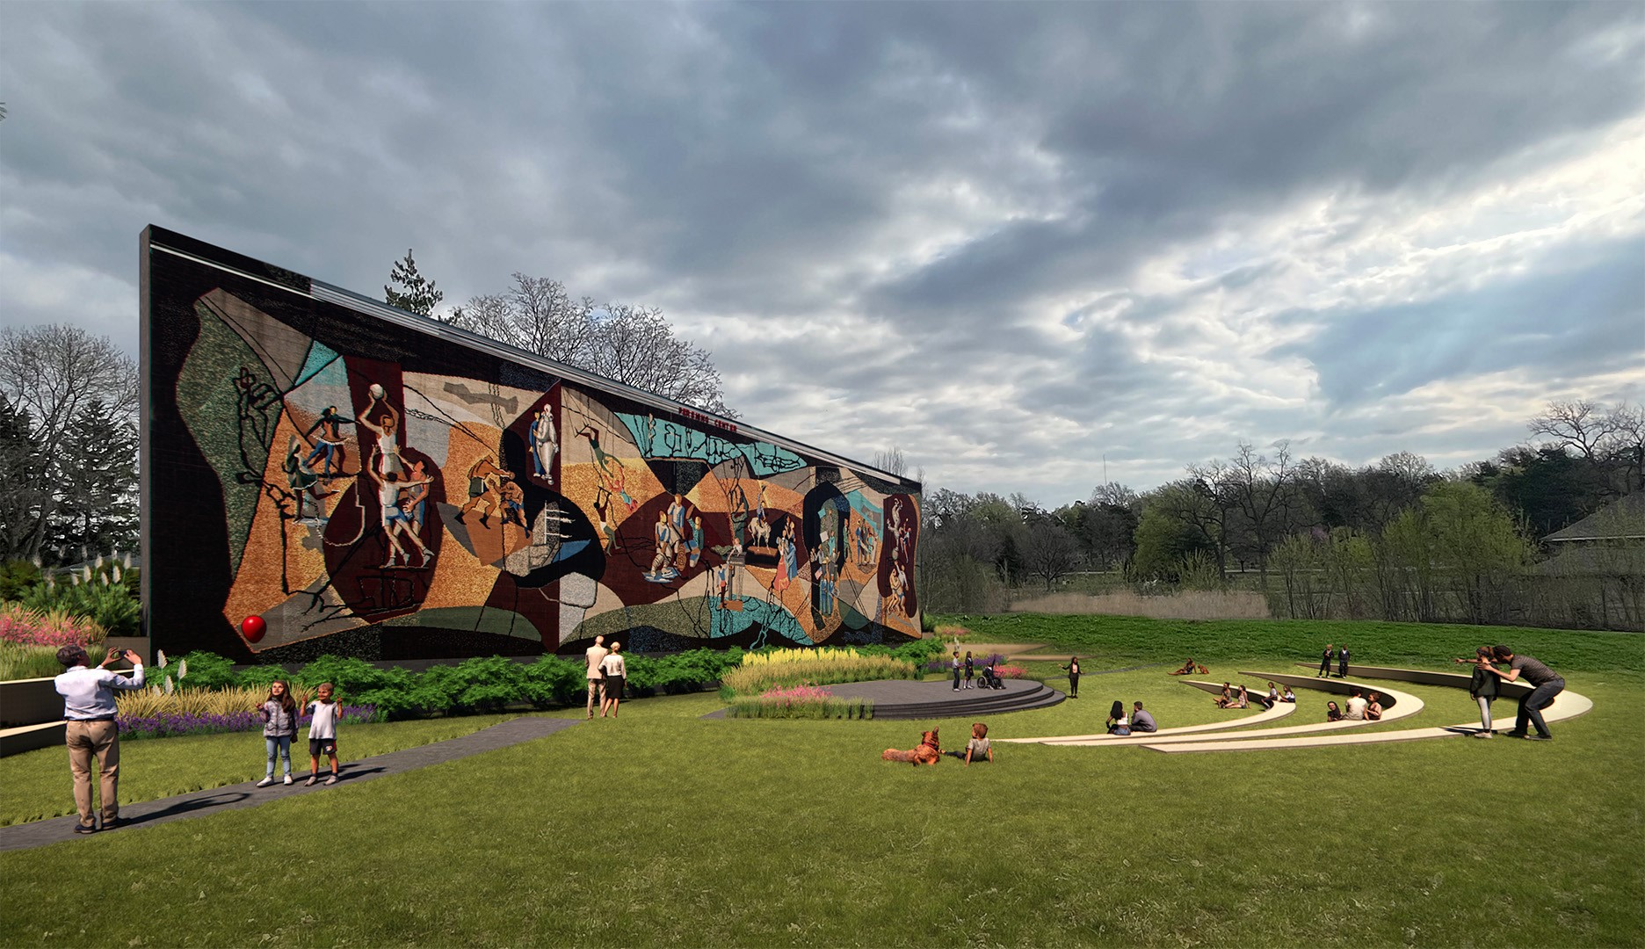
The Pershing Mural
An Experience for All Nebraskans

Slide 2
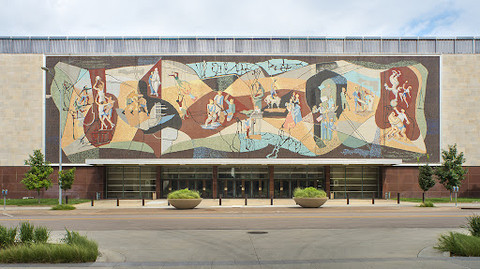
At the time of its dedication in 1957, the Pershing Mural on the west façade of the Pershing Auditorium was the largest ceramic mosaic of its kind in the Western Hemisphere.

Slide 3
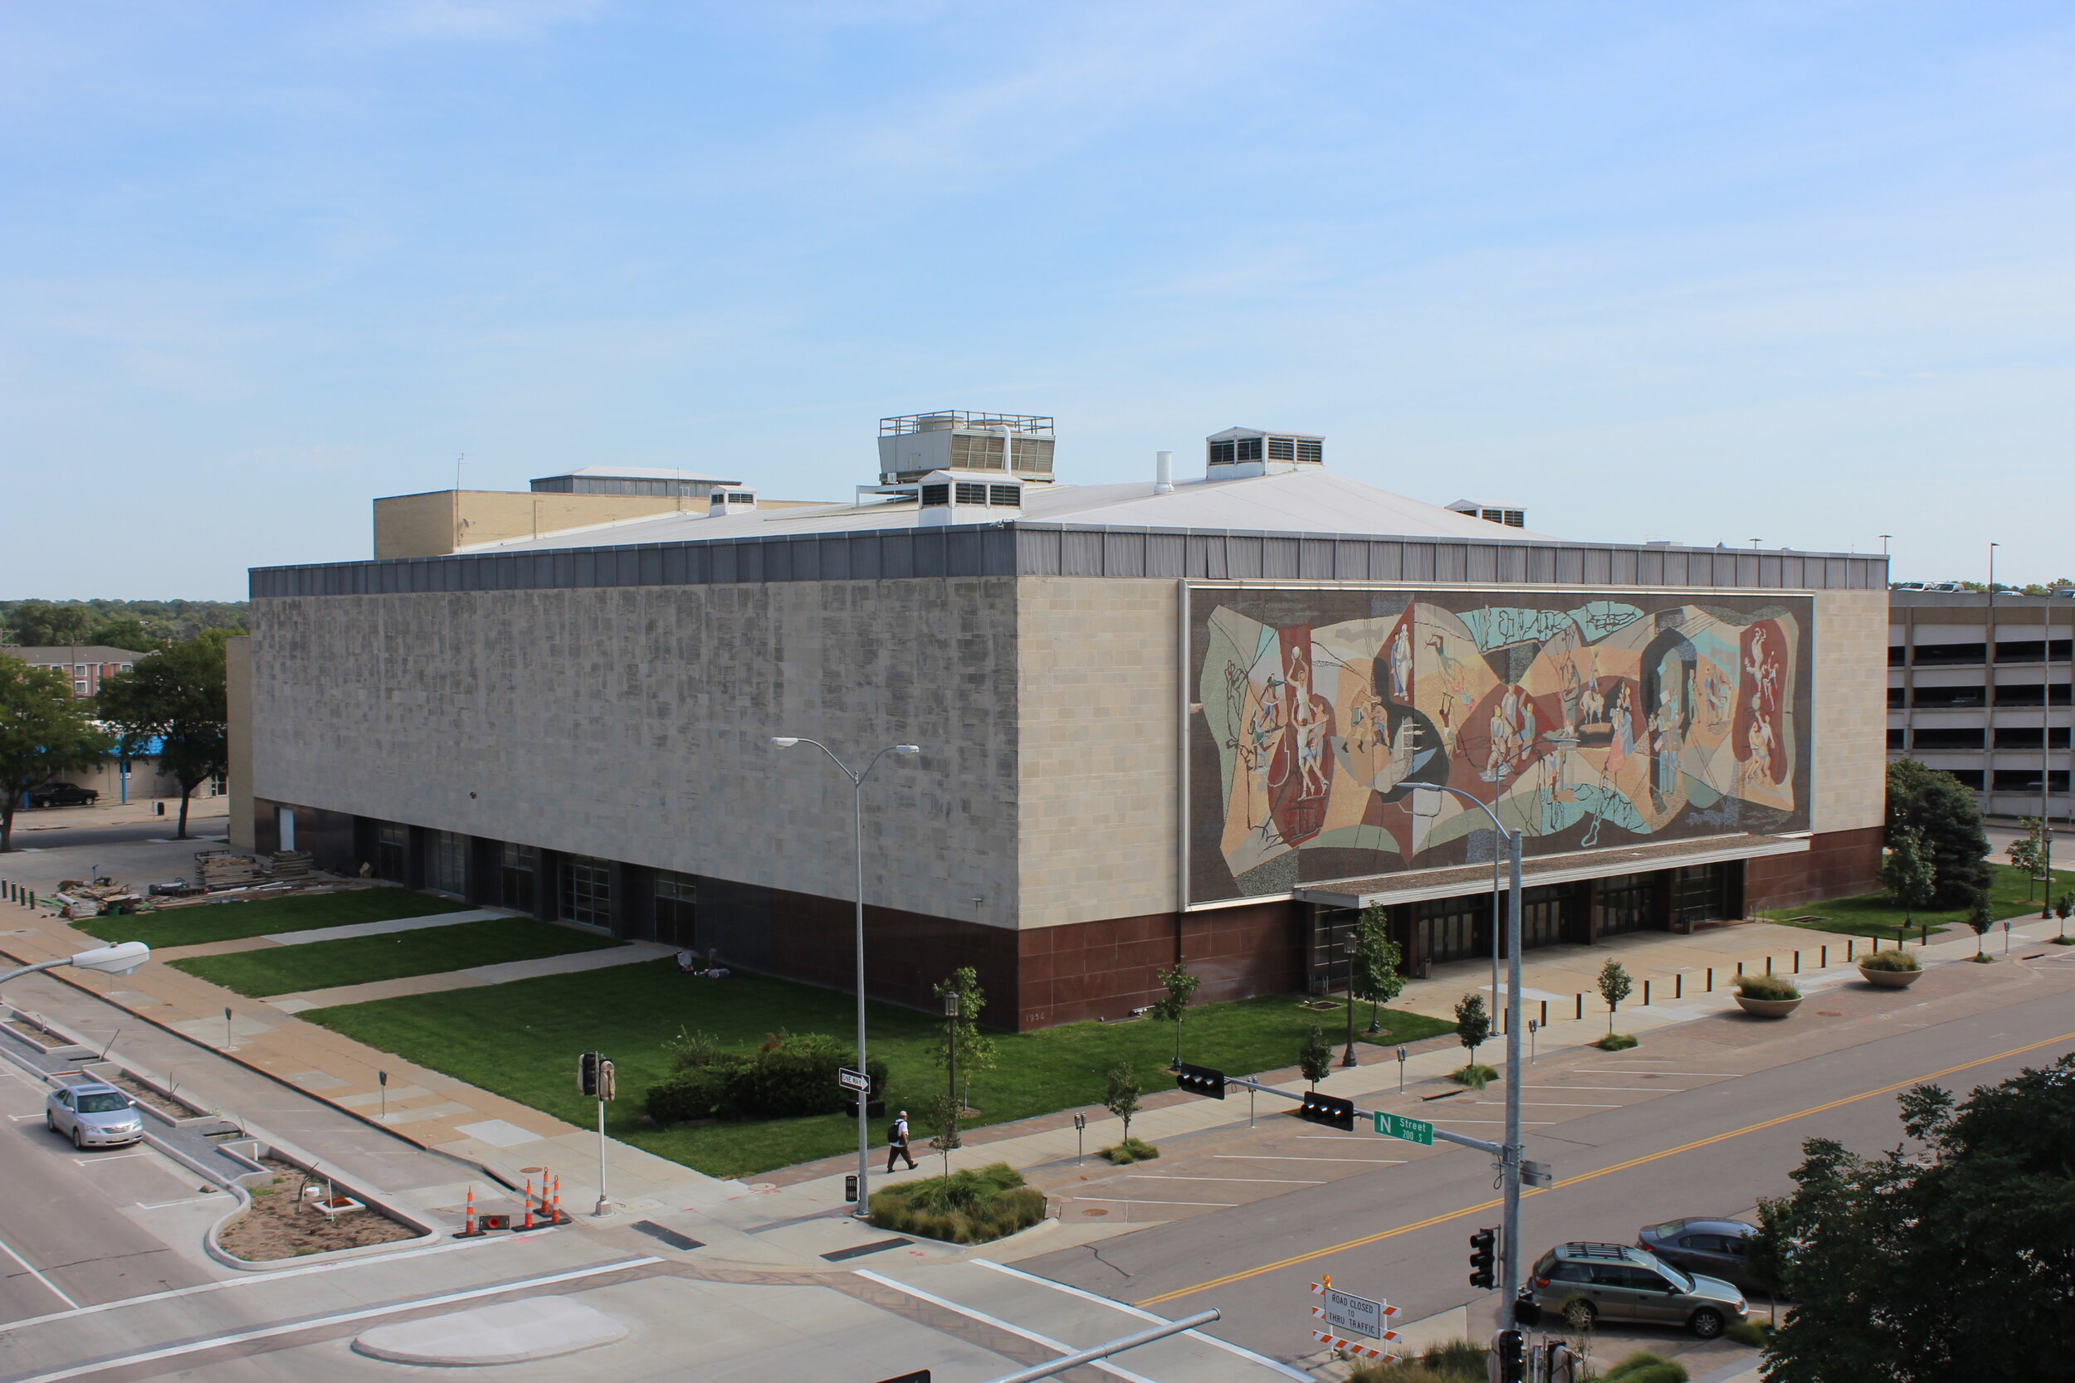
Created using more than 763,000 one-inch ceramic
tiles, the Mural came to life using 38 figures to depict the
many activities its artists imagined would take place within the auditorium.

Slide 4
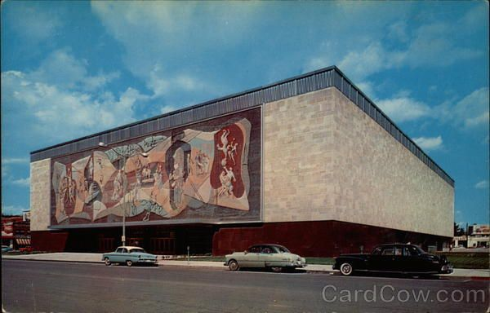
High atop its lofty perch, the massive, towering mosaic had a bird’s-eye view of the Nebraska State Capitol and Centennial Mall for more than 65 years.

Slide 5
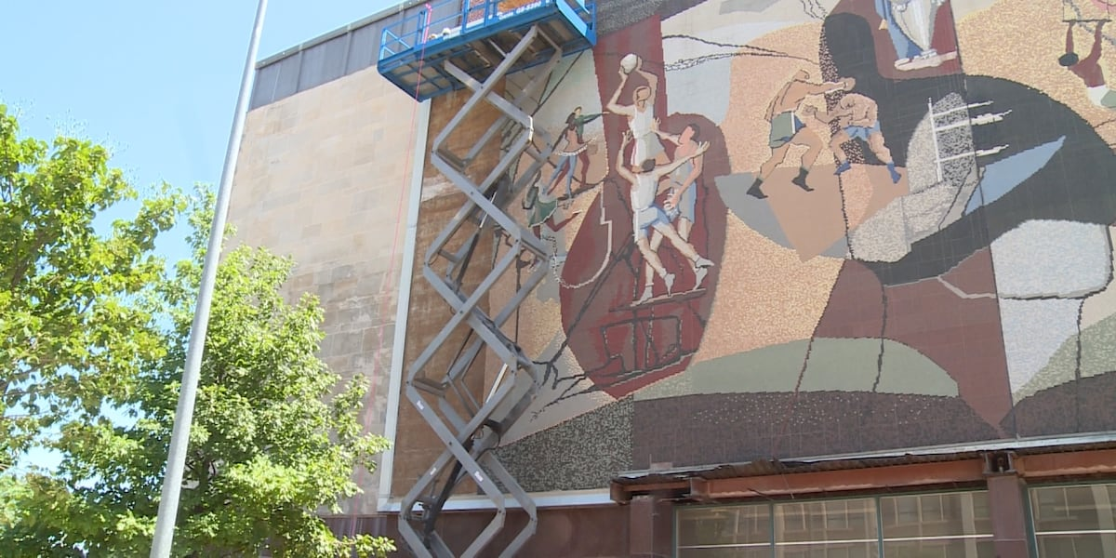
In 2021, when the now-vacant auditorium
was slated for demolition, a grassroots effort was launched to save the iconic and historic artwork.

Slide 6
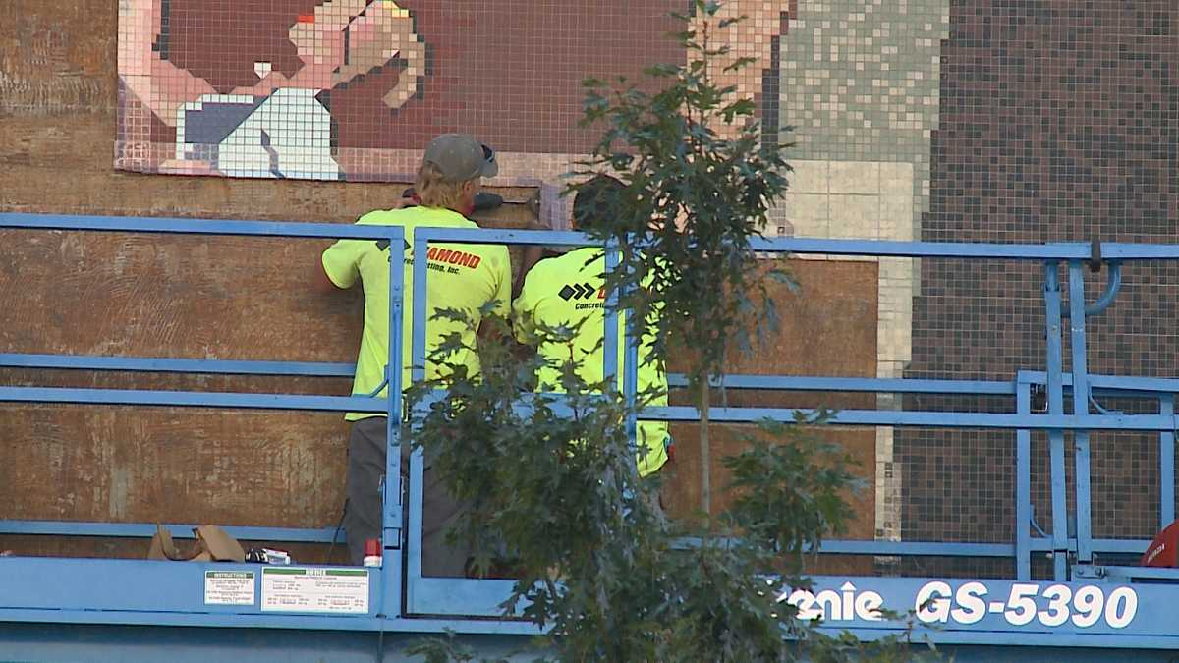
With necessary funds quickly raised, the Mural was saved and each section of tiles was painstakingly and carefully numbered and removed. Work was completed just two weeks prior to the Auditorium’s scheduled demolition.

Slide 7
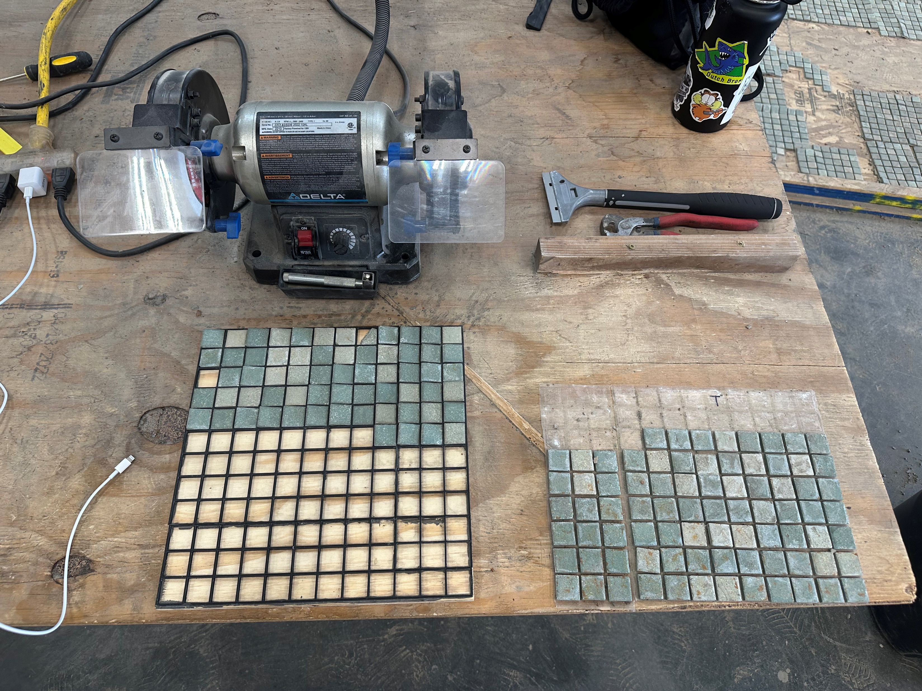
Following their removal, the plan was for each of those tile sections to be cleaned and remapped in preparation for their eventual reinstallation at their new home within Historic Wyuka Park.

Slide 8
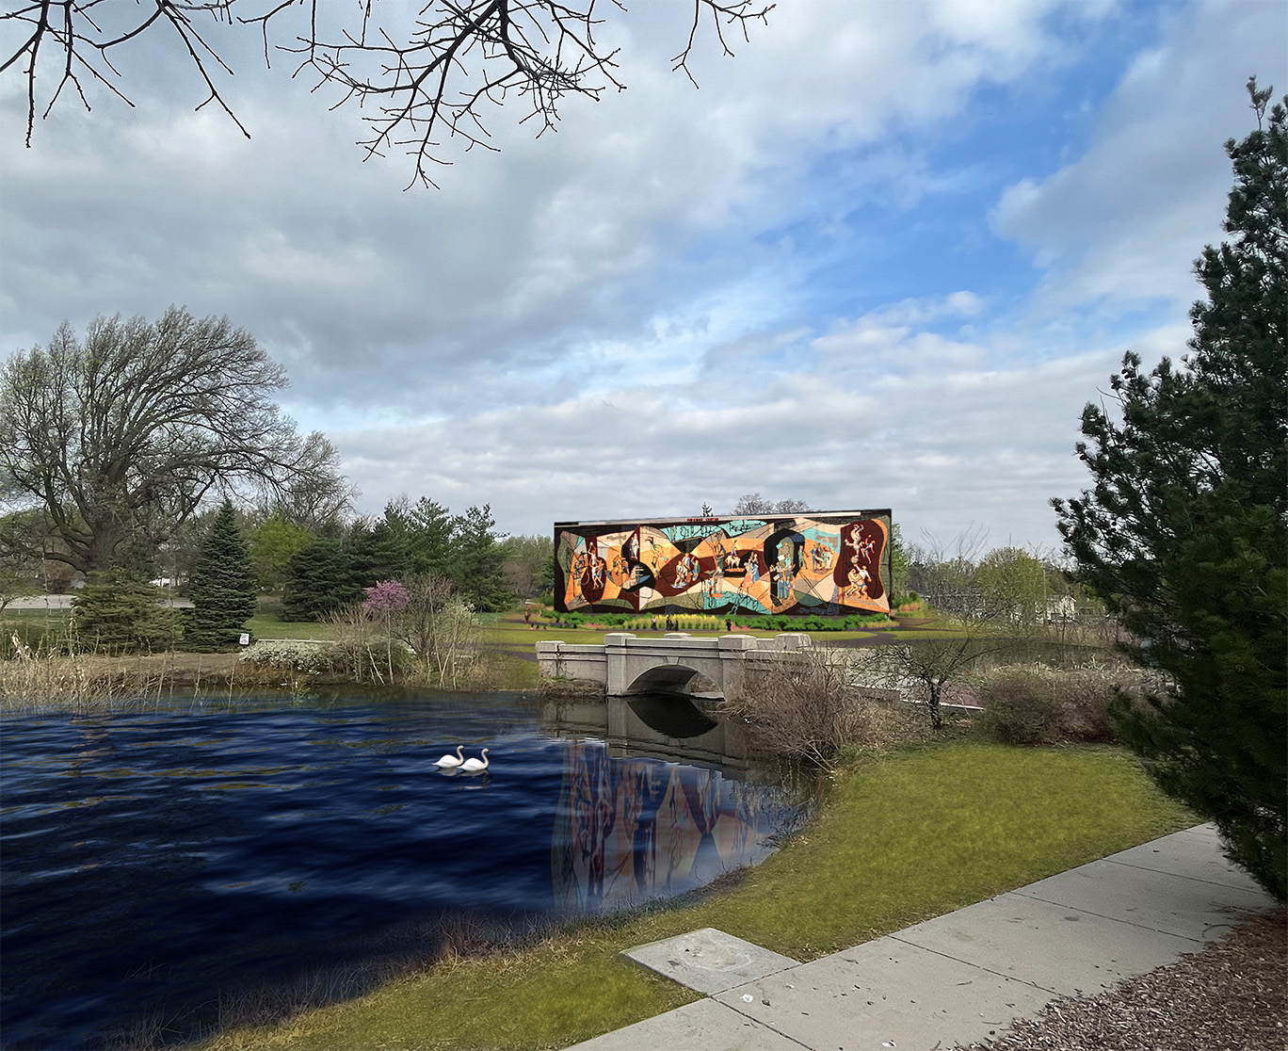
The 110-ton, five-story
installation will make it
one of the largest
free-standing, ceramic
mosaics in the world…
…affording those who visit a chance to finally get “up close and personal” to experience this massive, historic art.

Slide 9
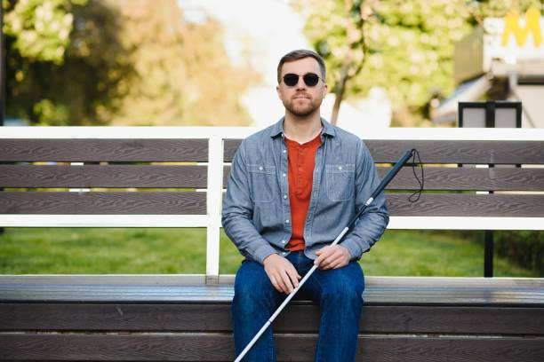
However, some wishing to personally experience the mural may need to use other avenues for exploration.

Slide 10
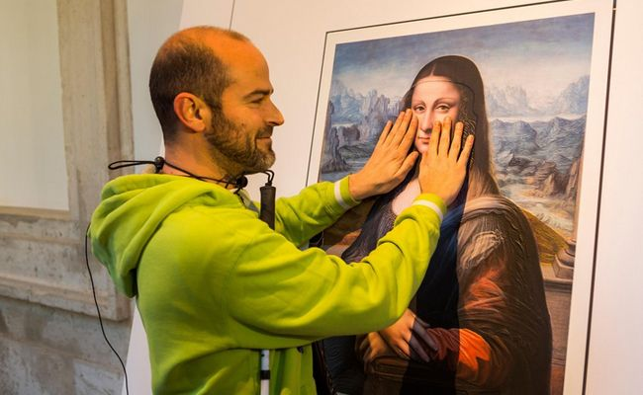
Because…..
“Not every mind or body will experience art the same way.
But every mind and body is entitled to the experience.” – National Endowment for the Arts

Slide 11
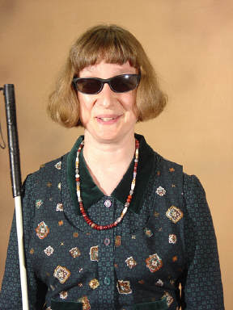
Enter Barbara Loos, blind since birth, who is the past President
of the National Federation of the Blind of Nebraska:
“I have both heard of and appreciated descriptions of various aspects
of the Pershing Mural. While those can spark interest in learning more,
they only flow one way—from the outside in.”

Slide 12
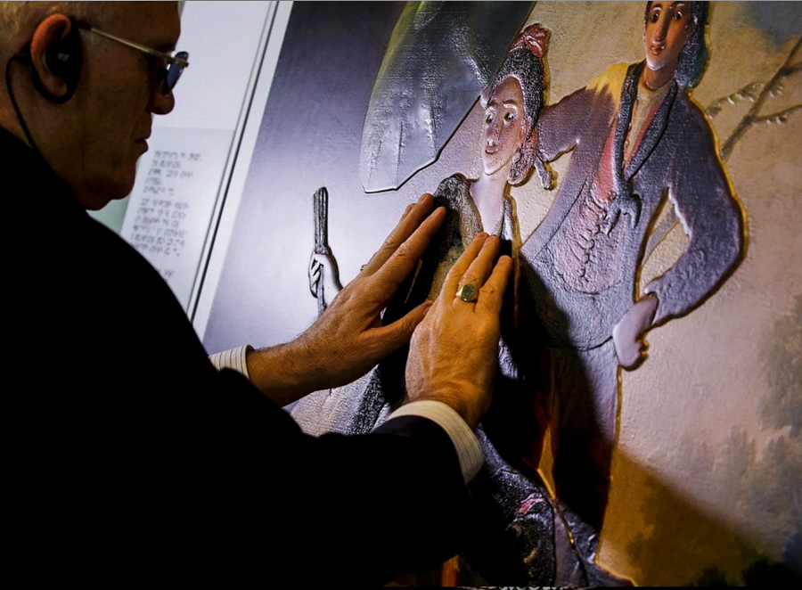
The Pershing Mural Preservation Committee heard her challenge and began to explore ways to make the Mural accessible to individuals like Barbara who view and experience the world through their fingers.
Barbara explained, “Experiencing the Mural in
3-D form would allow me to interact with it. My perspective
can then include what it evokes from within—something visual art
can’t convey.”

Slide 13
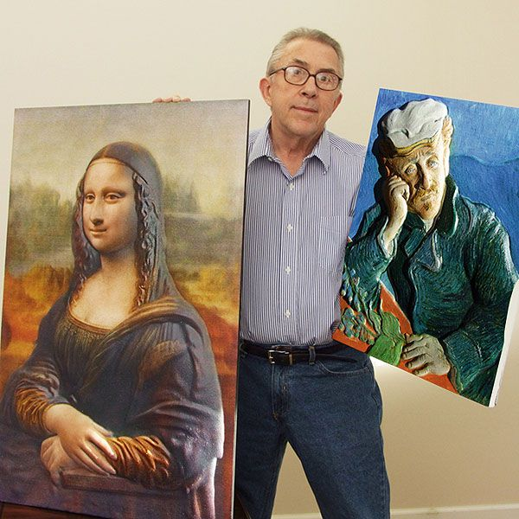
The search began and the Committee found
John Olson.
A former photographer for LIFE magazine, Olson (Chatham, NY) co-founded a company called 3DPhotoWorks that developed and patented their own printing process for works of art.

Slide 14
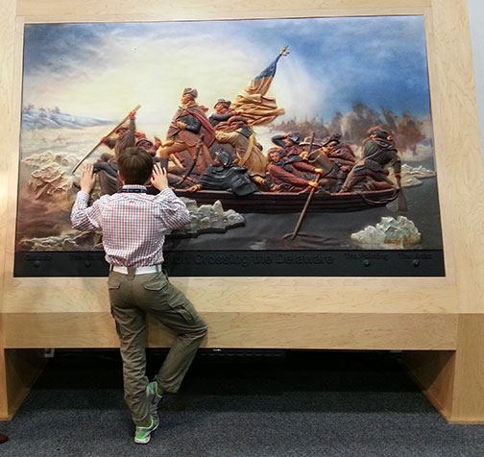
Olson shares, “With 285 million blind people
worldwide, we’re going to change the way they ‘see’ art and photography.”

Slide 15
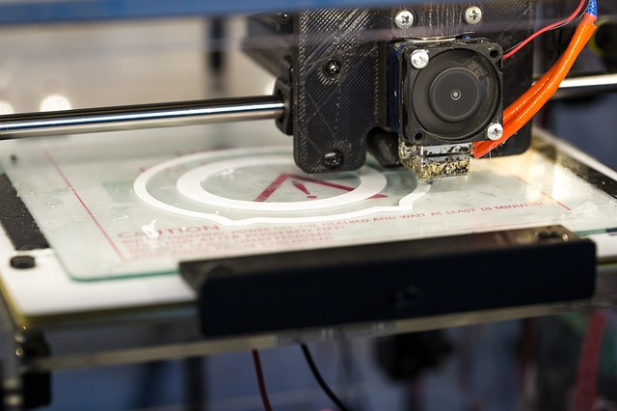
Olson explains: “It’s a three-step process in which we take a conventional, two-dimensional image and convert it to 3-D data.”
“Once that data has been converted, we send
it to a machine that sculpts the data out of a
block of substrate. It gives that image length,
width, depth and texture.”

Slide 16
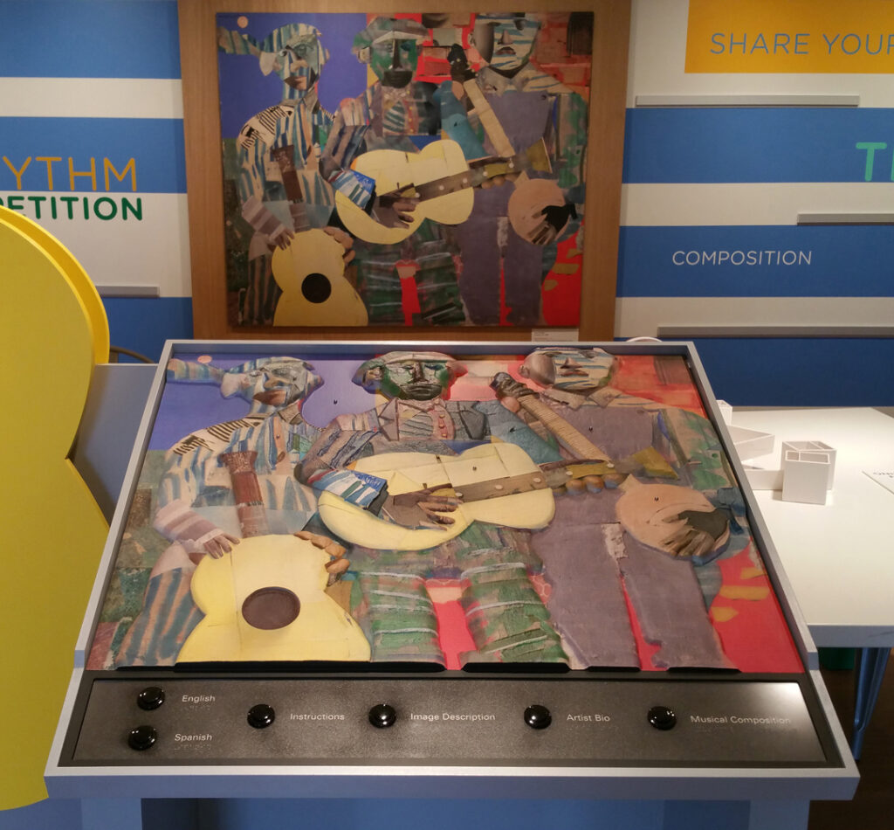
“And once that’s been sculpted, it goes through a printing process where we lay the image back down on top of the relief in perfect registration.”
“So what you end up with is a three-dimensional print that has length, width, depth and texture.”

Slide 17
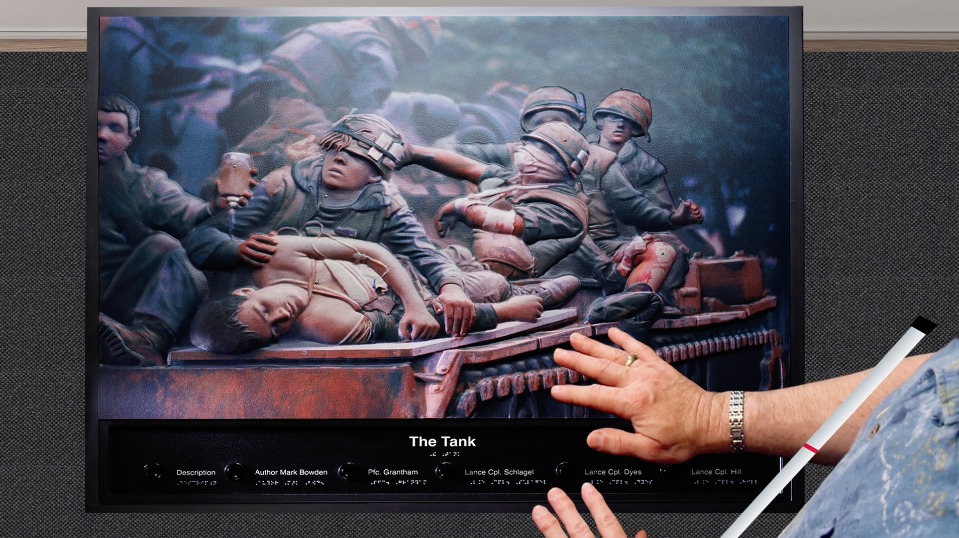
When headsets are made available, narrative will help the visitor experience the exhibit using multiple senses.

Slide 18
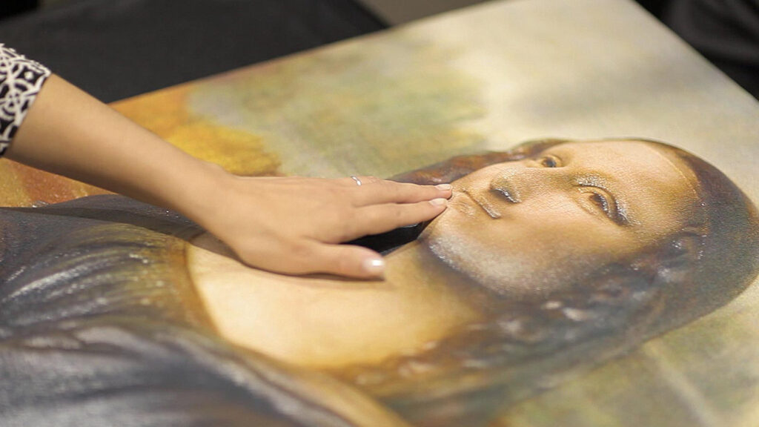
Olson shares that his 3-D images can be found throughout four countries (U.S., Canada, Norway, and Belgium) in permanent and traveling exhibits…..

Slide 19


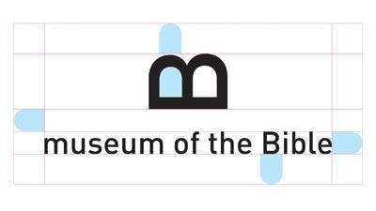

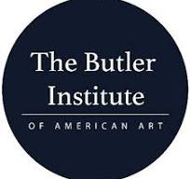

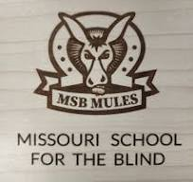

…..and in places like
Houston Museum of Natural Science (Houston, TX)
Sacramento History Museum (Sacramento, CA)
Museum of the Bible (Washington, DC)
Lowell Observatory (Flagstaff, AZ)
Laura Ingalls Wilder Historic Home and Museum (Mansfield, MO)
Butler Institute of American Art (Youngstown, OH)
National Museum of Wildlife Art (Jackson, WY)
Missouri School for the Blind (St. Louis, MO)

Slide 20
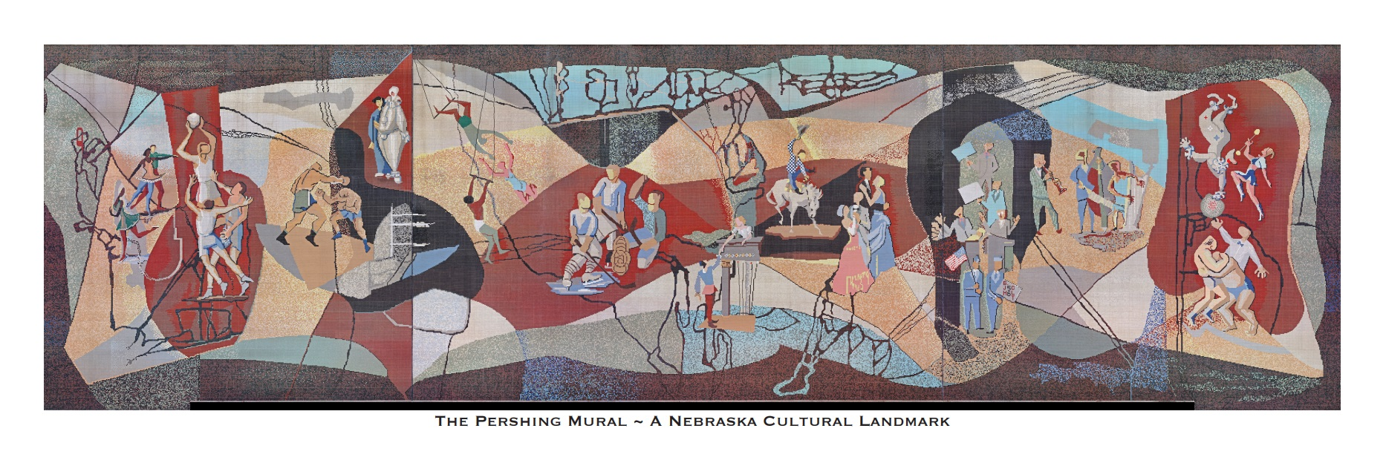
After several months of discussion, correspondence and an in-person meeting, Olson was able to conceptualize how a 3-D model of the Pershing Mural could become a reality and make it possible for Barbara Loos and the more than 35,000 other Nebraskans who are blind or have low vision to experience the Mural in this unique way.

Slide 21
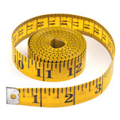

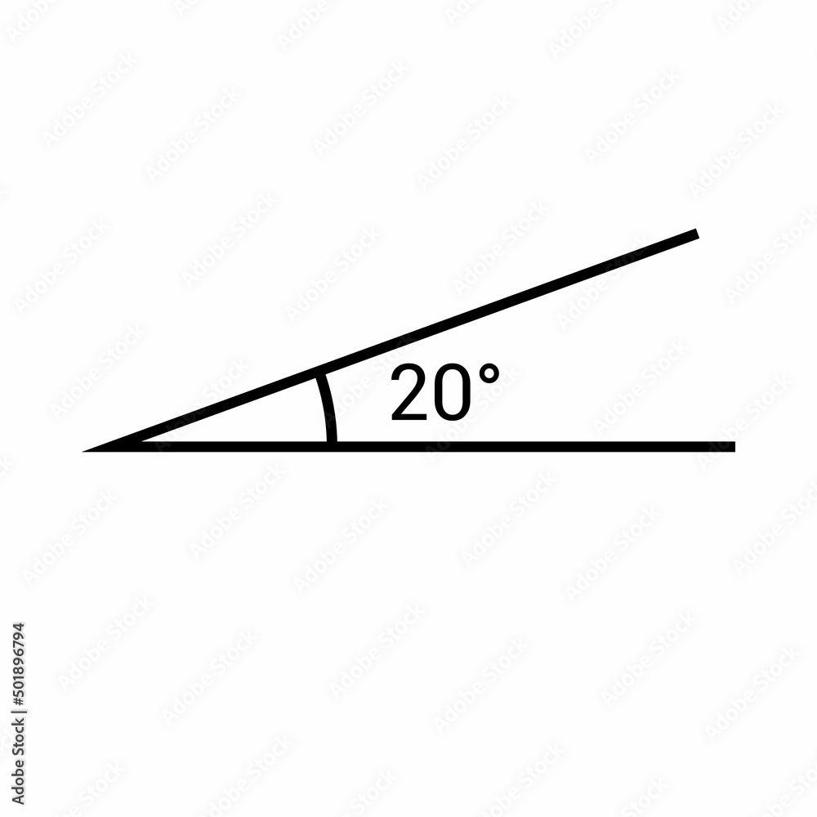

The Model will measure 120” x 36”.
It will weigh approximately 150 pounds.
Because of the Pershing Mural’s substantial size, the 3-D Model will have a slight, 20-degree upward angle, making it easily accessible to visitors of different ages and heights.
By using headsets, the Model will offer bilingual (English/Spanish) auditory prompts built into the control panel.
When visitors touch the proximity sensors that are embedded throughout the Model, the auditory component will explain/describe the approximately 14 different activities that are included within the Mural’s composition.

Slide 22
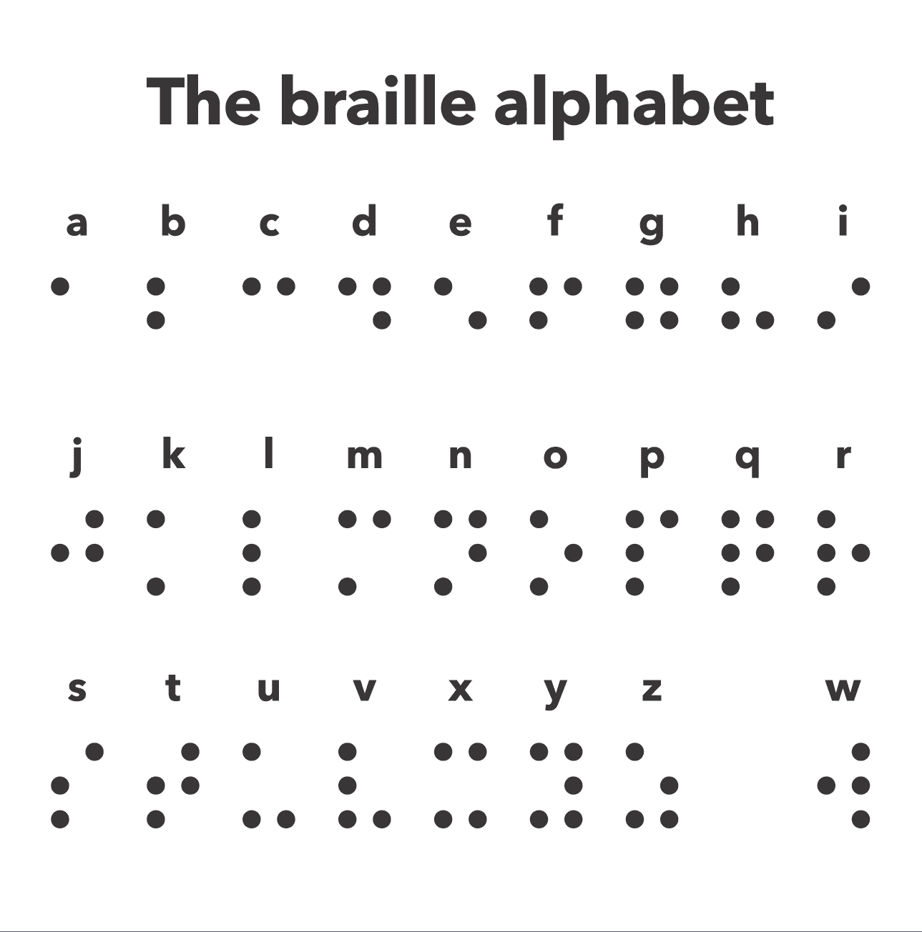
DIVERSITY AND INCLUSION:
The Model will incorporate braille and bilingual (English/Spanish) audio elements.
It will also reach more members of our community, including bilingual and blind and low-vision individuals.

Slide 23
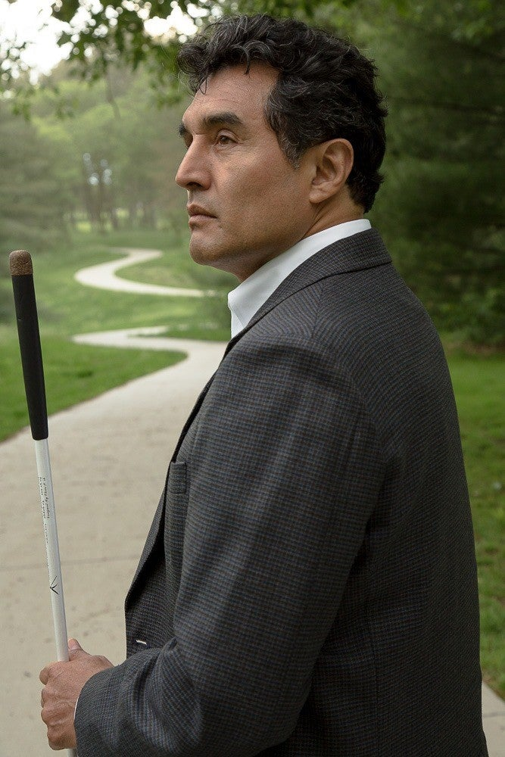
“If art and history are important for all Nebraskans, we shall include blind/visually impaired individuals, too. There is no excuse now, there is technology and the collective knowledge of blind people to make it accessible. For all these years, blind people didn’t have a chance to enjoy art and participate fully in the community. Knowing that this mural will be accessible, is exciting!”
Carlos R. Serván, MPA-JD
Executive Director
Nebraska Commission for the Blind and Visually Impaired

Slide 24
“If a picture’s worth a thousand words, a model is worth a million.”
And ALL are included!!

