Slide 1
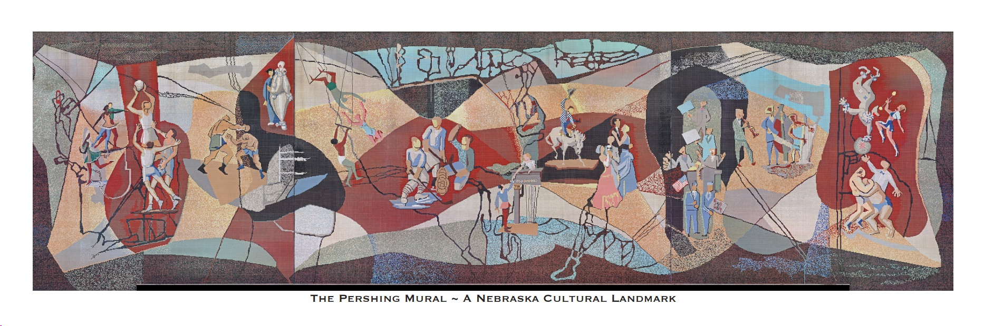
Mysteries of the Mural

Slide 2


Everyone likes a mystery!
The Pershing Mural has a lot of mysteries to solve….just look closely.

Slide 3
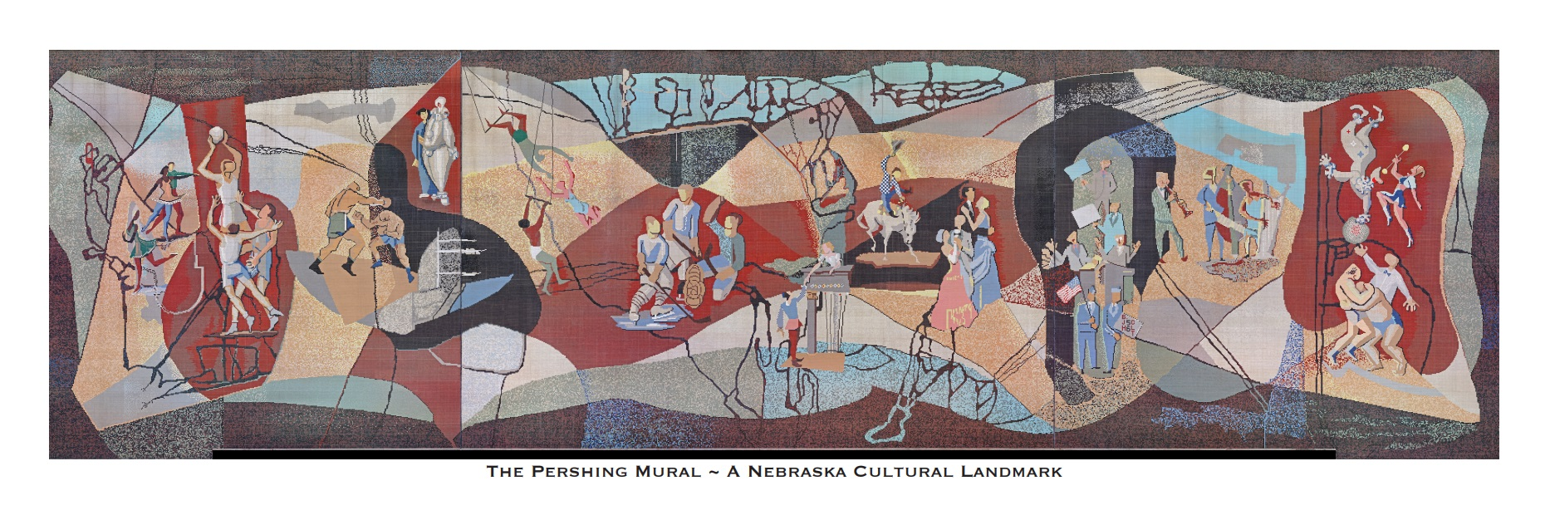
Let’s see what we find!
Artists Charles Leonard Thiessen and Bill J. Hammon were commissioned in 1955 to design the Pershing Mural.

Slide 4
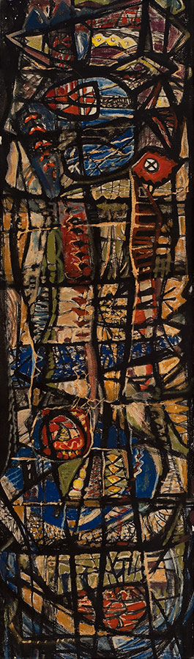
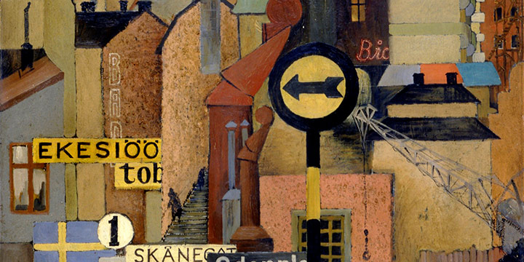
Both were distinguished Nebraska artists and accomplished muralists….
Leonard Thiessen
Stockholm Synthesis
oil on panel
1937
Bill J. Hammon, Growth, Aldamar, oil on canvas, n.d.

Slide 5
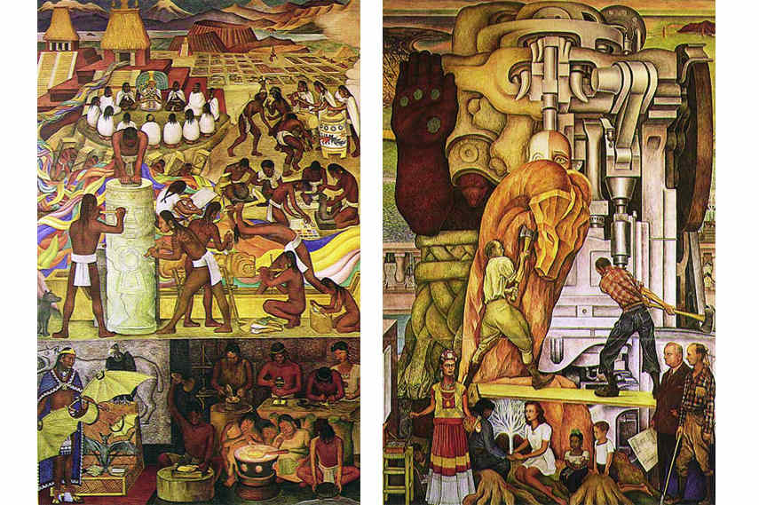
….drawing inspiration and influence from working with famous muralists such as Diego Rivera.
Pan American
Unity—the
Marriage of
North and South
By Diego Rivera

Slide 6
And while the design was left to Thiessen and Hammon, the subject matter of the commission was dictated by the Associate Auditorium Architects.
In their commission, the artists were directed that the Mural should be made of tile to withstand the elements.

Slide 7

Thiessen would share in later recollections that composing a mural at such a large scale that was to be seen from street level and creating harmony with its surroundings were the biggest challenges and points of focus.

Slide 8
Thiessen and Hammon seemed to have conceived of the Mural as an abstract with blocks or color first and then added in the figures to meet the subject requirements.

Slide 9

In the 1950’s the artists didn’t have computers and digital tools to help them with the scale of their design.
So they relied heavily on scaled models as part of the design process to help them visualize the Mural.

Slide 10
The architects commissioned the artists to illustrate the type of events that the new auditorium was to host.

Slide 11


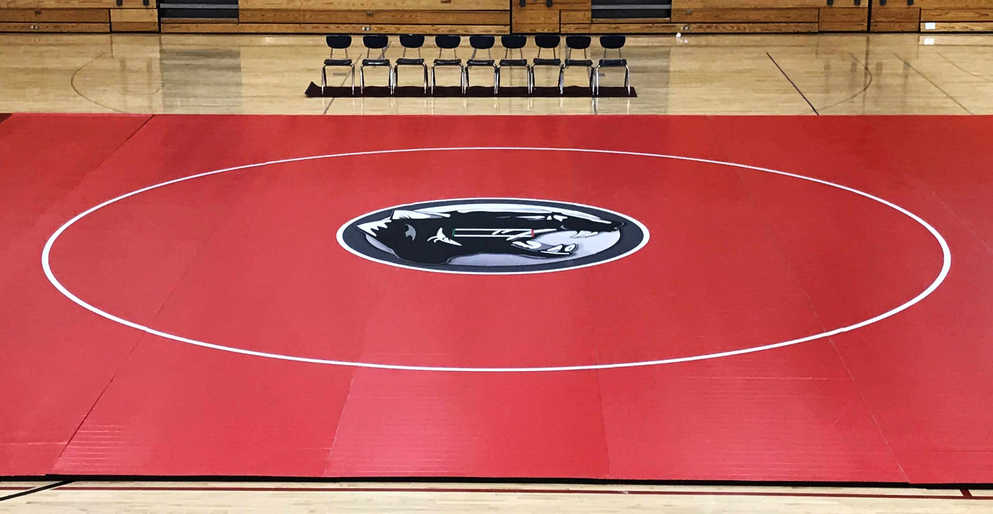

In choosing what to portray, there was certainly an emphasis on athletics and sports…..
Basketball
Wrestling
Hockey
Boxing

Slide 12
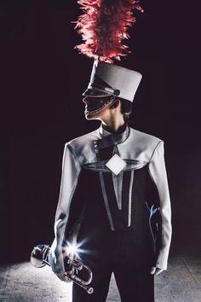
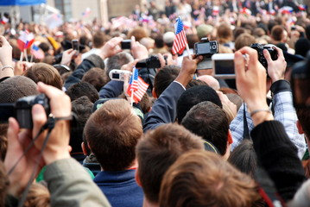

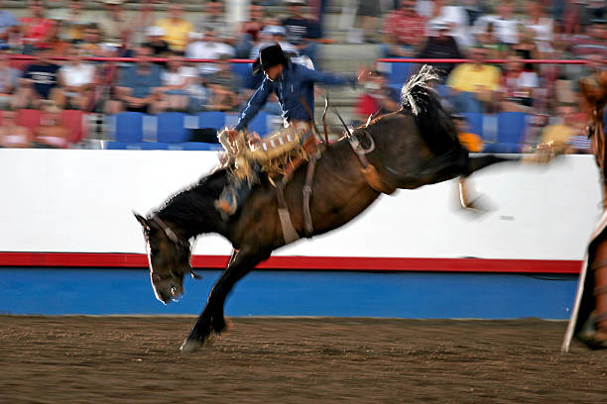

But the Mural needed to depict other events and activities as well.
Parades
The Circus
Rallies
Ice skating
Rodeos
Speakers

Slide 13
And Thiessen and Hammon didn’t forget to include cultural events!
Theater
Ballet
Music
Ballroom Dancing
Opera
Concerts
Their vision included it all through their emphasis on composition.

Slide 14
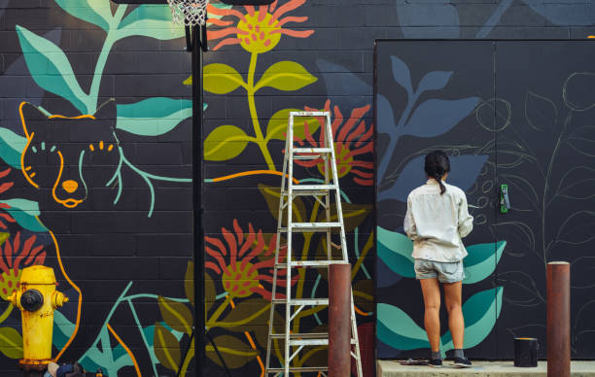
Thiessen and Hammon employed “artistic license” in their design.
ARTISTIC LICENSE - when an Artist interprets something in their own way without keeping in mind or being accountable for accuracy.
Artists may use ‘artistic license’ within a commissioned work to subtly add humor and/or symbolism into a work of art that may go unnoticed by the employer as a way to incorporate their own individuality/creativity.

Slide 15
For example, the artists’ initials are CLT and BJH. They completed their design in 1956.
See if you can discover any instances of artistic license.

Slide 16

Let’s see if we can find them in the Mural!

Slide 17
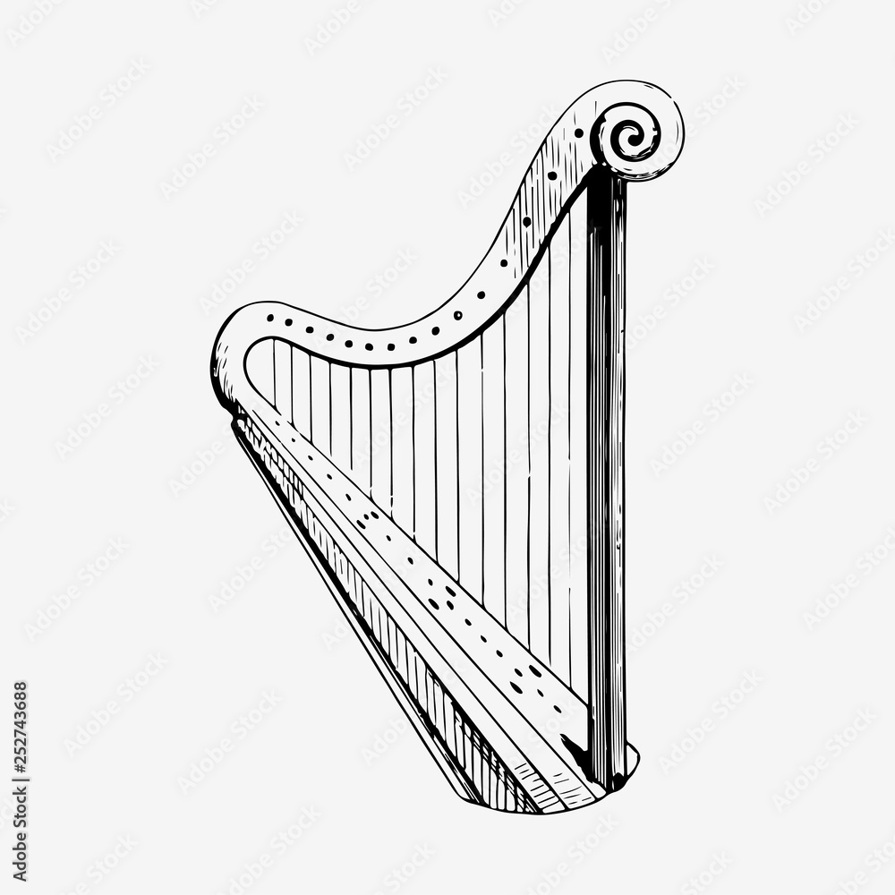
The Artists had a sense of humor.
They included a harp in a jazz combo???
What was that all about???

Slide 18
And did you catch the two guys having a heated debate….
They are two of only four figures in the Mural that have any facial features—the rest have blank faces.
And check out the hand movements of the guy on the left….he was REALLY excited!

Slide 19
You get two guesses as to who these figures are…and the first one doesn’t count!
O Romeo, Romeo, wherefore art thou, Romeo? Deny thy father and refuse they name, Or, if thou wilt not, be but sworn my love, and I’ll no longer be a Capulet.

Slide 20
This next one is a little tougher. Start with the figure on the left.
Is her blue garment a kimono (the traditional dress of Japan)?
Is she wearing getas (traditional Japanese footwear sort of like a flip flop?)
Does she have Asian features?

Slide 21

Are you familiar with an Italian composer named Giacomo Puccini?
If not, he wrote a number of operas including one called Madame Butterfly.
It’s a 20th Century love story about a Japanese girl and an American naval officer.

Slide 22
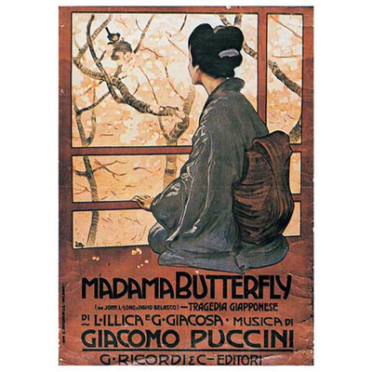
Do you suppose our mystery woman is Cio Cio San from Madame Butterfly?

Slide 23
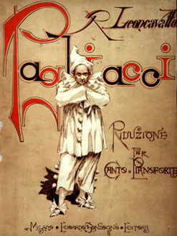

Now as to the figure on the right…..
Could this be Canio, the clown who is the lead character in Ruggero Leoncavallo's Italian opera, Pagliacci (The Clown) which premiered around 1890?

Slide 24
Next, are we looking at dancers or ice skaters?
Look at the bottom figure. Do you see skates on her feet?
Do you see the toes of the figure above on pointe like a ballerina?

Slide 25
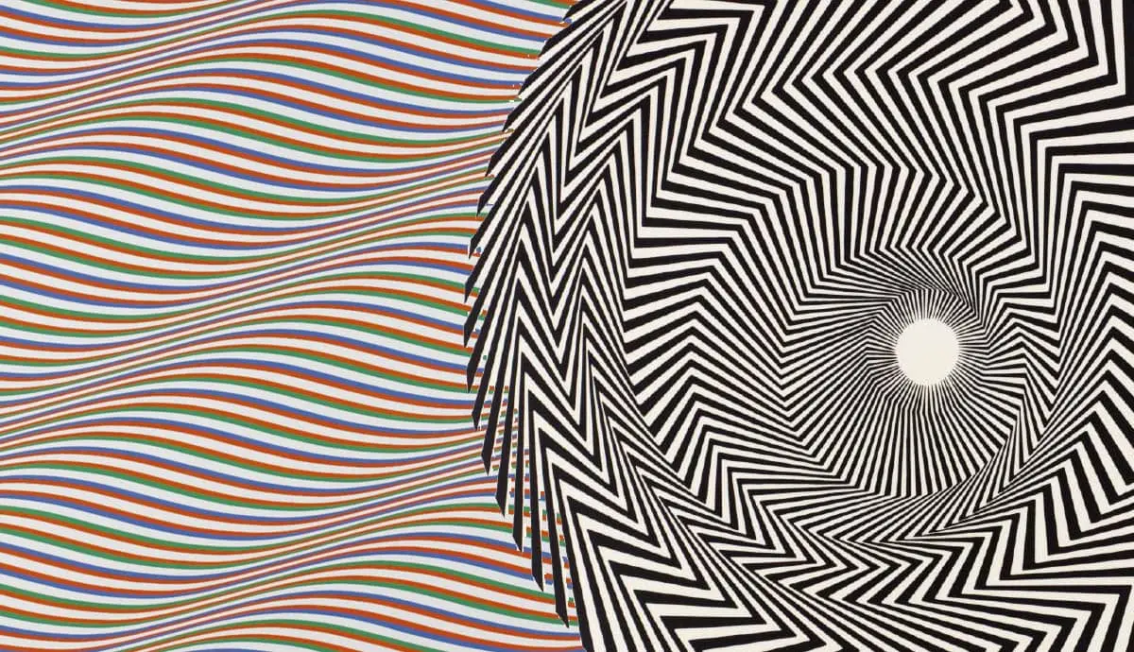
Lines are an important element in art.
They are the most basic element in drawing.
Line variation—the use of a variety of lines including width, length, texture, and thickness add interest to art.
Lines serve as a visual definition of shapes and play a vital role in expressing emotion, form, texture, and motion.

Slide 26
Do you have any idea how hard it would be to make curved lines in the design using over 760,000 one-inch square tiles?
Thiessen and Hammon really rocked!!

Slide 27
Thiessen and Hammon LOVED lines and used them as part of their artistic license, but we are mystified by what they all mean!
What are these lines all about?
Are they trees?
Are they geological formations?
Are they roads or rivers?

Slide 28
Check this out…..
Are the lines above the musicians meant to be a musical staff which is made up of five horizontal lines?
Are they a highway?
Are they rows in a field?

Slide 29
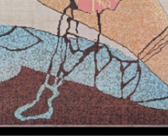
And what do you suppose this is??
Is it a shoe or boot attached to a leg?
Is it a seed sprouting from the ground?
Is it part of the aquifer that is found under much of Nebraska ?

Slide 30
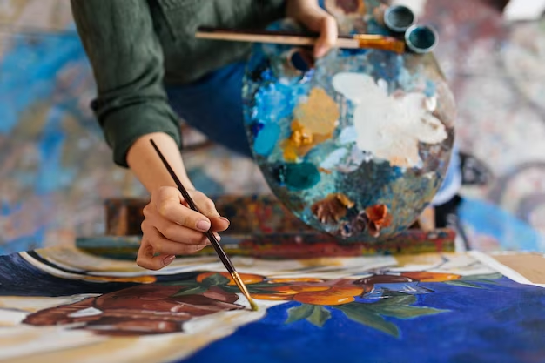
Composition is the arrangement of the visual elements in a piece of art.
Composition uses these elements to give the art structure and convey the intent of the artist.
Balance
Contrast
Emphasis
Movement
Pattern
Rhythm
Unity
Variety

Slide 31
For the artists, it was the most important part of their design.
By exercising their artistic license, Thiessen and Hammon were able to incorporate their own individuality and creativity….and they have given us many mysteries to solve!

Slide 32
Now, the Challenge….
What other Mysteries of the Mural can YOU uncover?

