Slide 1
Making the Case for Historic Preservation
Preserving the Past to Enrich the Future

Slide 2
It seems as if today's society is dominated by the idea of "new."
But is newer always for the best?
Often, new things and new ideas are given a high priority just because of their newness.

Slide 3
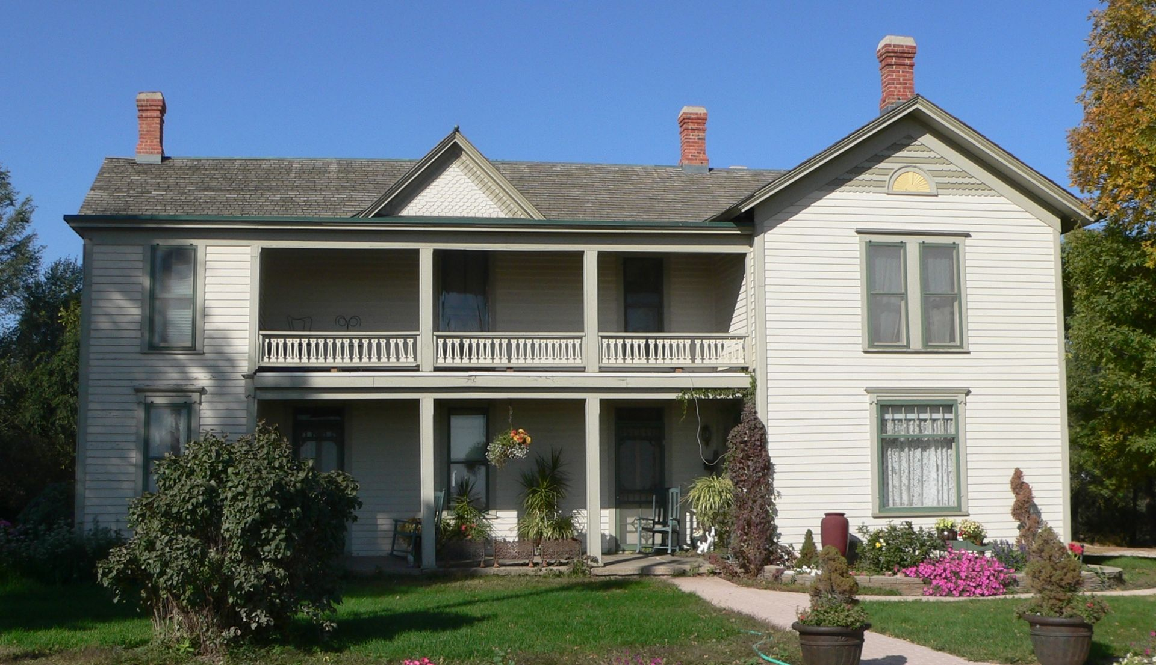
When it comes to historic sites, old can be better than new!
Let’s make the case for saving and preserving historic sites!
McCue-Trausch Farmstead, Hastings, NE

Slide 4
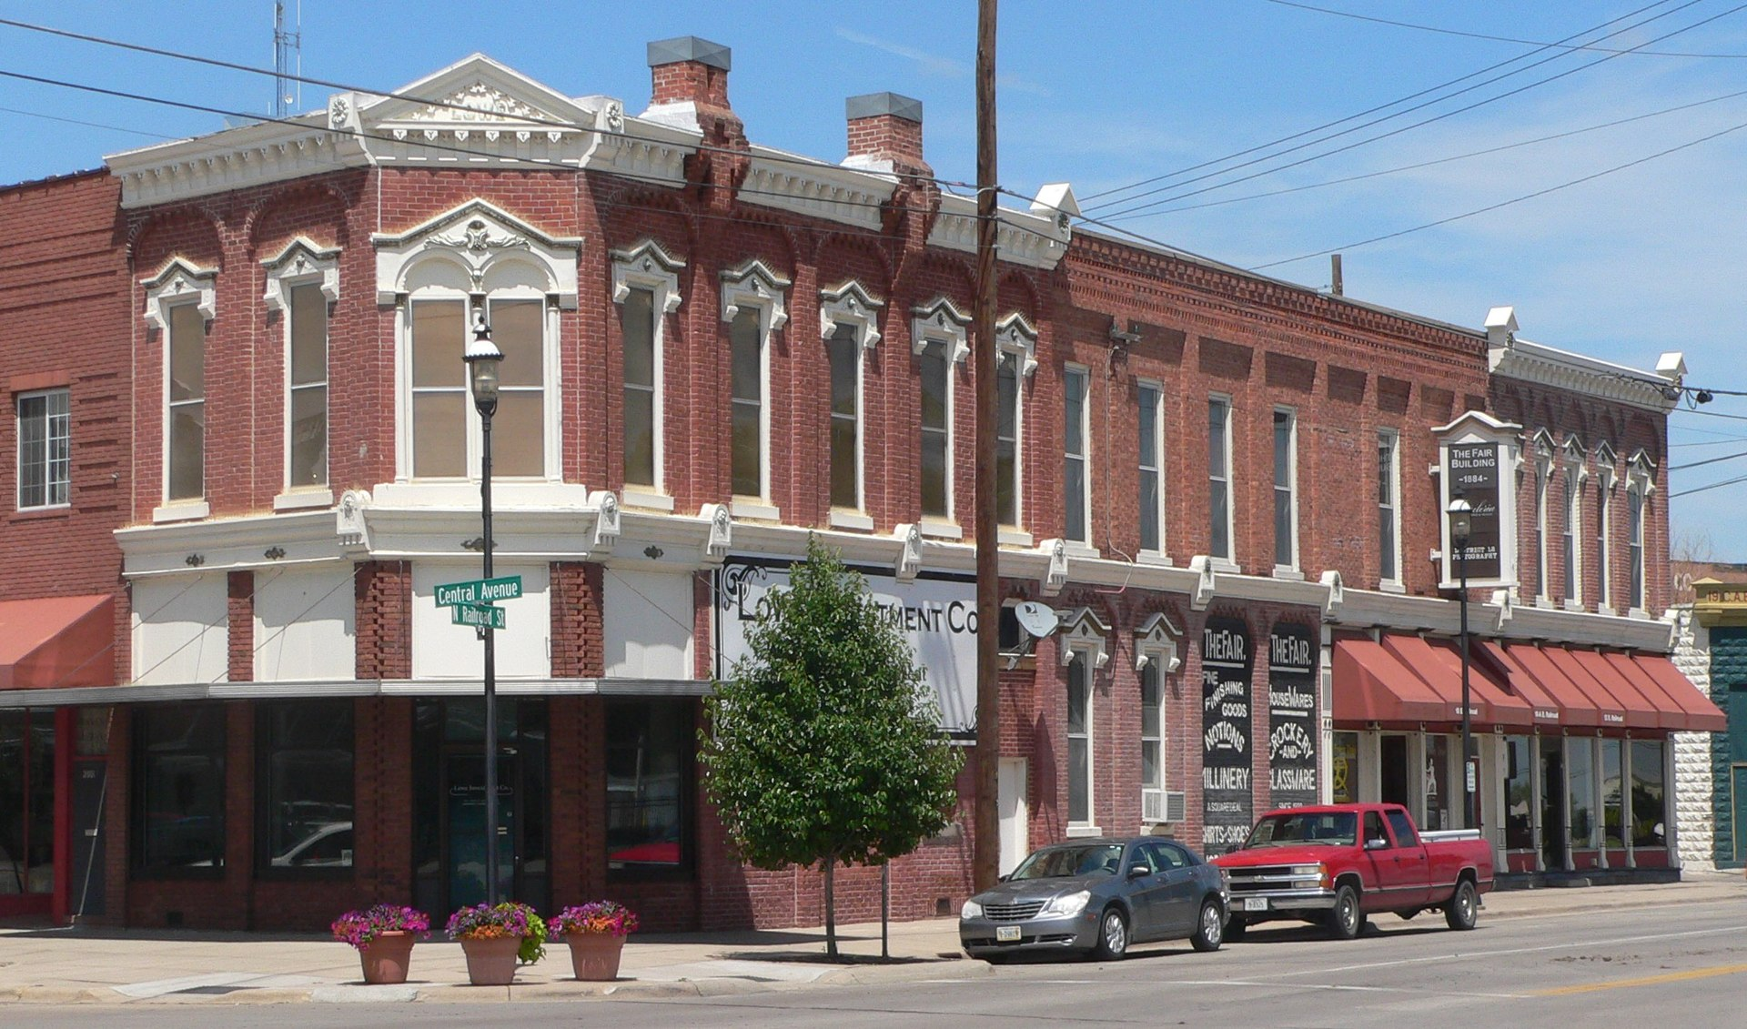
Culture
Preserving and restoring historic buildings connect us to the past.
They are physical reminders of where we came from and they bond us to a neighborhood or community.
Kearney Downtown Historic District, Kearney, NE

Slide 5
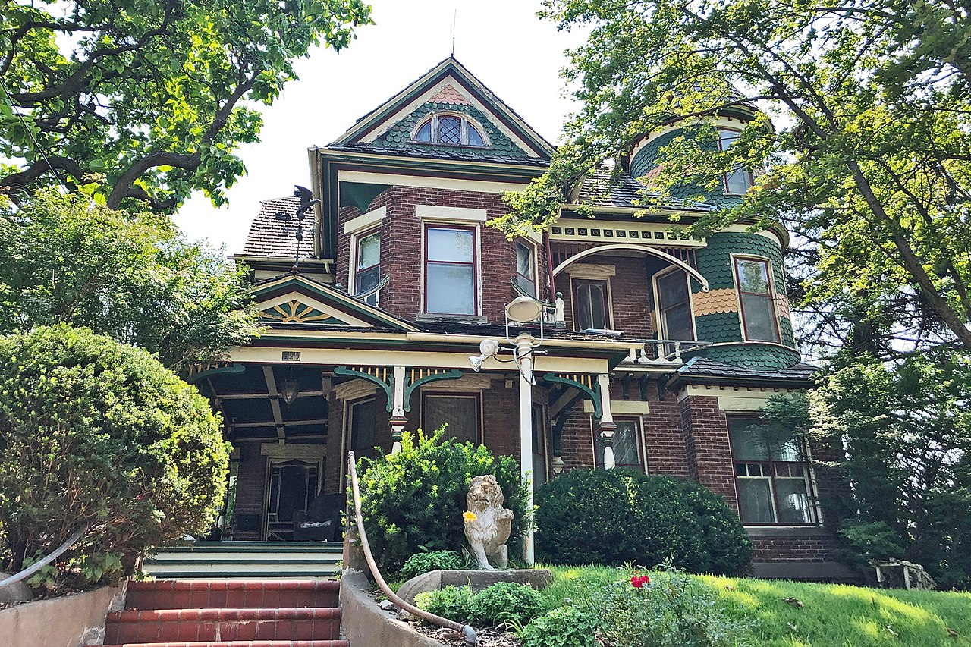
Culture and Preservation
Architects and builders can employ techniques to make a new building look old, but they cannot capture the essence of an historic structure.
Historic places also preserve and promote the human stories of the people who built, lived, or worked in them.
George E. Dovey House, Plattsmouth, NE

Slide 6
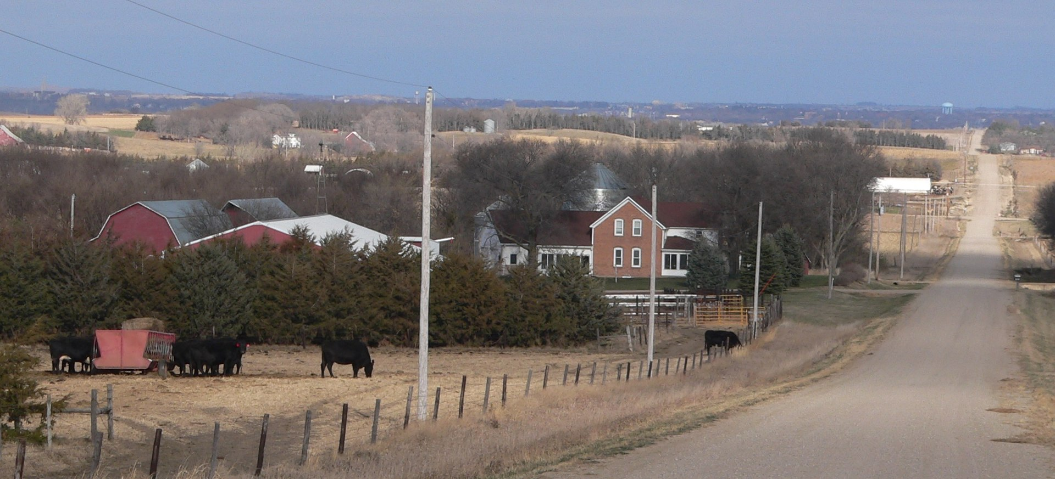
Education
Historic buildings are a record of ourselves and our communities.
Frank Zanvandall
Farmstead, Menominee, NE
Preserving important historic resources creates a visible connection with the community’s history and culture.

Slide 7
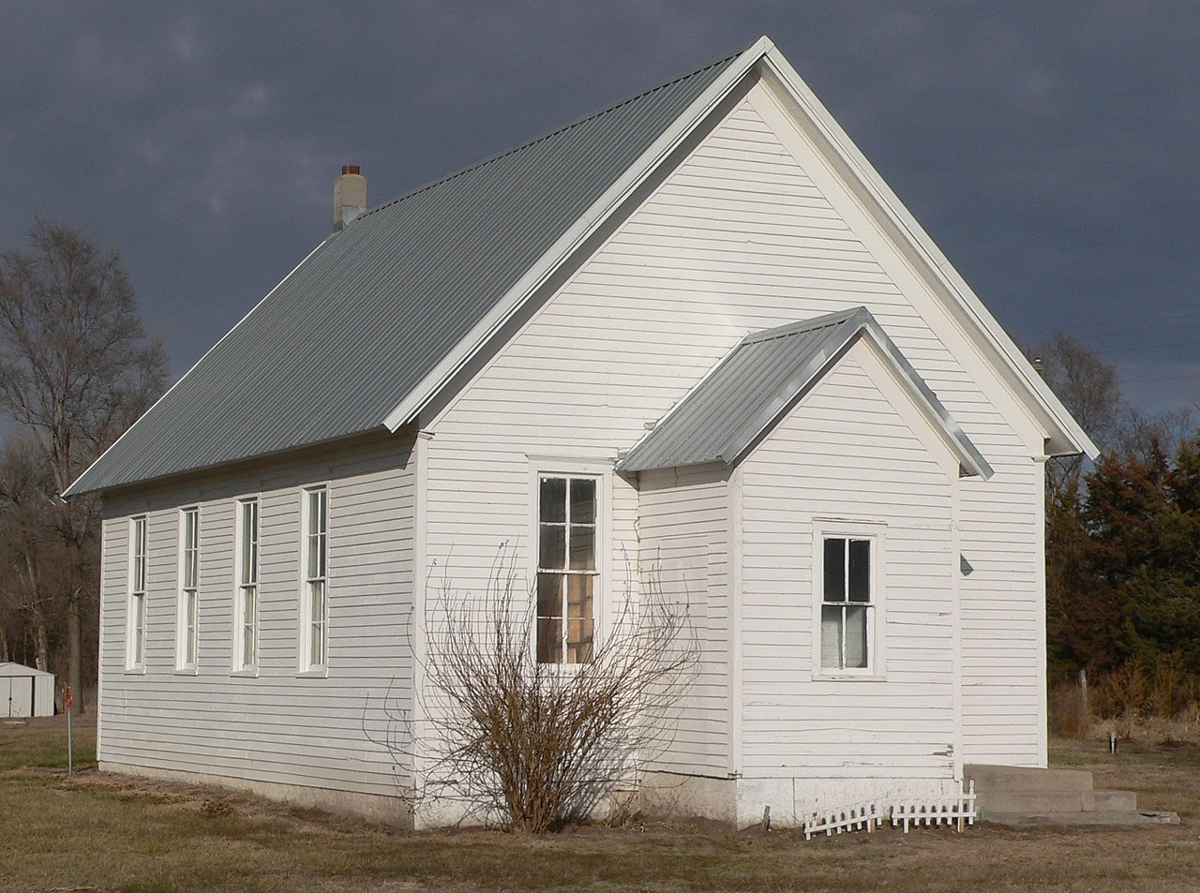
They can present many educational opportunities which cannot be provided by strictly classroom-held lessons.
Physically visiting, touching, and experiencing historic places can spark students’ imaginations in ways that in-class learning cannot.
Butler County District, No 10 School, Linwood, NE

Slide 8
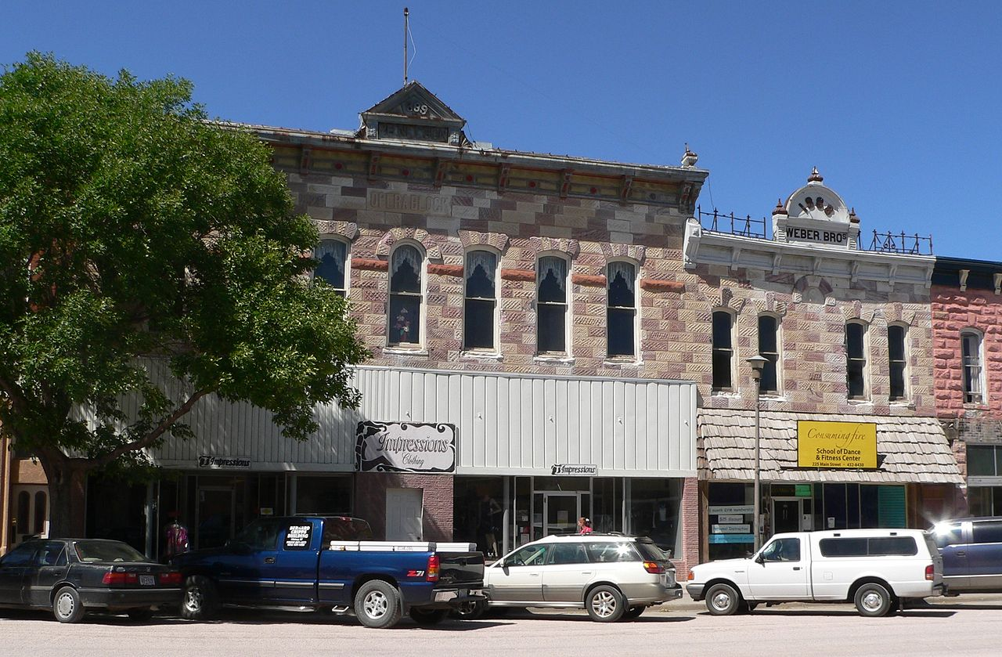
Economy
Preserving and restoring historic buildings brings in tourism dollars and gives a boost to the local economy.
Established, historic buildings may attract new businesses because people are often fascinated by them.
Chadron Commercial Historic District, Chadron, NE

Slide 9
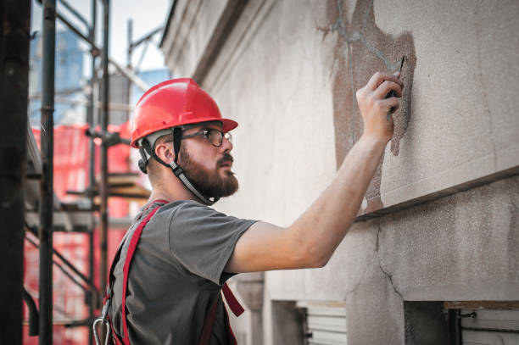
Economy
Preservation also helps create jobs for tradespeople who restore, preserve, and maintain historic buildings.

Slide 10
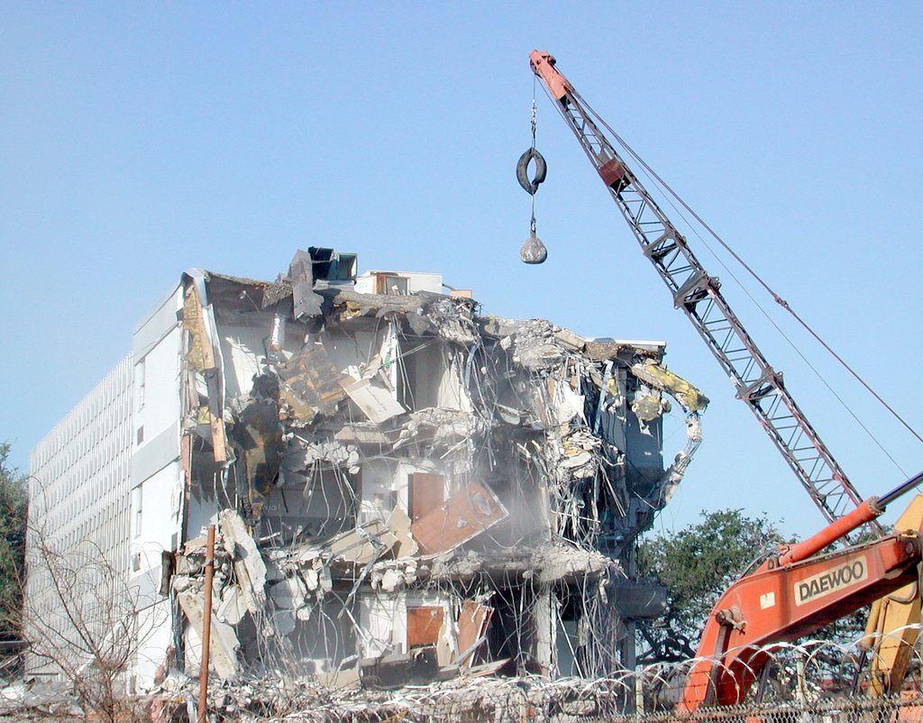
economy
Sometimes it is more cost-effective to refurbish or repurpose an historic building rather than incur the costs of demolition and rebuilding.

Slide 11
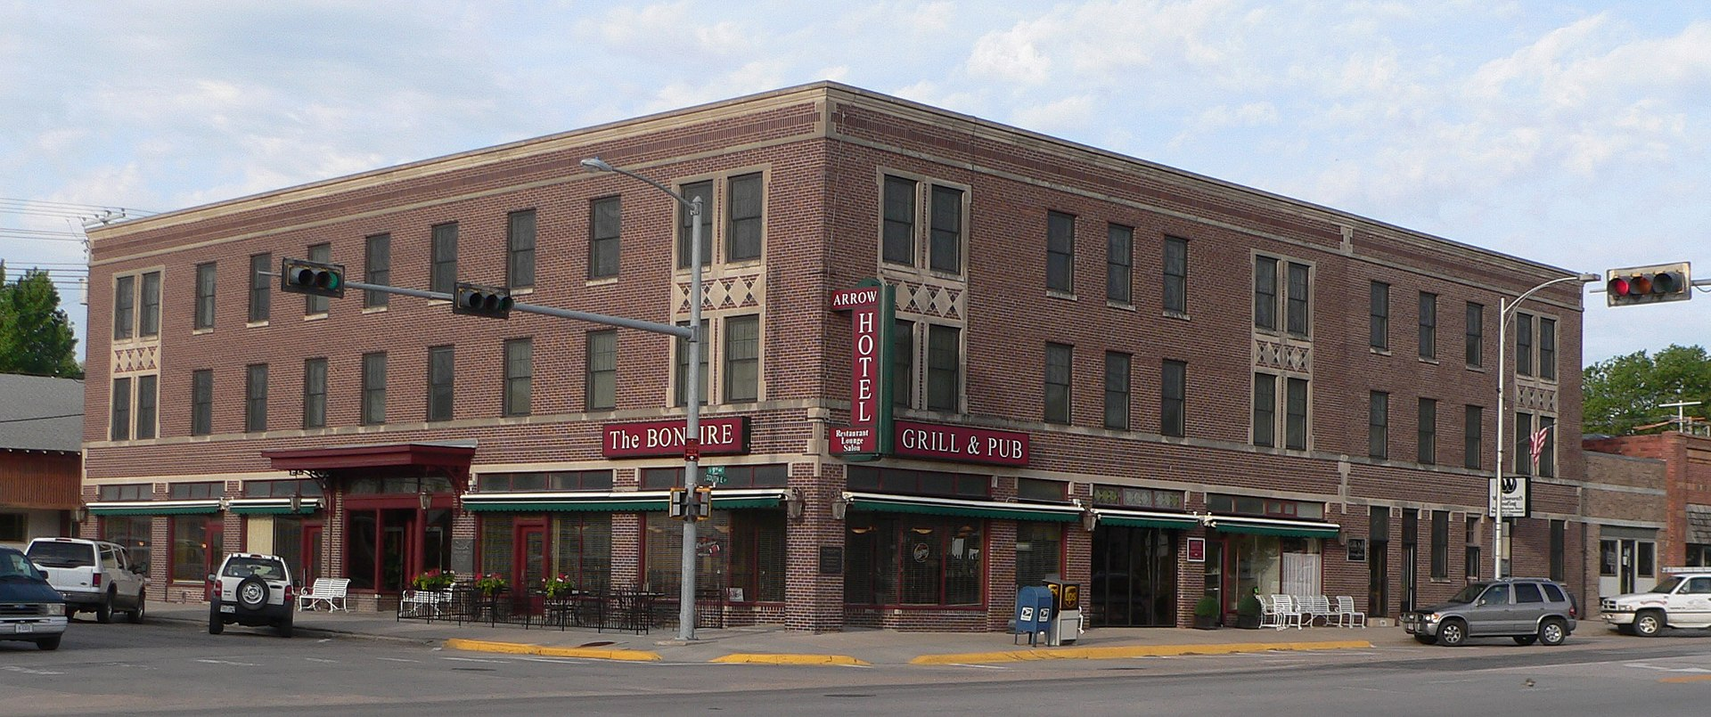
Economy
Historic buildings can be affordable for businesses to rehabilitate with the possibility of tax incentives, grants, and other support for their restoration.
Arrow Hotel, Broken Bow, NE

Slide 12
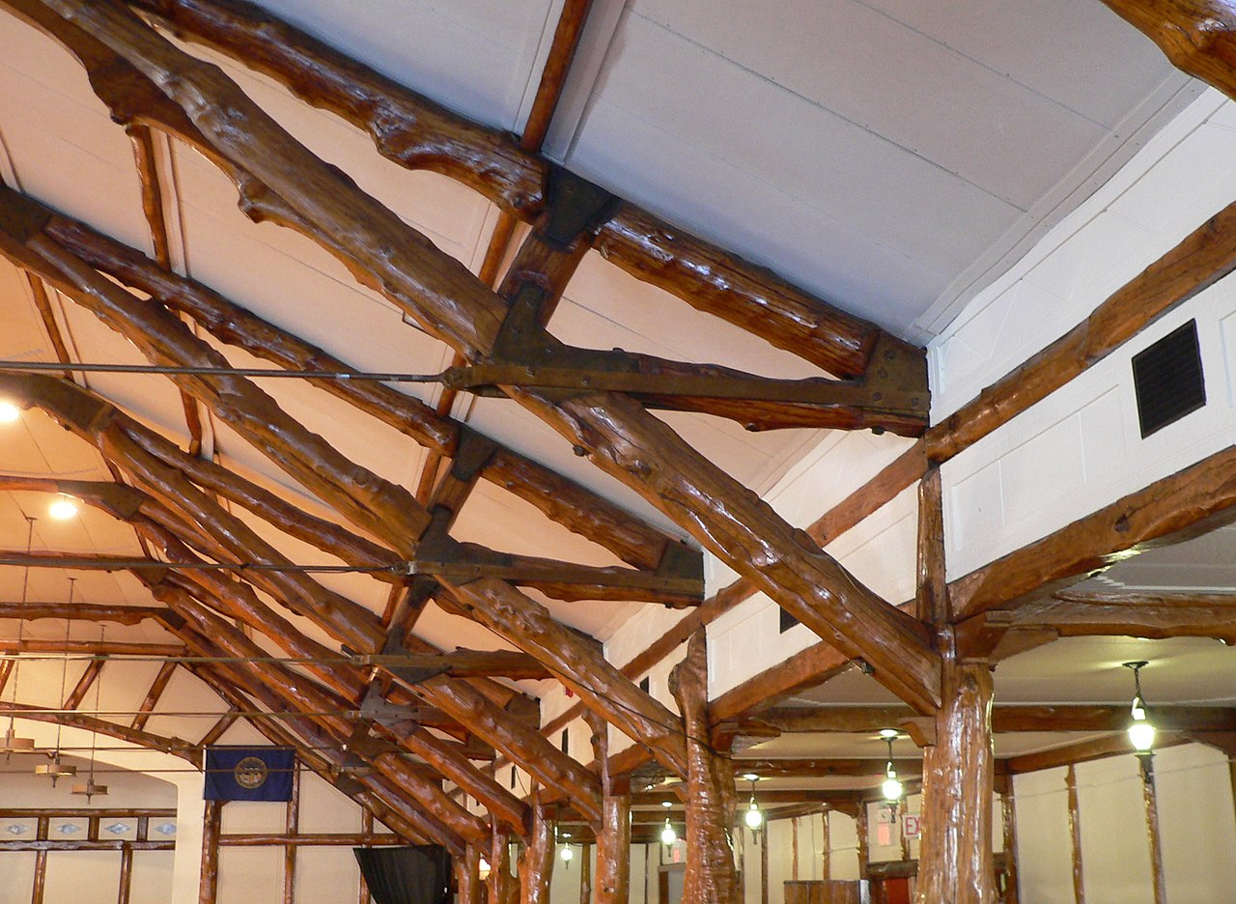
Building Materials
Older buildings, especially those built prior to World War II, are often made of higher quality materials (such as heart pine, marble, beams, or old brick) using superior craftsmanship—they were built to last.
Oak Ball Room, Schuyler, NE

Slide 13
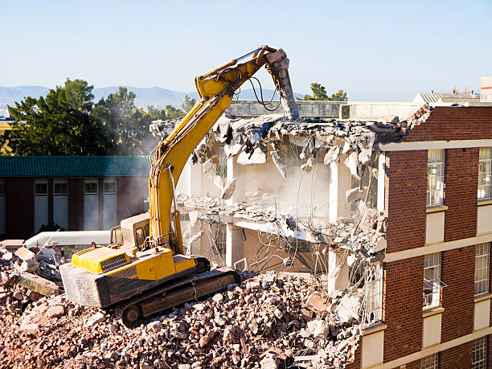
Building MATERIALS
Replacing these buildings using similar materials would be impractical and unaffordable.
There is a limited inventory of historic buildings and once they have been demolished, there is no going back.

Slide 14
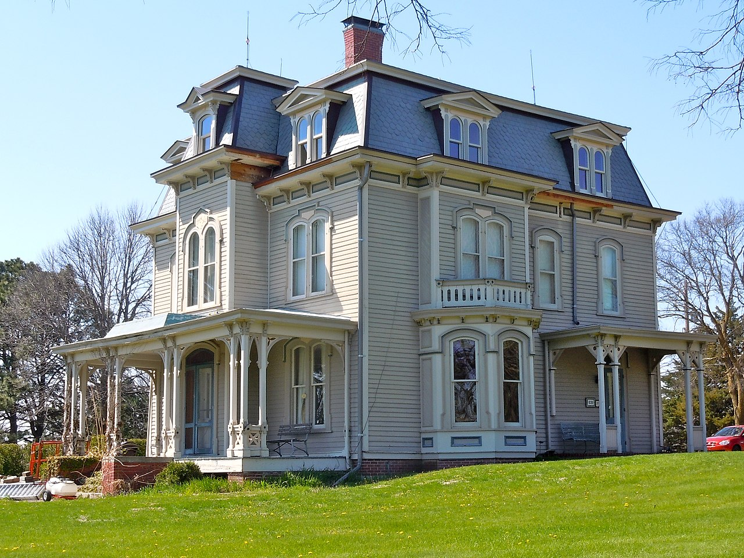
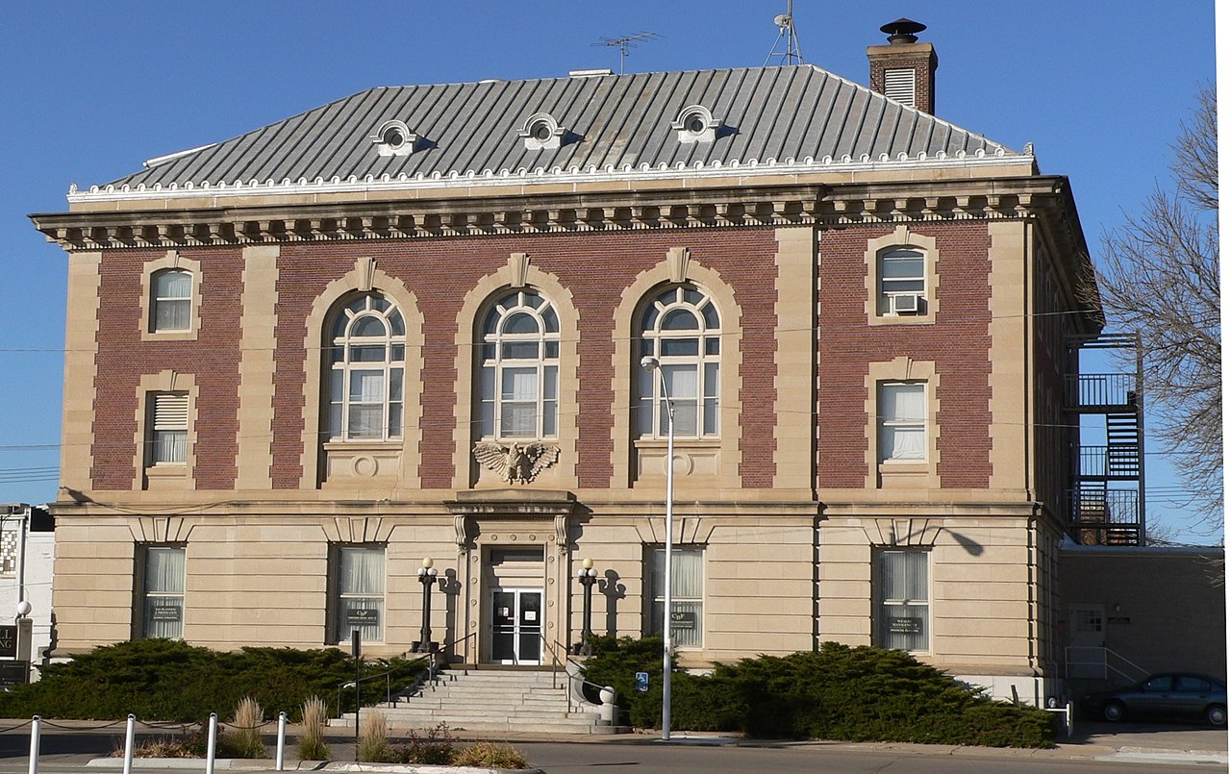
Building Methods
John Cattle, Jr. House, Seward, NE
Visiting old structures is a way for architects and builders to study past techniques and designs and see how they influence present-day construction.
U.S. Post Office and Court House, Norfolk, NE

Slide 15
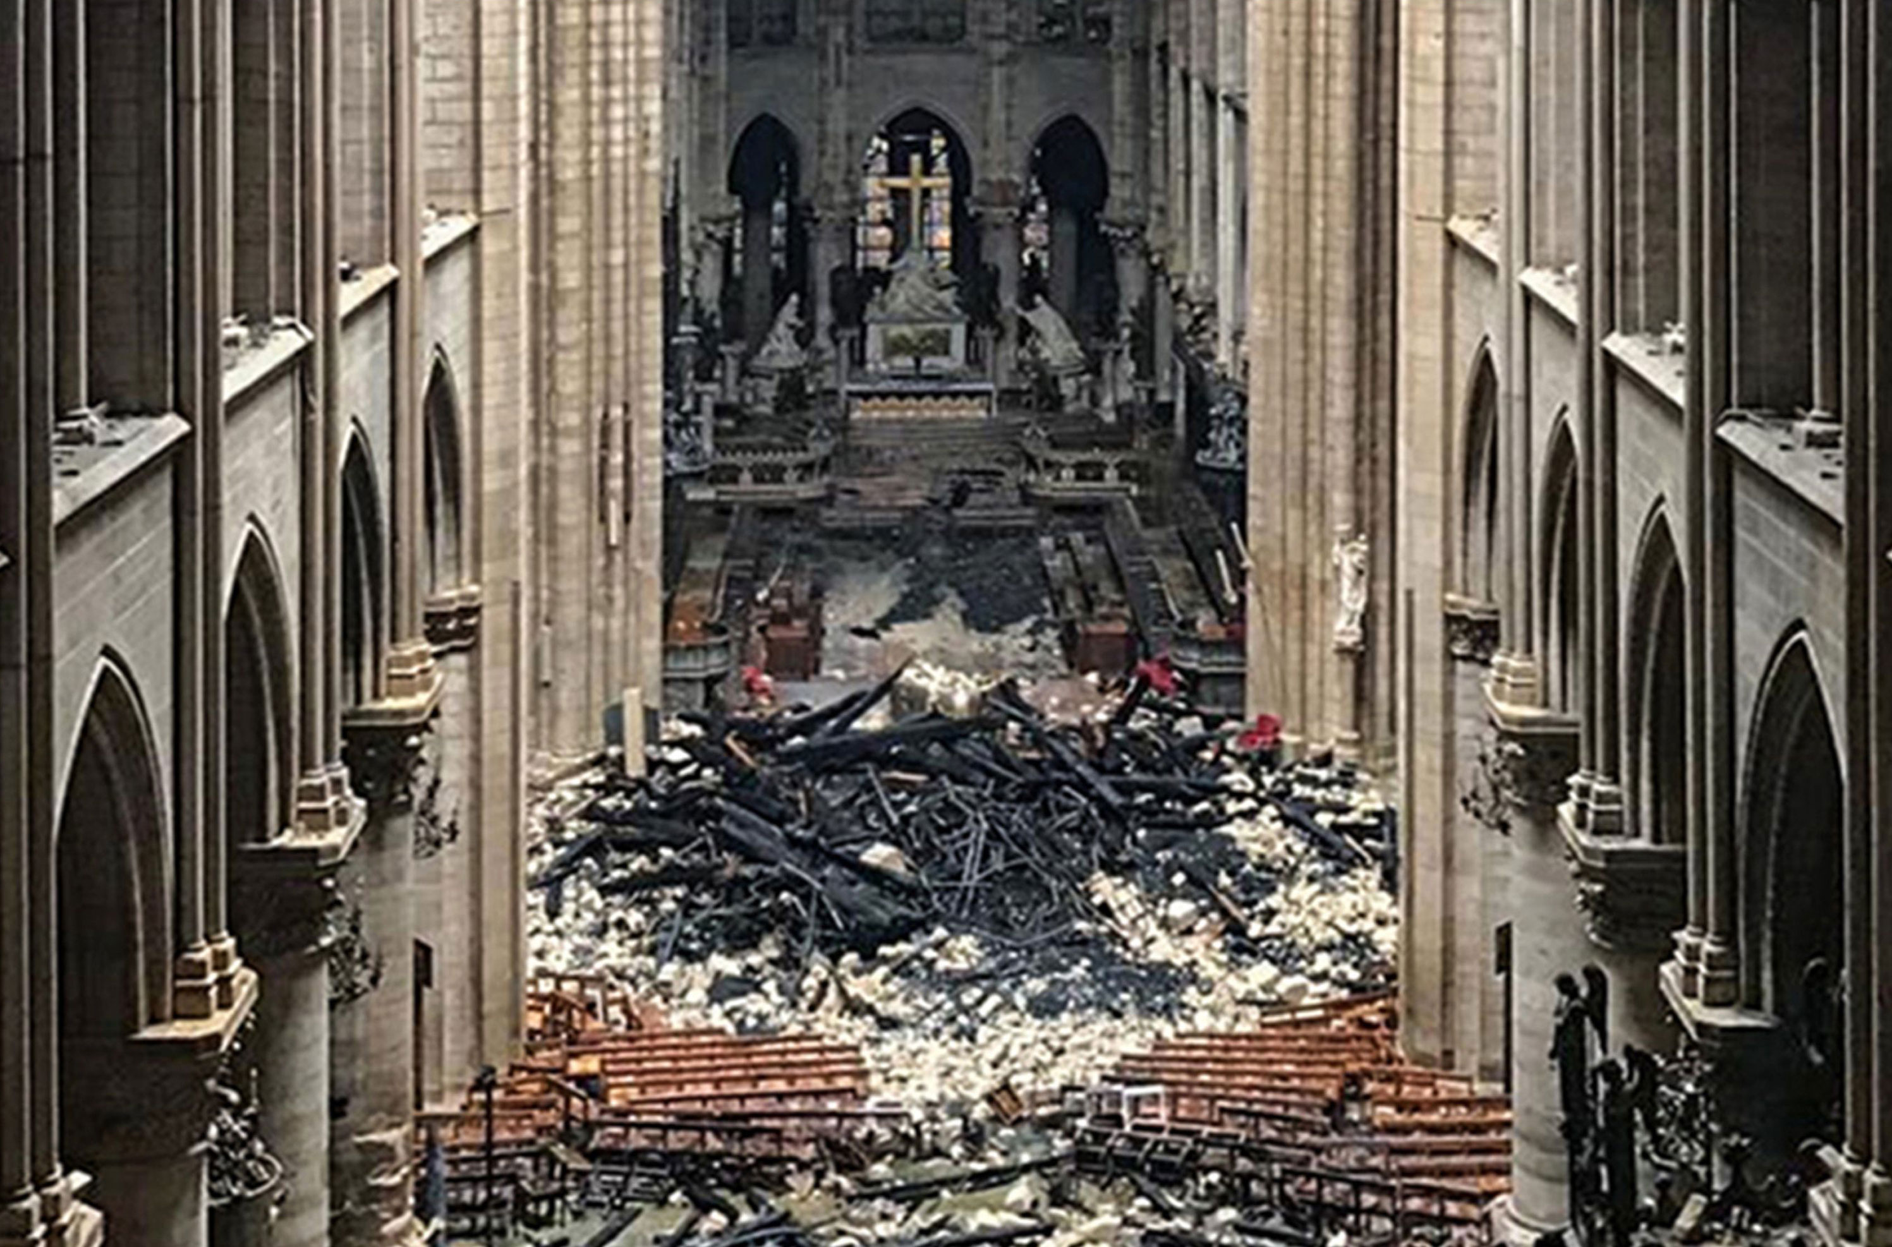
Building Methods
When the roof of Paris’ Notre Dame Cathedral was destroyed by fire in 2019, artisans, architects, and construction workers utilized medieval techniques dating back to the 12th through14th centuries when the Cathedral was constructed.

Slide 16
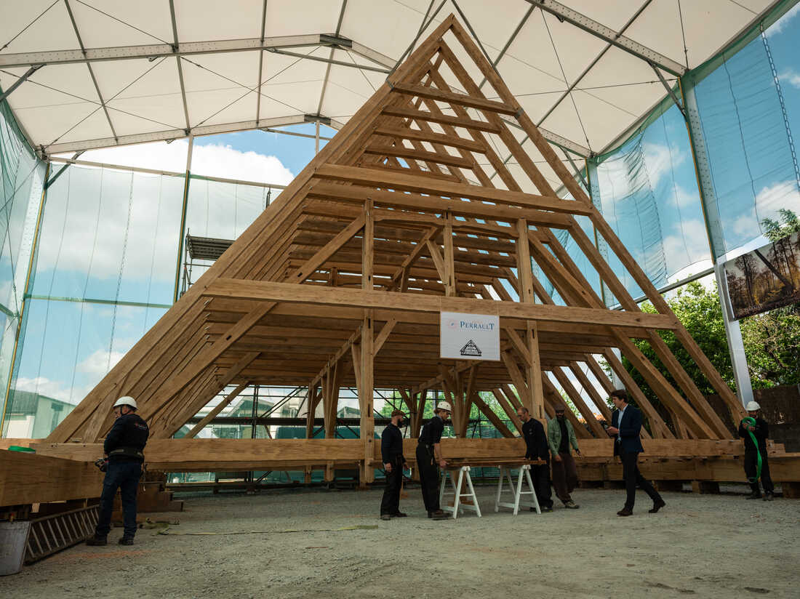
Building Methods
It would have been easier and faster to use modern tools (electric saws, drills, nails, etc.), but the rebuilders wanted to preserve the Cathedral using the “old ways.” In fact, they have gone so far as to use axes to harvest and transform oak trees into the beams needed for the reconstruction.

Slide 17
Unique Design Features
Historic buildings often have detailing and features that are not usually found in new construction—facades, unusual glasswork, spires, domes, columns, cupolas, cornices, balustrades, etc.
Hall County Court House, Grand Island

Slide 18
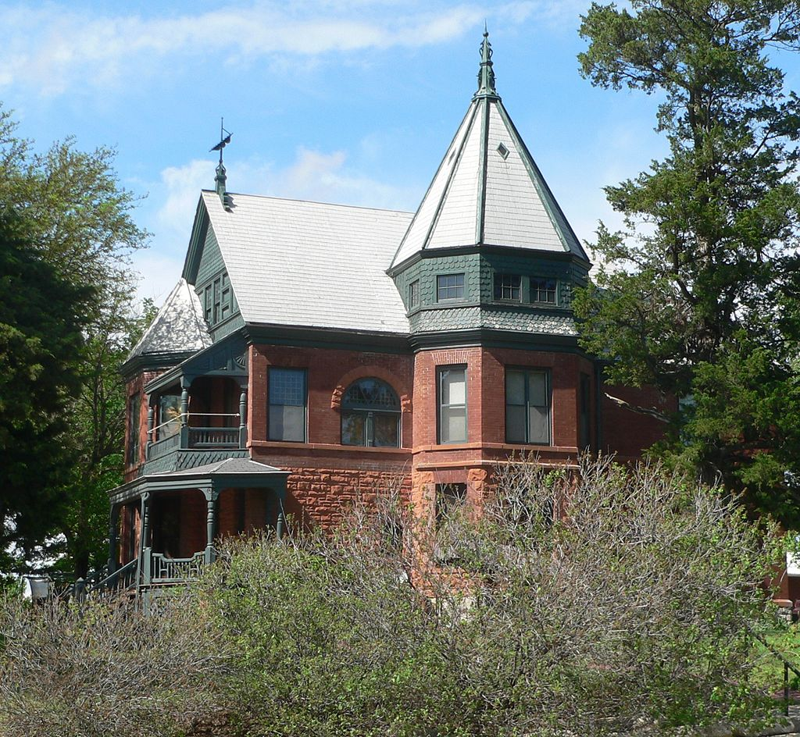
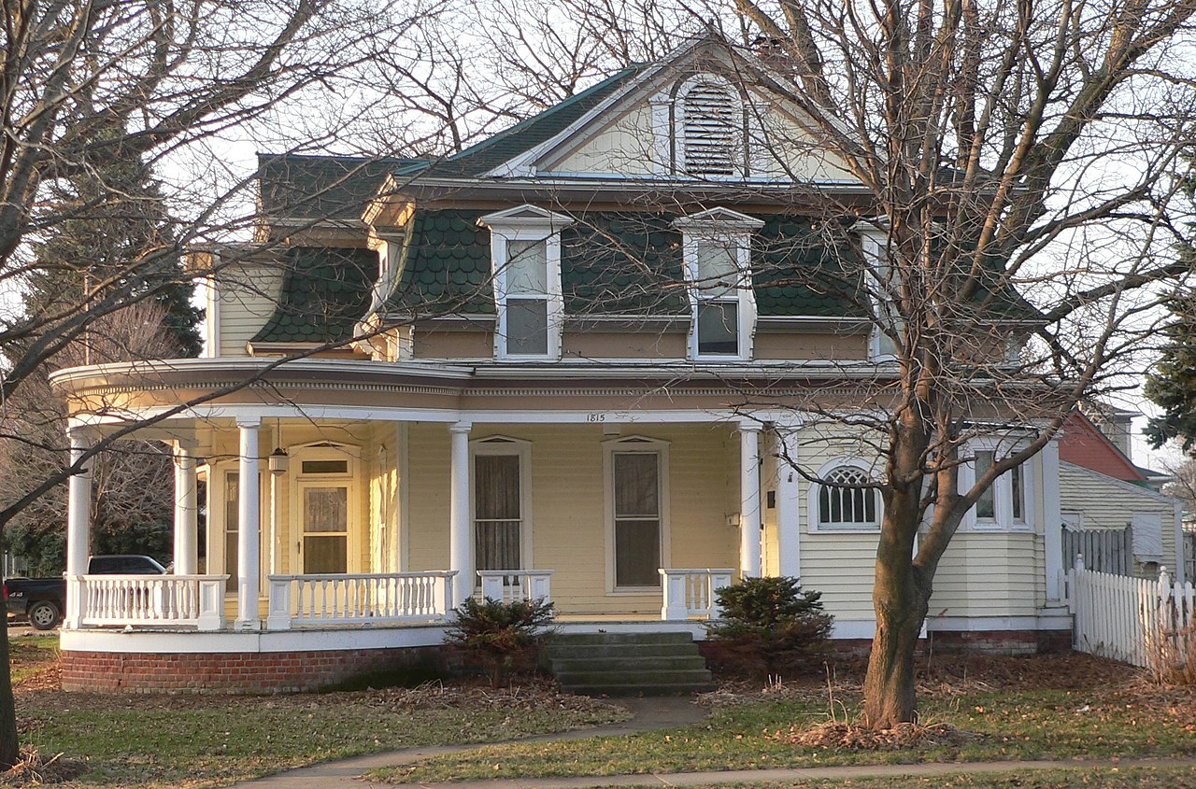
Unique Design Features
These unique features give buildings their own identity and distinctive character……
Johnston-Muff House, Crete, NE
Abraham Castetter House, Blair, NE

Slide 19
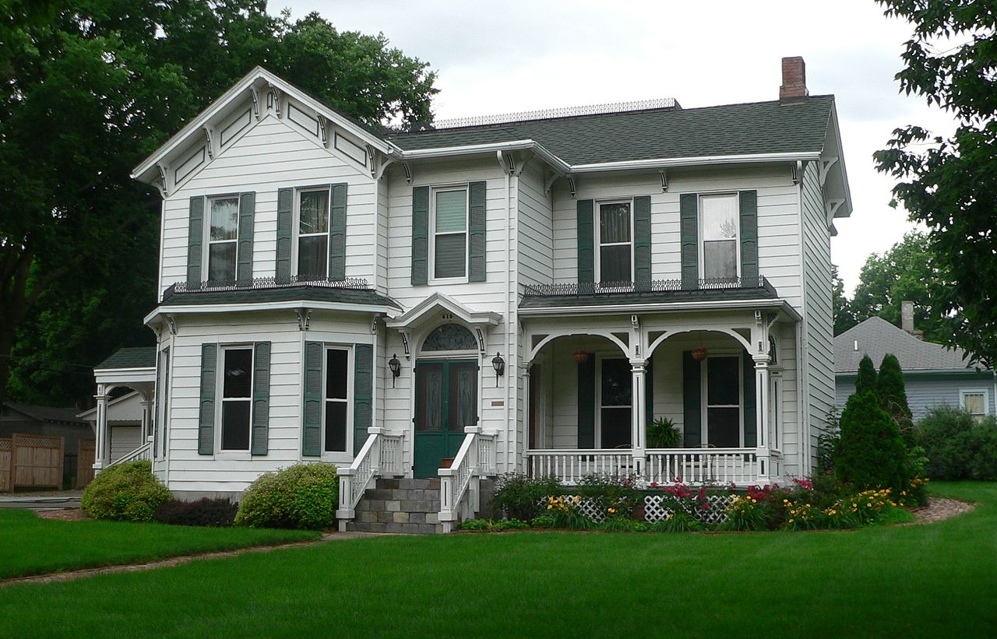
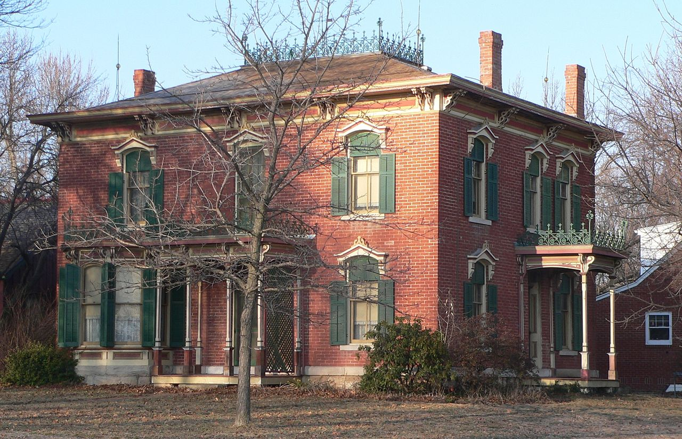
Unique Design Features
…..which makes them more interesting than modern buildings.
Nebraska City Historic District, Nebraska City, NE
Wilber T. Reed House, Auburn, NE

Slide 20
Unique Design Features
They also support and maintain old methods of workmanship.

Slide 21
Neighborhoods
Restoring old buildings to their original appearance not only adds character but can help rehabilitate an entire neighborhood.
Garneau-Kilpatrick House, Omaha, NE

Slide 22
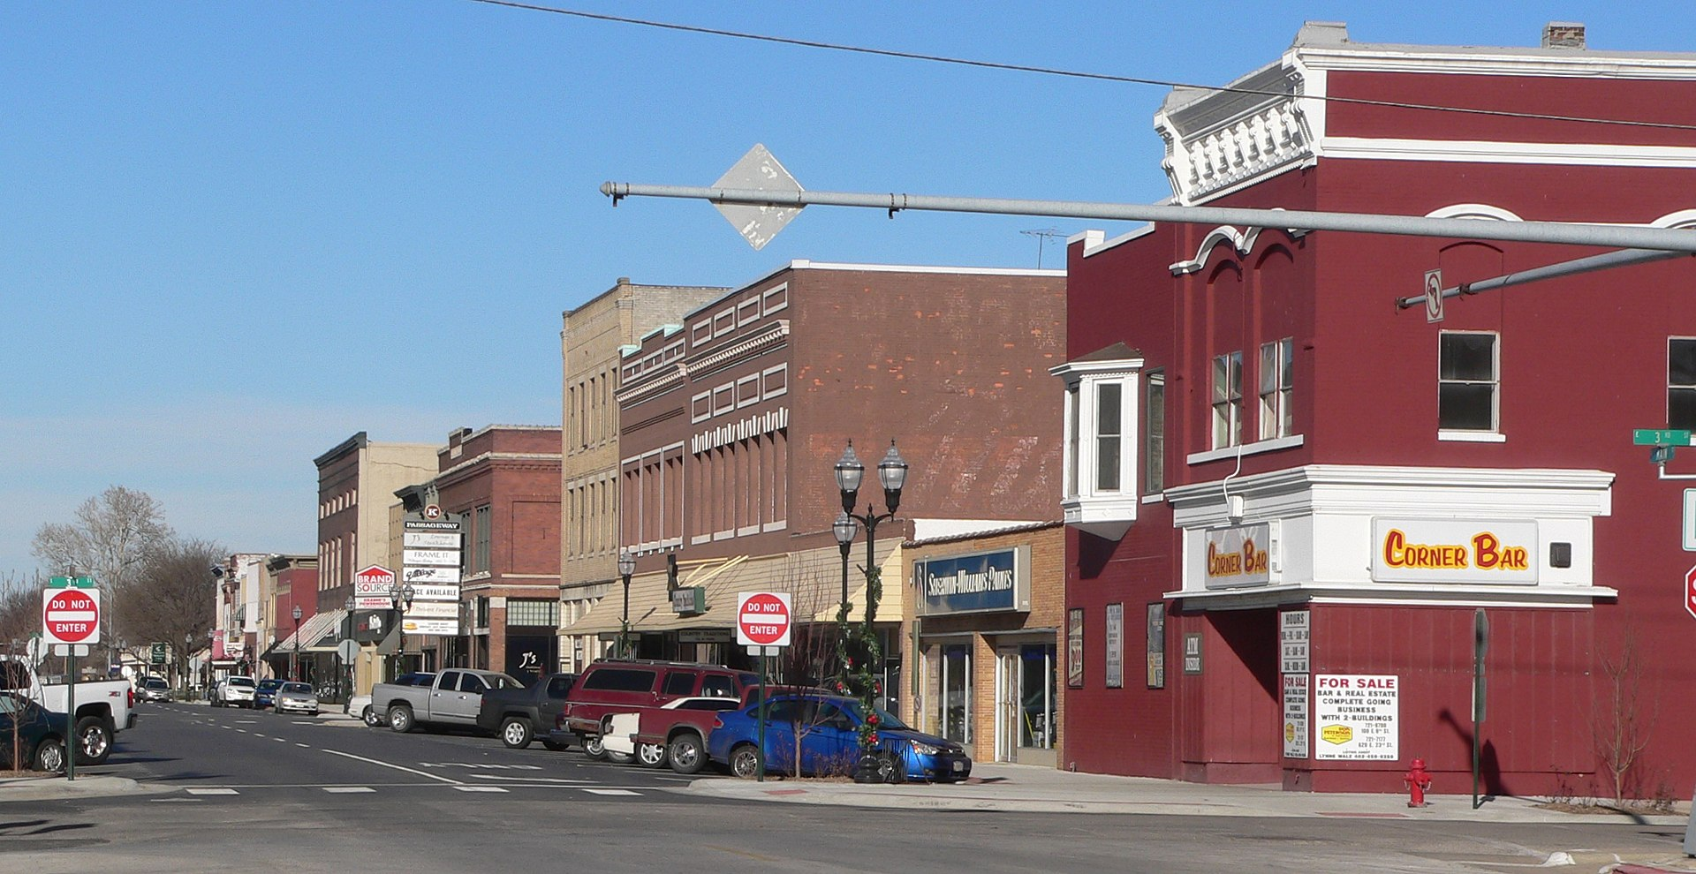
Neighborhood
Repurposing structures, such as remodeling an abandoned but historic industrial building into small business space or a mixed-use development, can give new life to an entire neighborhood.
Fremont Historic Commercial District, Fremont, NE

Slide 23
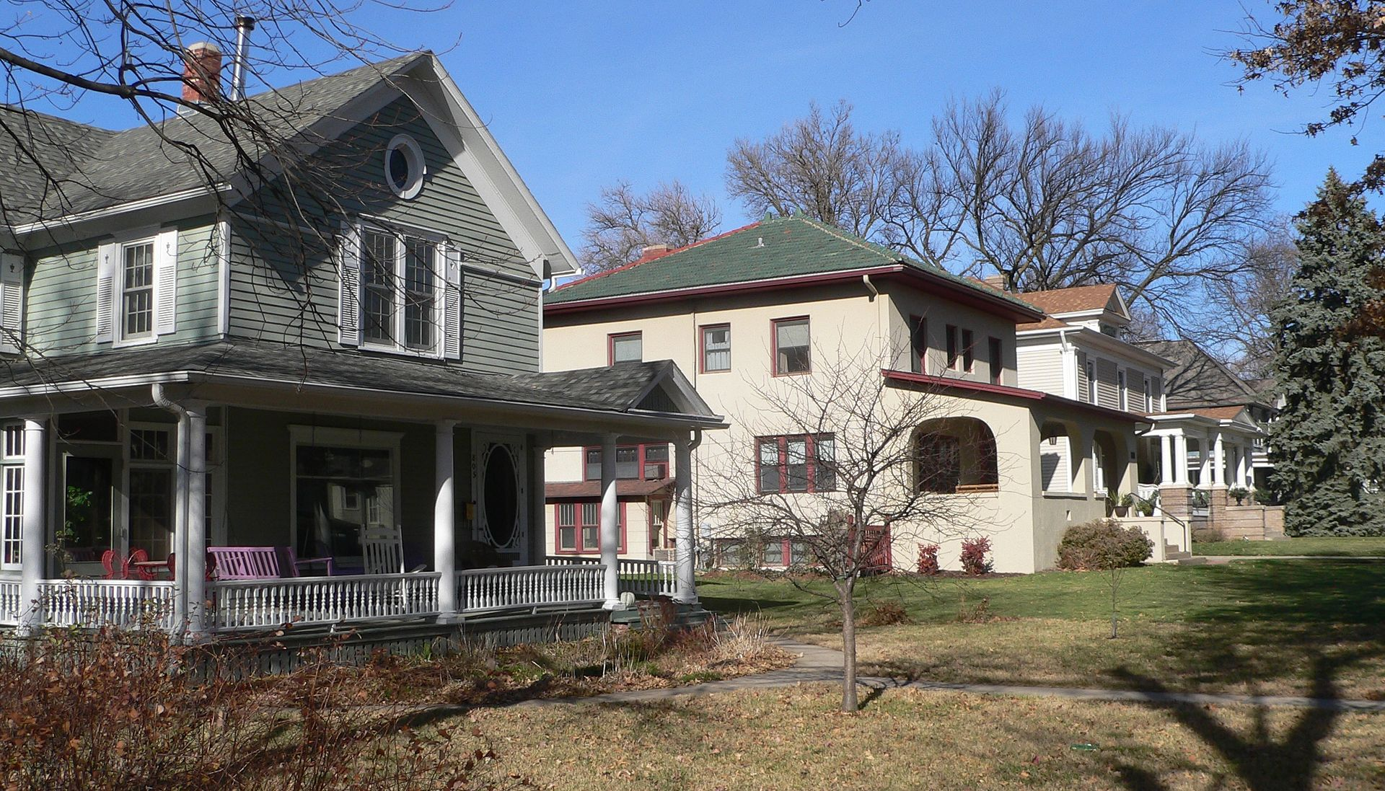
Neighborhoods
An area restored to its original appearance can serve as a magnet for new visitors and residents.
A rehabilitated historic building or neighborhood might be the focus of a new residential or commercial development.
They also preserve traditional development patterns, denser business districts and walkable neighborhoods.
Central Hastings Historic District, Hastings, NE

Slide 24
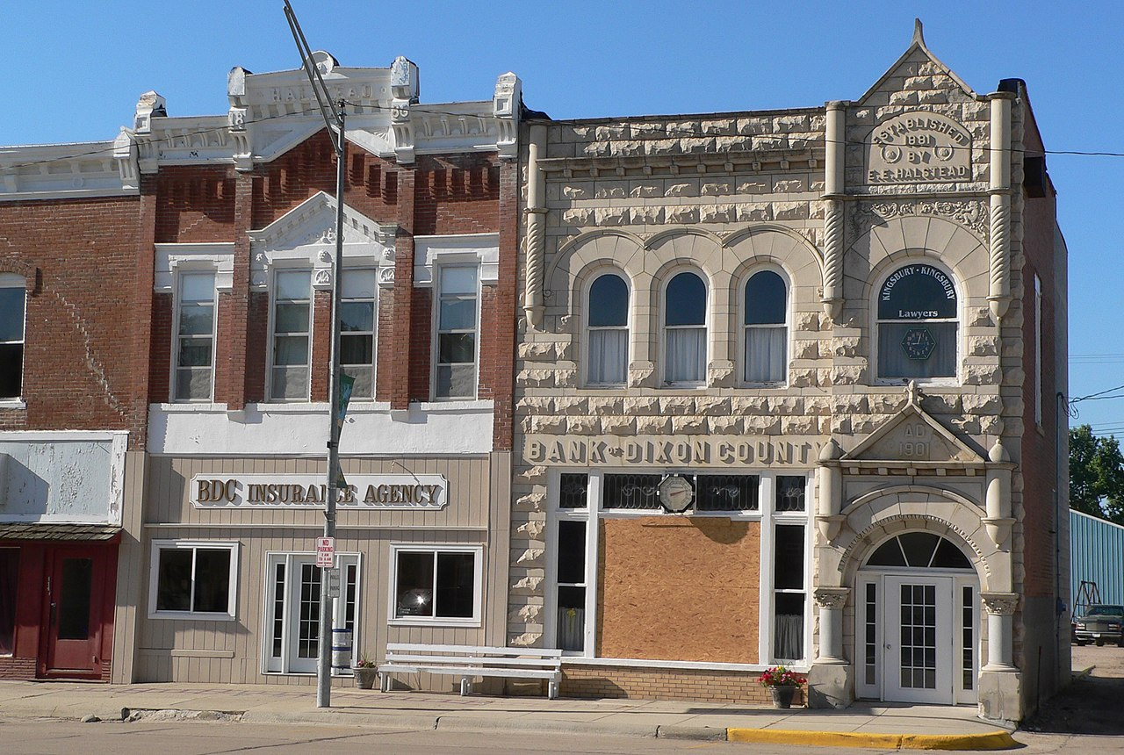
Environment
Preservation is good for the Environment.
Preserving older buildings is a wise use of infrastructure, land, and non-renewable resources.
Ponca Historic District, Ponca, NE

Slide 25
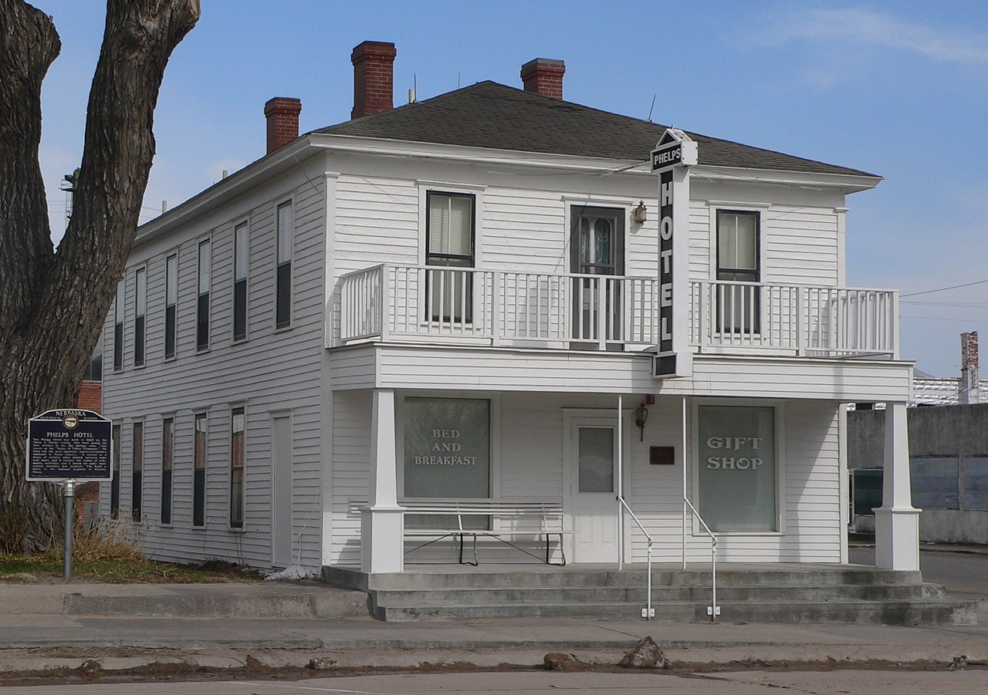
Environment
Preserving and reusing existing buildings makes better use of tax dollars by reducing the need for new roads, sewers, and utilities.
Phelps Hotel, Big Springs, NE

Slide 26
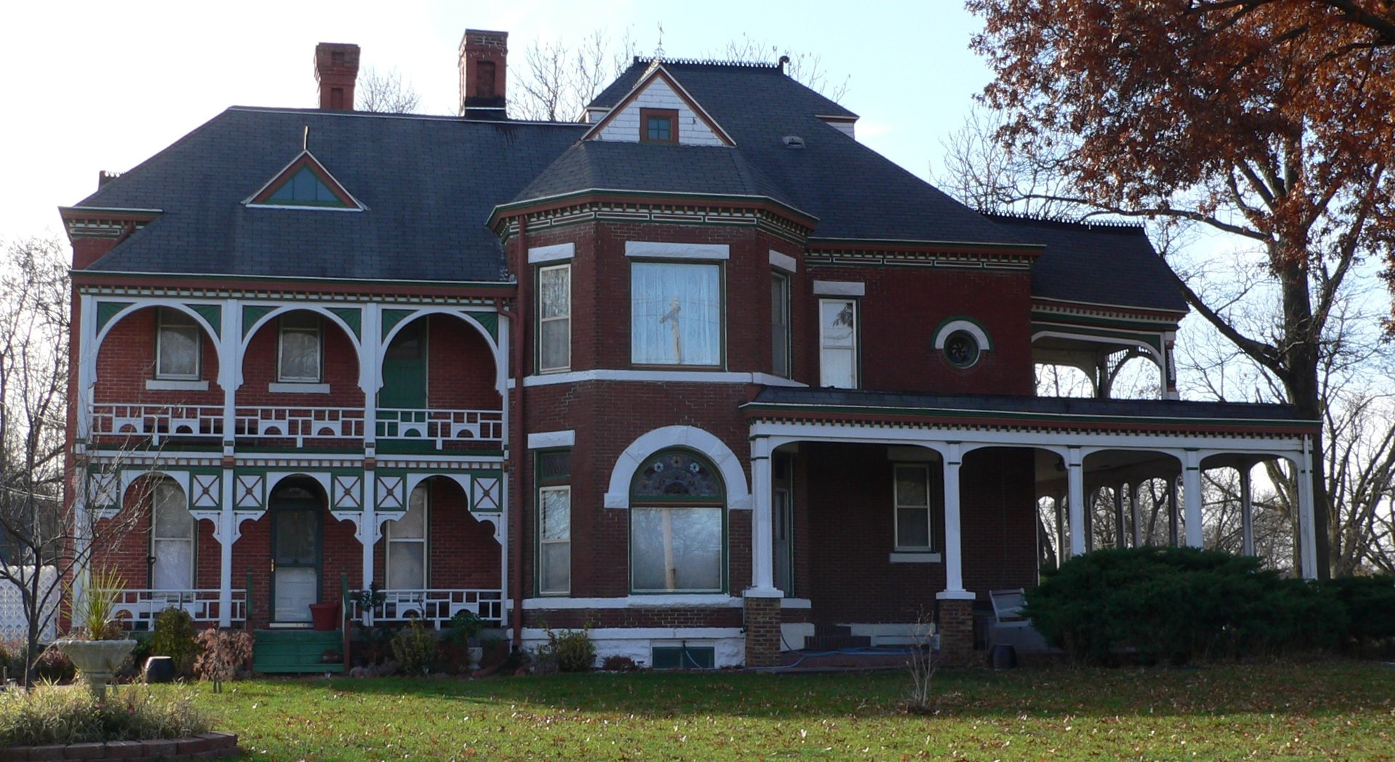
environment
Avoiding demolition reduces landfill waste and the release of toxins and pollutants into the environment.
Historic preservation is an important part of “smart” or sustainable growth.
J. M. Burk House, Geneva, NE

Slide 27
Now that you know the facts….
Are you ready to make the case for preservation?

