Slide 1
How to Write an Artist Statement

Slide 2
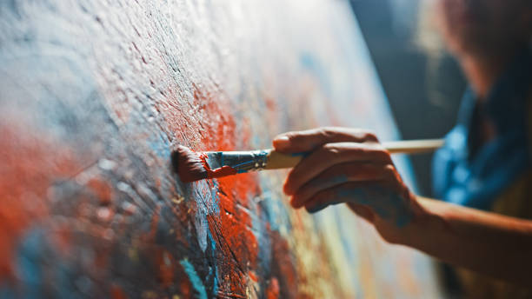
An Artist Statement summarizes what an individual creates and what motivates them to create.

Slide 3
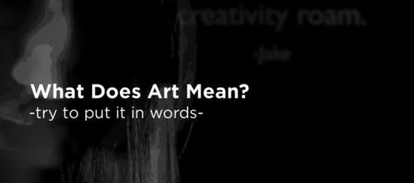
Each statement is unique and personal and varies greatly between Artists.

Slide 4
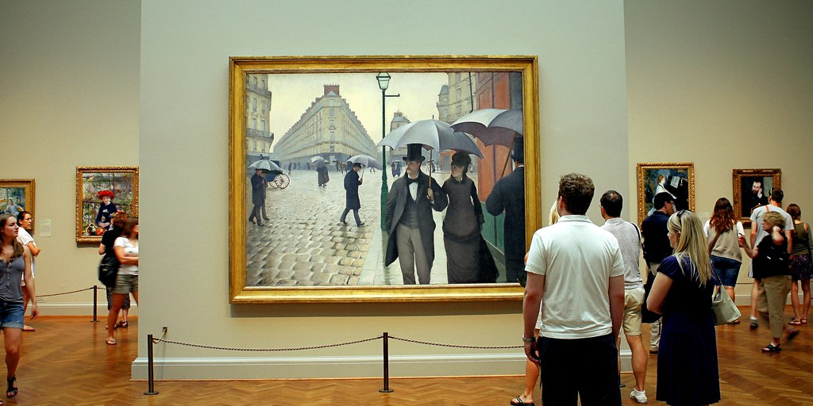
This statement can provide meaning for a single work or an entire collection and helps the viewer better understand the Artist’s work.

Slide 5
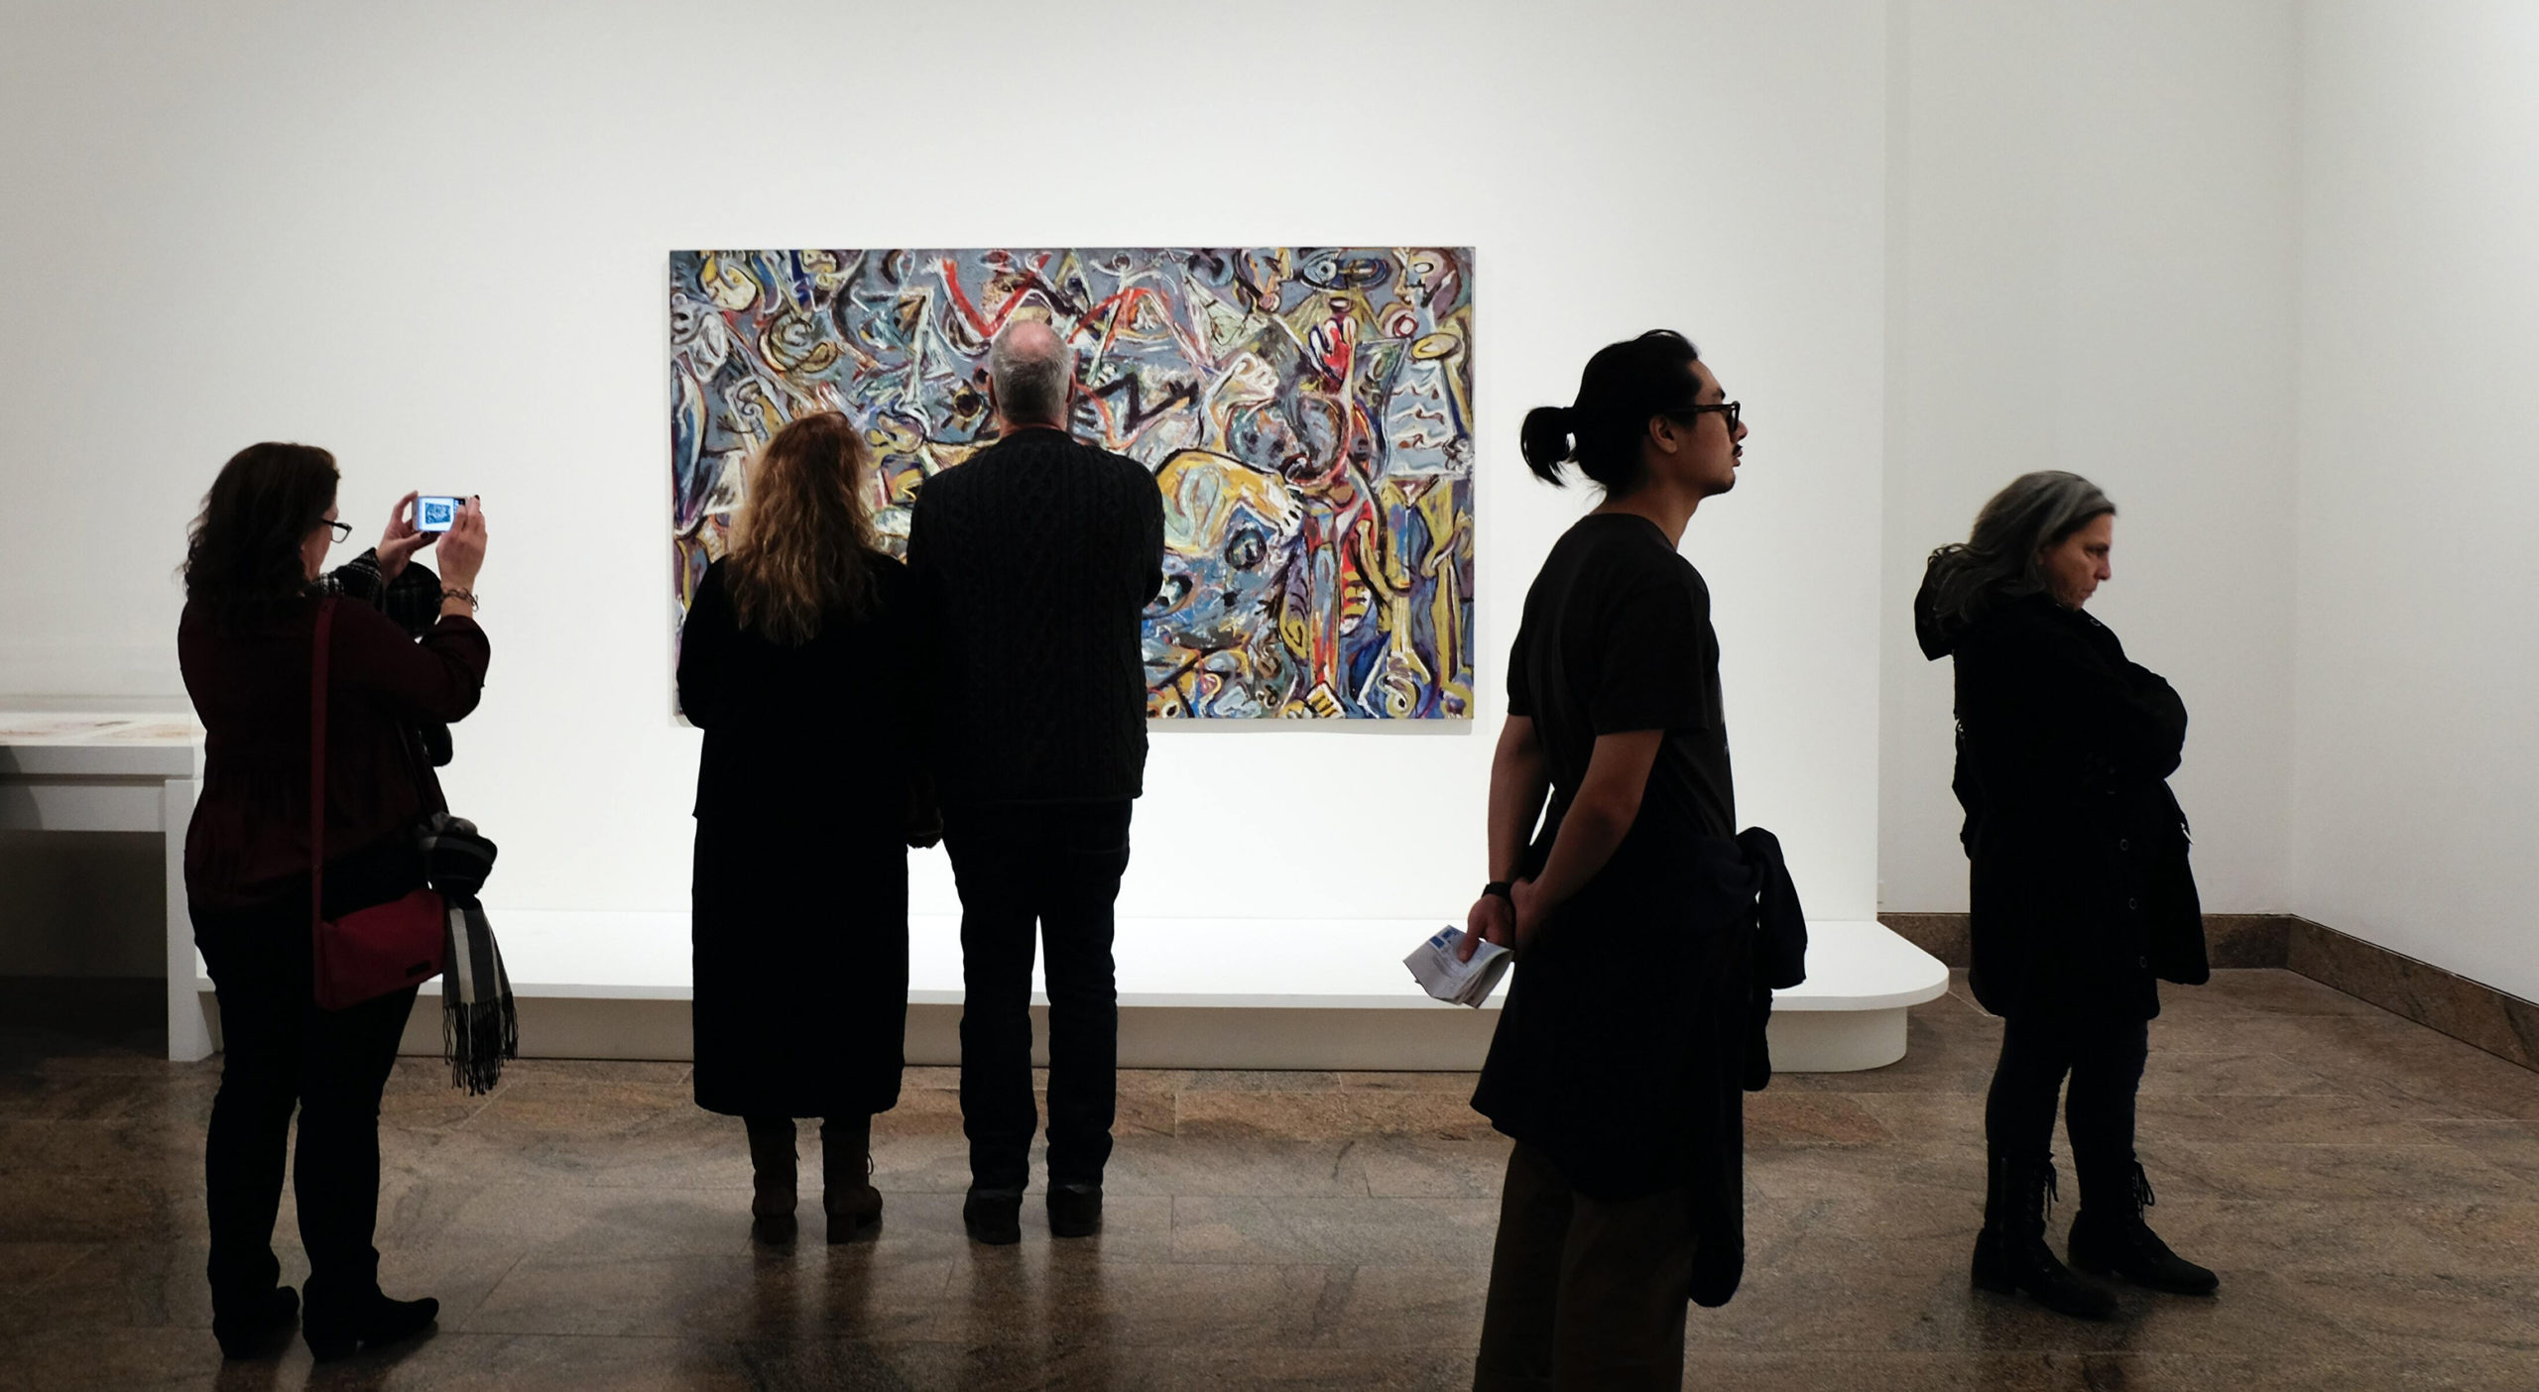
It is meant to explain the style, approach, philosophy, and theme of the art.

Slide 6
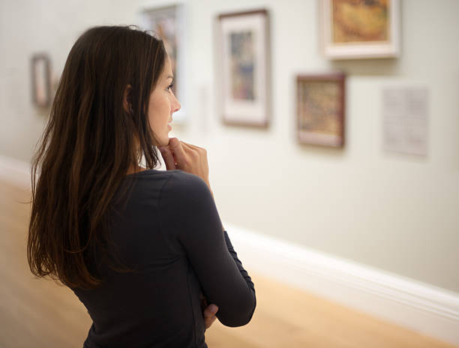
It talks about what the artist intended to convey through the art.

Slide 7
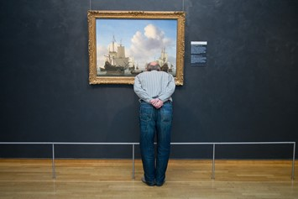
The statement is meant to clarify and add understanding for those who are viewing the art.

Slide 8

Before you write your artist’s statement to help the public better understand your art, you need to answer a few questions.
Why do I like to make art?
What processes or techniques do I use in my art?
What subjects do I like to use?
What are my goals and hopes in creating art?
What inspires me?
What was it like for me to undertake this art project?

Slide 9
More questions to answer……
What steps did I take to design and create my art?
What challenges did I face? How did I work through them?
What did I like or dislike about the finished art?
What title will I give to my piece?

Slide 10
Some last questions to answer….
Would I change anything about my art piece?
How did my unique artistic style show up in my art?
What is my favorite part of the finished art work?
Did my art turn out how I had originally imagined it?

Slide 11

Your artist statement will be three paragraphs long.
Each paragraph should be at least three sentences but can be longer.

Slide 12

Paragraph One:
This opening paragraph will tell who you are, what your work is about, and why you created it.

Slide 13
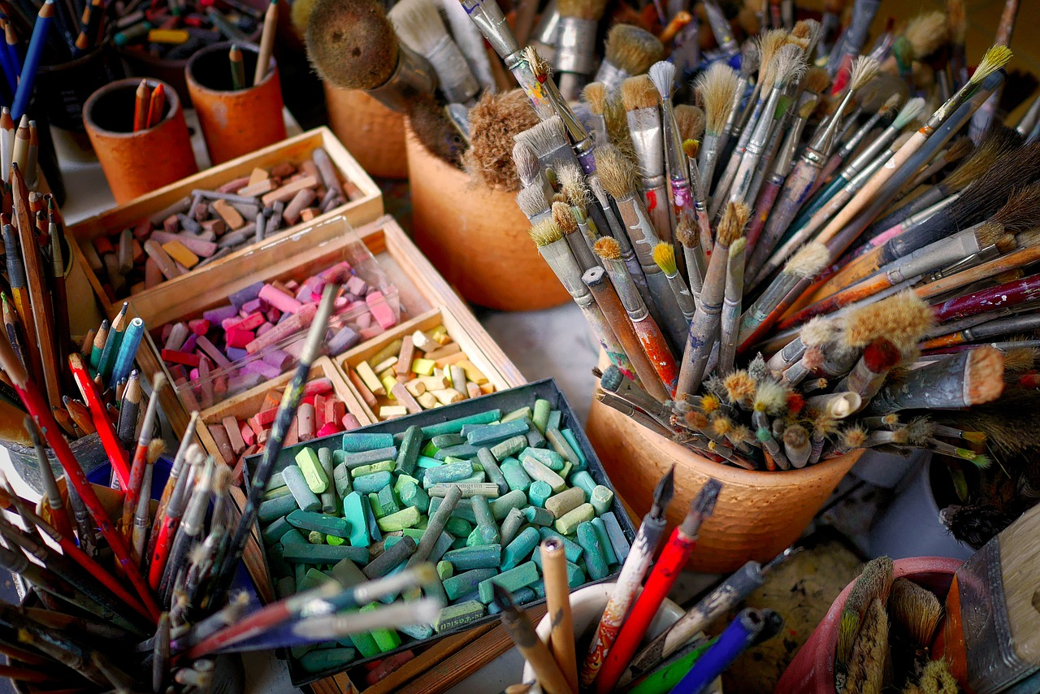
Paragraph Two:
The second paragraph will describe the materials you used to create your work. Also talk about what influenced and inspired you in creating this art.

Slide 14

Paragraph Three:
Describe what feeling or emotion you wanted to invoke with the art piece. What was challenging? What was your personal experience from creating this art? Did you grow as an artist or learn something new?

Slide 15

After brain storming and taking notes….
….you will write a draft of the artist statement, revise, rewrite, and edit.
It is helpful to read the statement aloud or get advice from a peer.

Slide 16

Your artist statement……
What a perfect way to share your vision with the world!!

