Slide 1
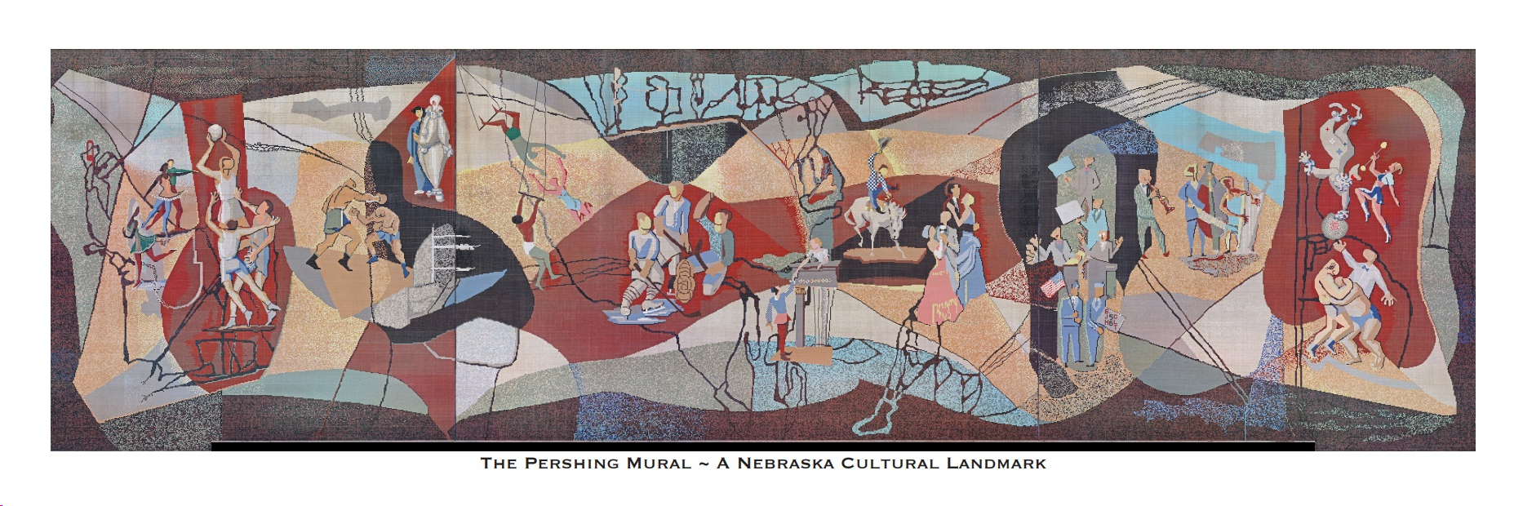
Greetings From
The Pershing Mural!

Slide 2
Hello, we haven’t been properly introduced……..
…..I’m the Pershing Mural!
Glad to meet you!
Do you have time for a chat?

Slide 3
I have been hanging around (literally!) since 1957 in one place or another. I’m really kind of big deal if I say so myself.

Slide 4
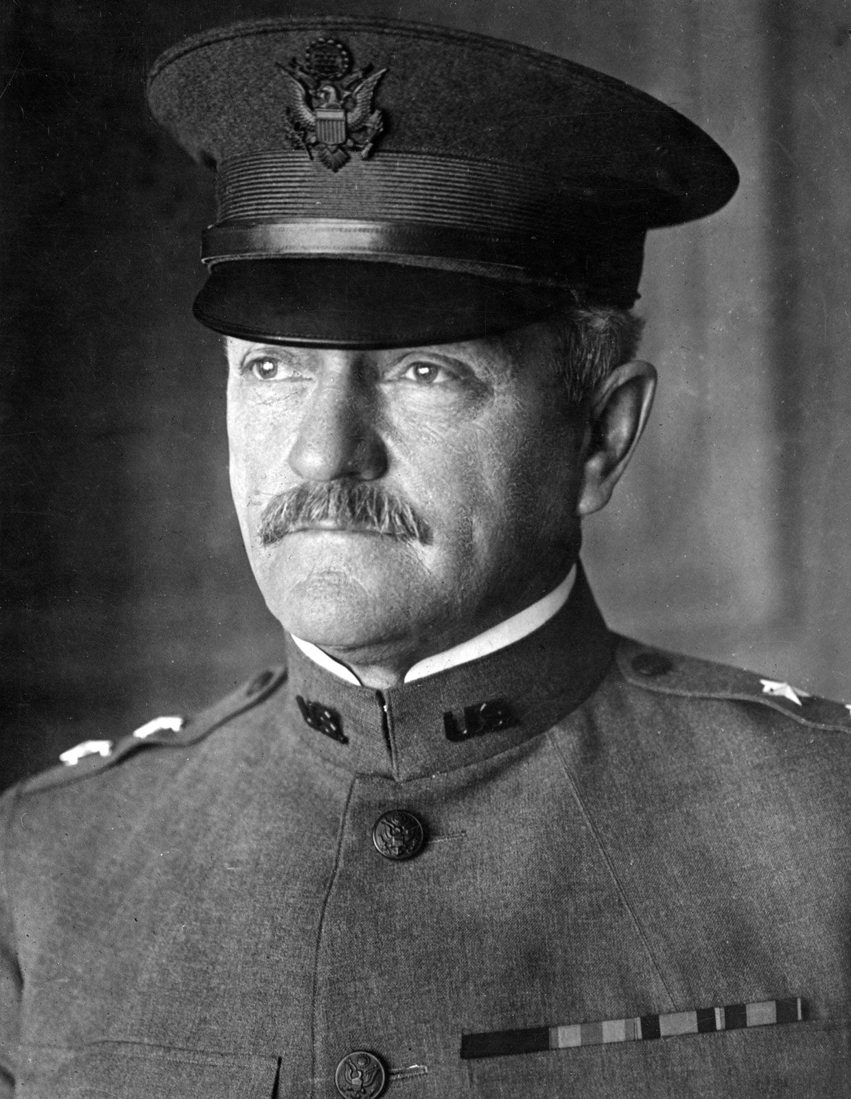
So here is my back story. In the 1950’s the city of Lincoln finally decided they needed a new auditorium and they wanted to make it special.
The “powers that be” decided to name me after General John J. Pershing.
He was the highest ranking military officer EVER and was responsible as commander of the allied army for the victory in WWI.
He also had some great ties to Lincoln.
I was very cool with that!

Slide 5

With a project like me, the motto is “Go Big or Go Home!”
Why not!
Who wants a plain old building like everyone else? So the architects asked, “Why not add some fantastic art in the form of a Mosaic Mural to the west side of the building to make it special?”. That’s where I come in.

Slide 6
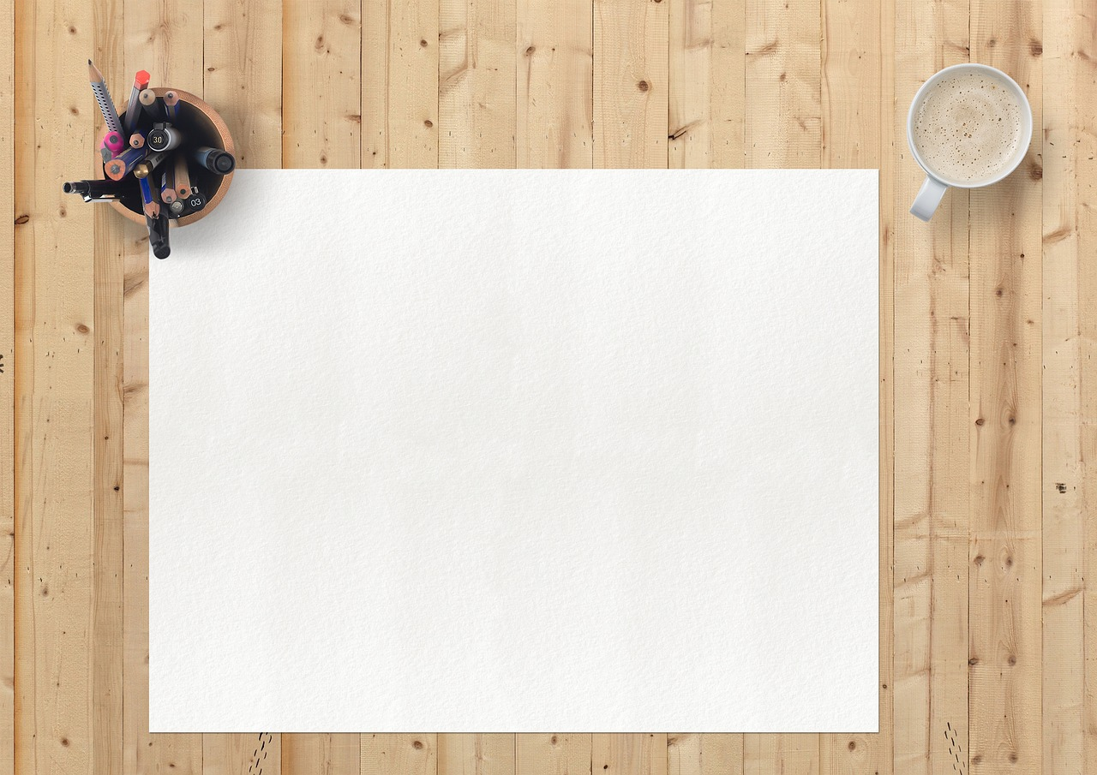
So, famous Nebraska artists and muralists Leonard Thiessen and Bill Hammon were commissioned to design me.
The architects on the project asked the artists to incorporate the many activities that would take place in the Auditorium into my design....
…..and make me a montage ceramic-tile mosaic that would be 38’ high and 140’ long!
When it came to me, they were thinking BIG!!!

Slide 7

Once everyone was happy with my design, off they went to talk with the folks at Cambridge Tile Manufacturing Company of good old Cincinnati, Ohio.
They were pretty excited to be on this project because once completed, I would be the largest tile mosaic ever created!

Slide 8

The largest tile used in my design is about one inch square, with as much as five-eighths of an inch of space left between tiles.
Cambridge had to be careful to use tiles for me that would stand up to the weather and not fade.
Ninety percent of my tiles were unglazed but then they got fancy and put glaze on the other ten percent.
My tiles could shimmer when placed just right and really add to the interest of my art.

Slide 9
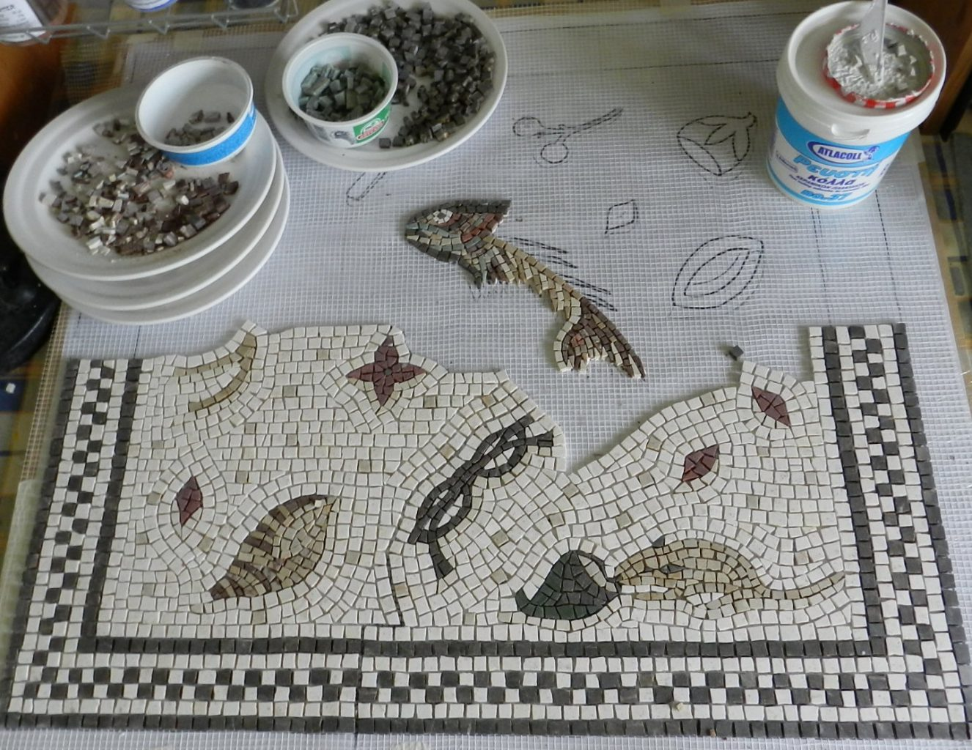
Using the artists’ design, my tiles were assembled in reverse and glued onto sheets of paper.
Then these sheets, most of them 12’ x 24” were applied to about-to-set cement and pressed in.
After my tiles were set, the paper was moistened, the soluble glue loosened, the paper taken off, and the joints grouted. Voila!

Slide 10

This was quick and easy compared to the Renaissance method, which involved a laborious, exacting process often taking years to complete a single work.
SMART!!!!

Slide 11
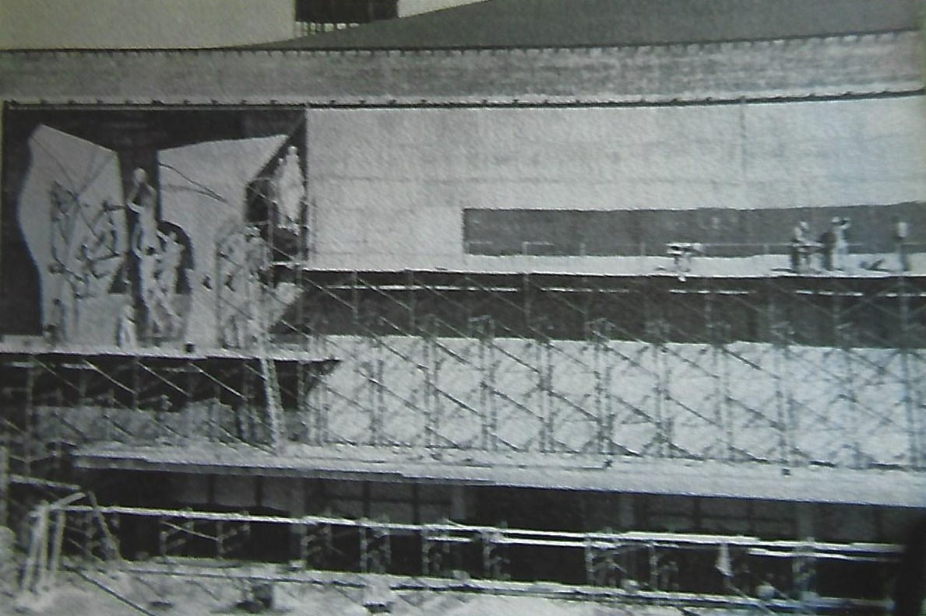
So when it came time to install me on the west side of the Auditorium, it was “easy peasy”……kind of!
By the time I was mounted with more than 760,000 tiles, I weighed a whopping 45 tons or 90,000 pounds!
Remember what I said about “go big or go home”? This is Nebraska, after all! That’s how we do things!

Slide 12
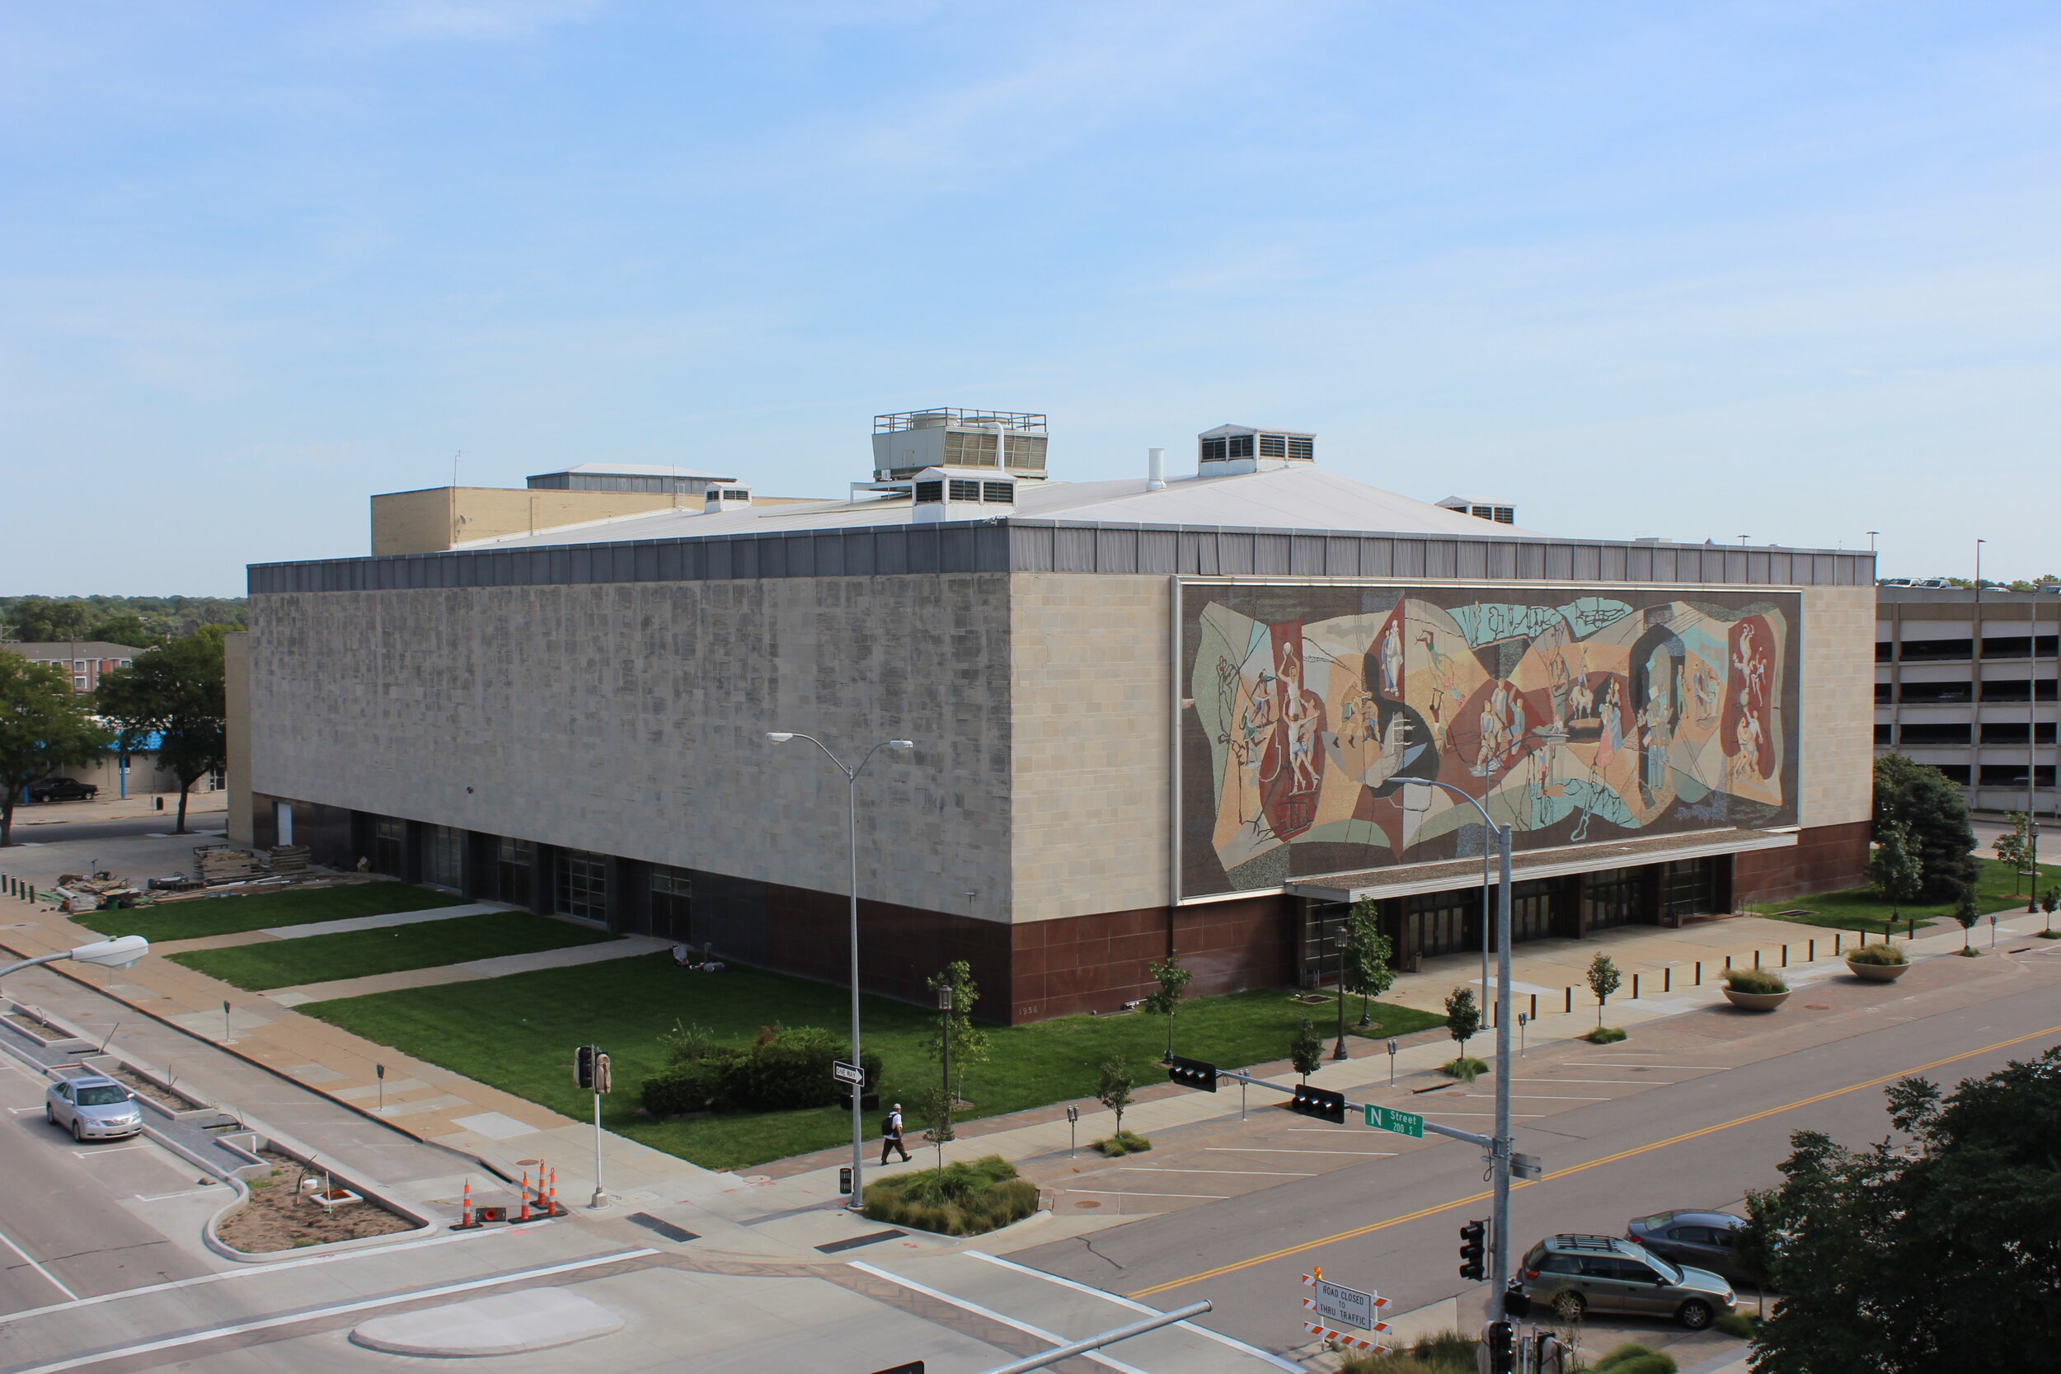
I think I turned out pretty nice, if I do say so myself!

Slide 13
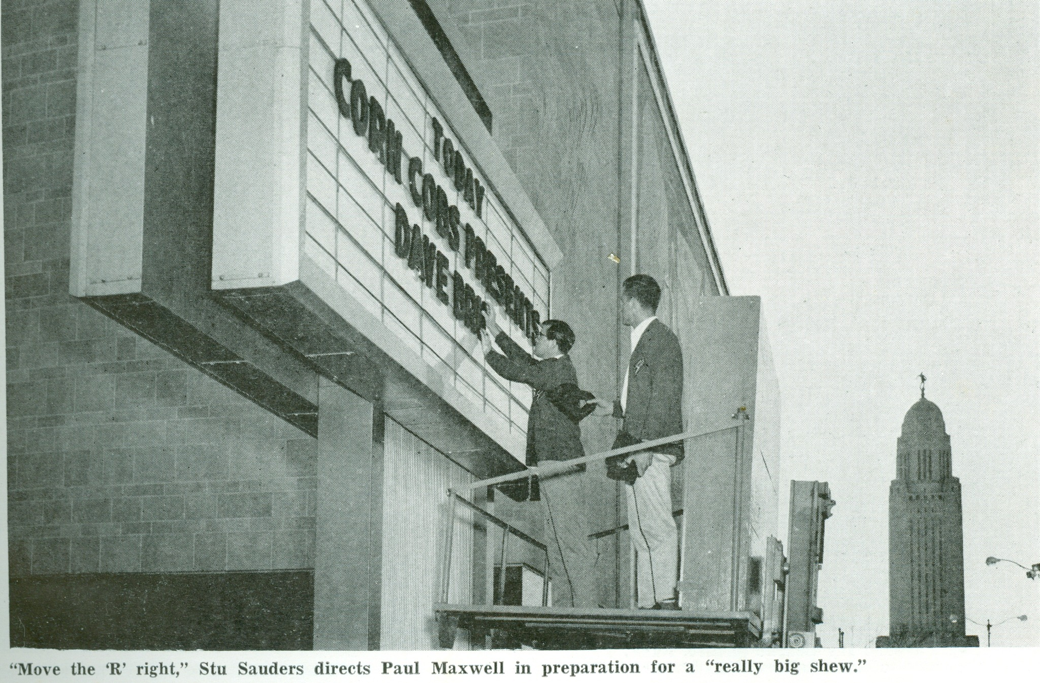
Over the next 57 years, you would not believe everything
I’ve seen.
No lie, the Pershing Auditorium was hopping and everyone walked right past me to be part of the action. I’ve seen it all!

Slide 14
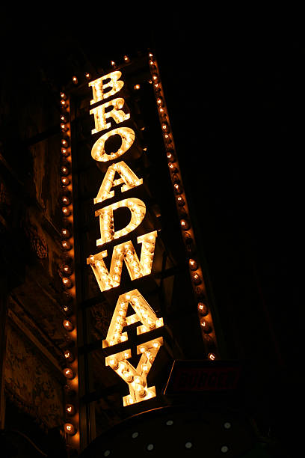
Take for instance the musicals, we delivered!
Annie
Ain’t Misbehavin’
Jesus Christ Super Star
Godspell
No, No, Nanette
Grease
Applause
Two by Two
Company
1776
Mame
Hello, Dolly!
A Chorus Line
We were a regular Broadway!

Slide 15
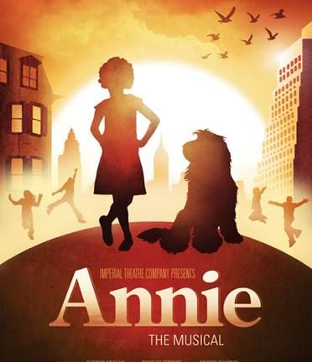


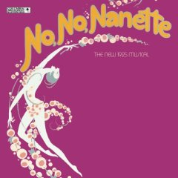
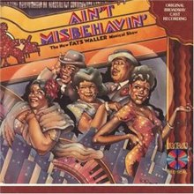
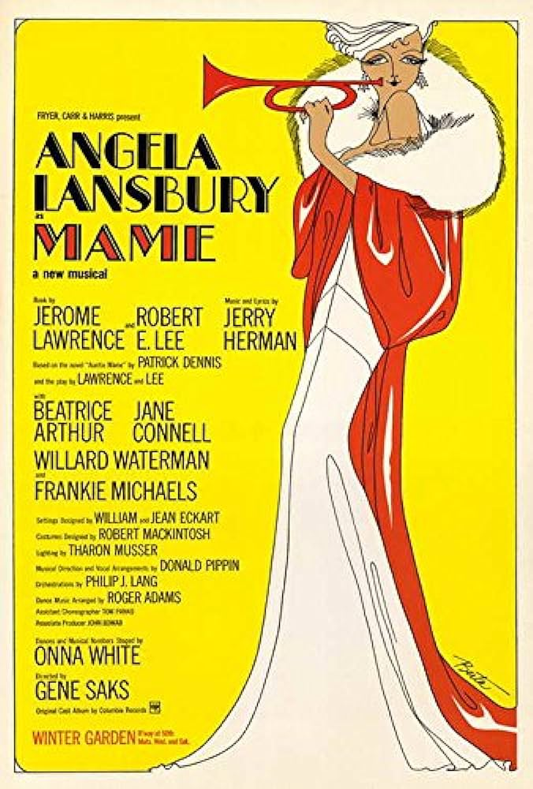
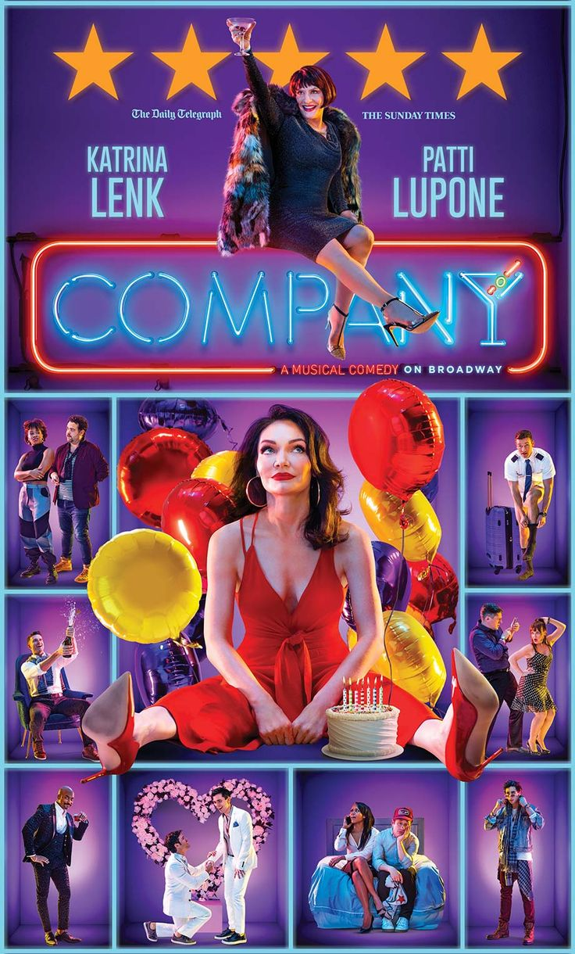
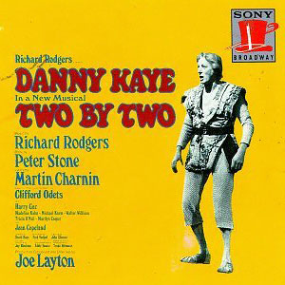
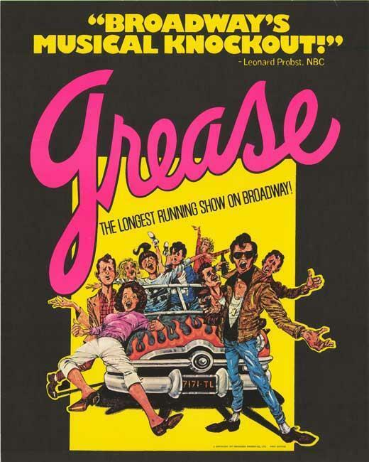
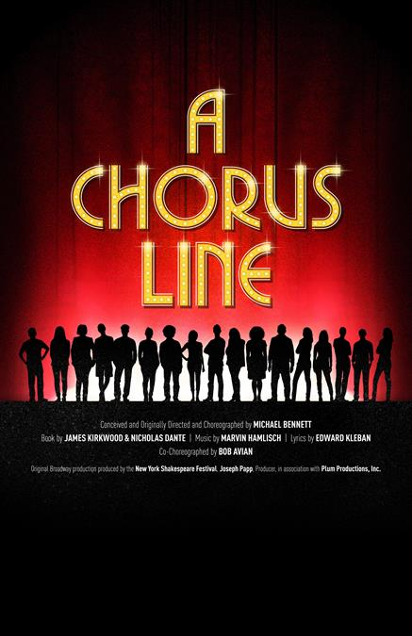
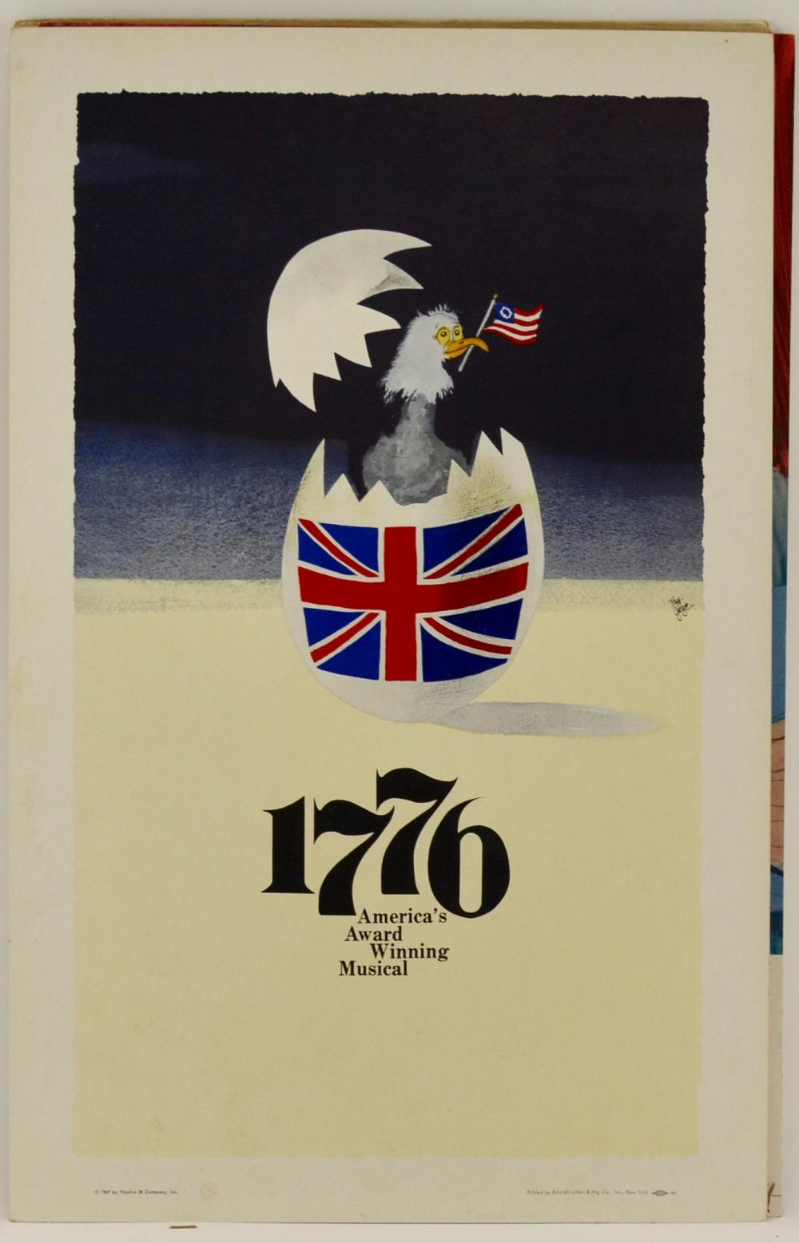

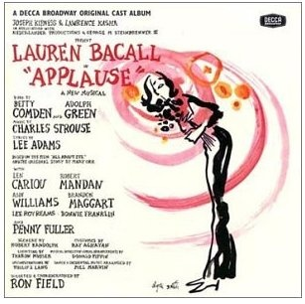

Slide 16
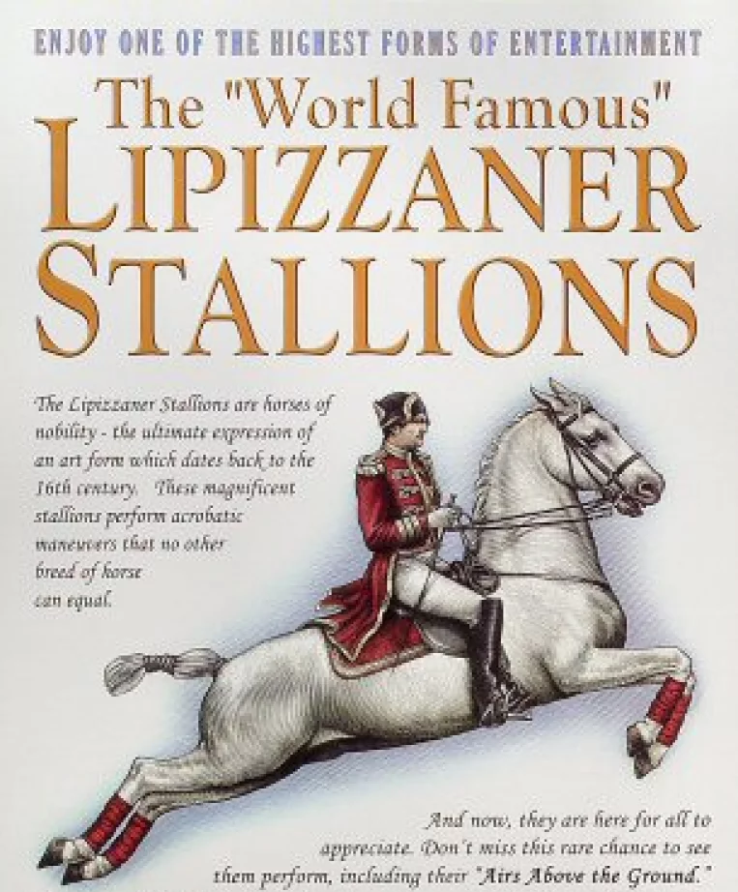

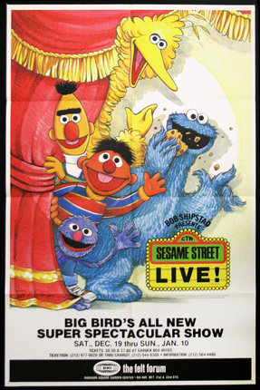
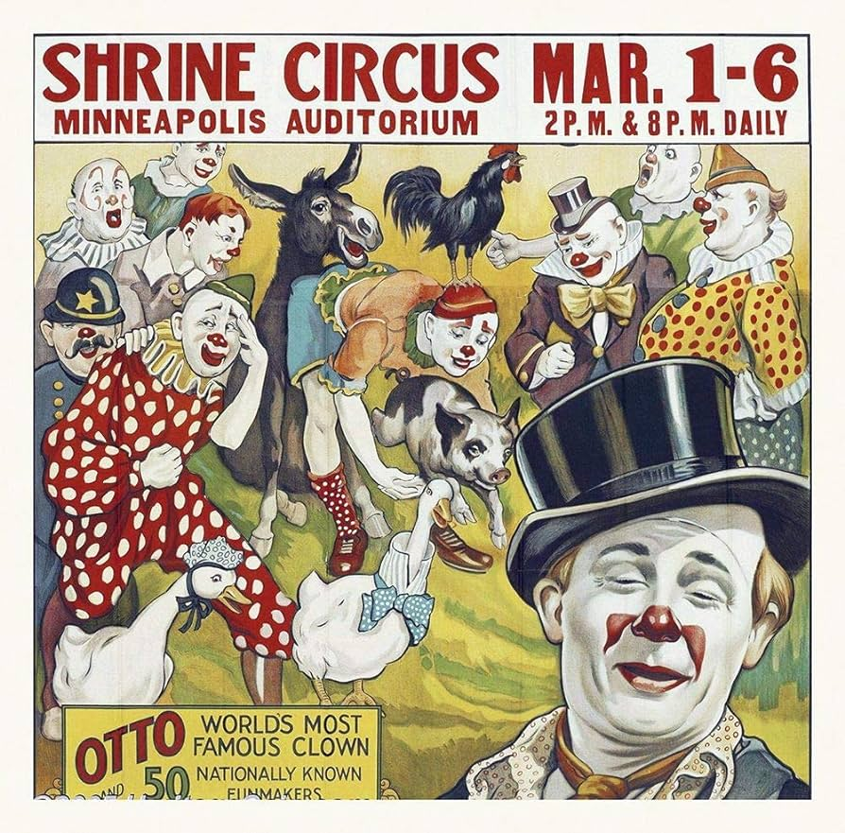
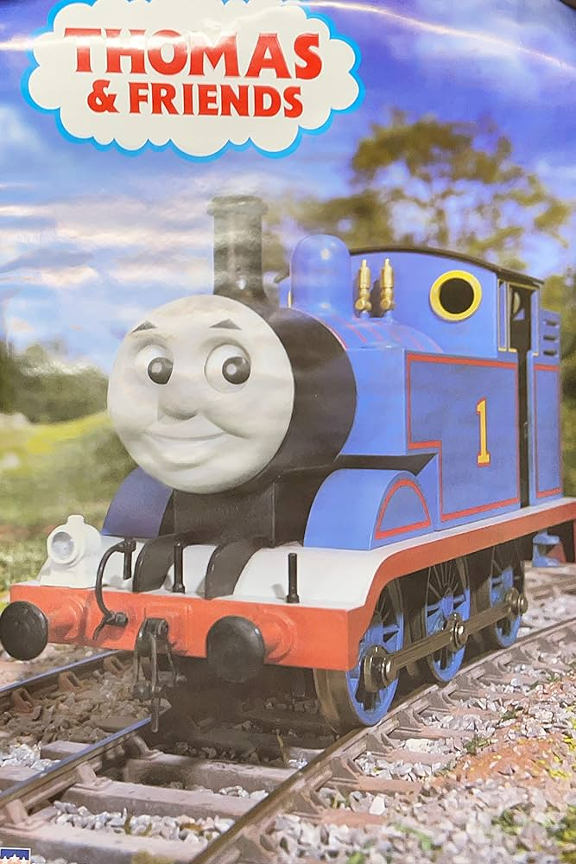
Everyone who walked past me to enter the place gave me a look and a wave. There was so much to see!
The Shrine Circus
Sesame Street Live
Thomas the Train and Friends
Cirque Musica
Lipizzaner Stallions

Slide 17
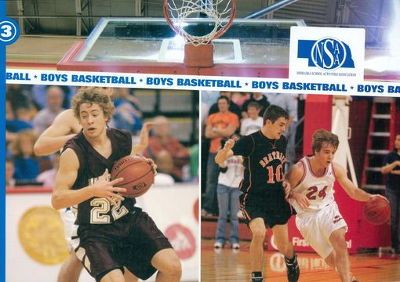
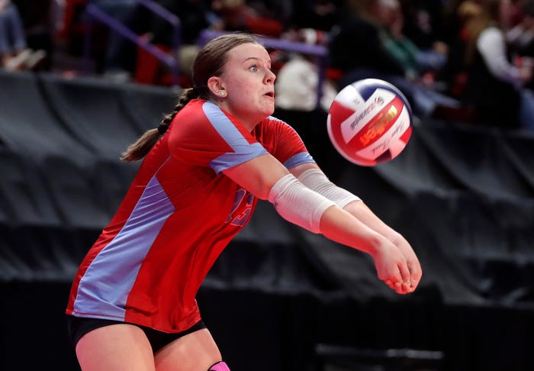
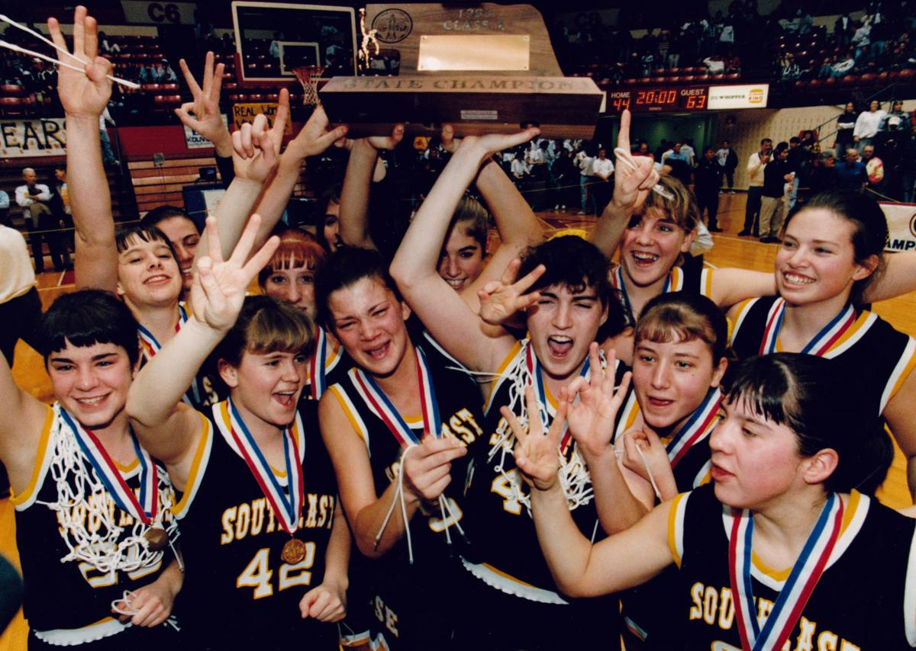

We were a sports center like no other!
NSAA Boys and Girls Basketball Championships
And Girls Volleyball Championships
With NSAA Boys and Girls State Basketball Championship Games
NSAA Girls State Volleyball Championships
Go Team!!!

Slide 18

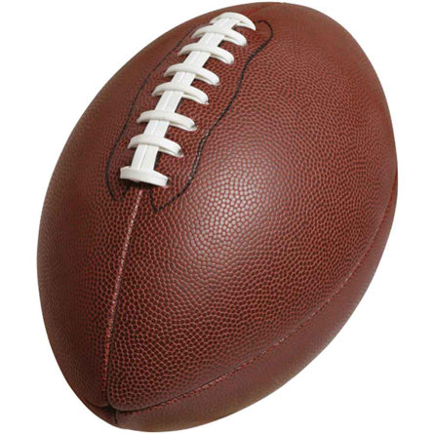
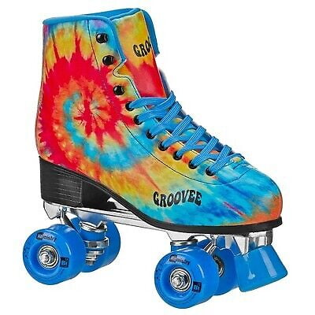
We were home to local semi-pro teams….
Lincoln Capitols NIFL Indoor
Football
Lincoln Thunder ABA Basketball
Lincoln Haymarket Champions
Indoor Football League
No Coast Derby Girls Women’s Flat
Track Derby Association

Slide 19
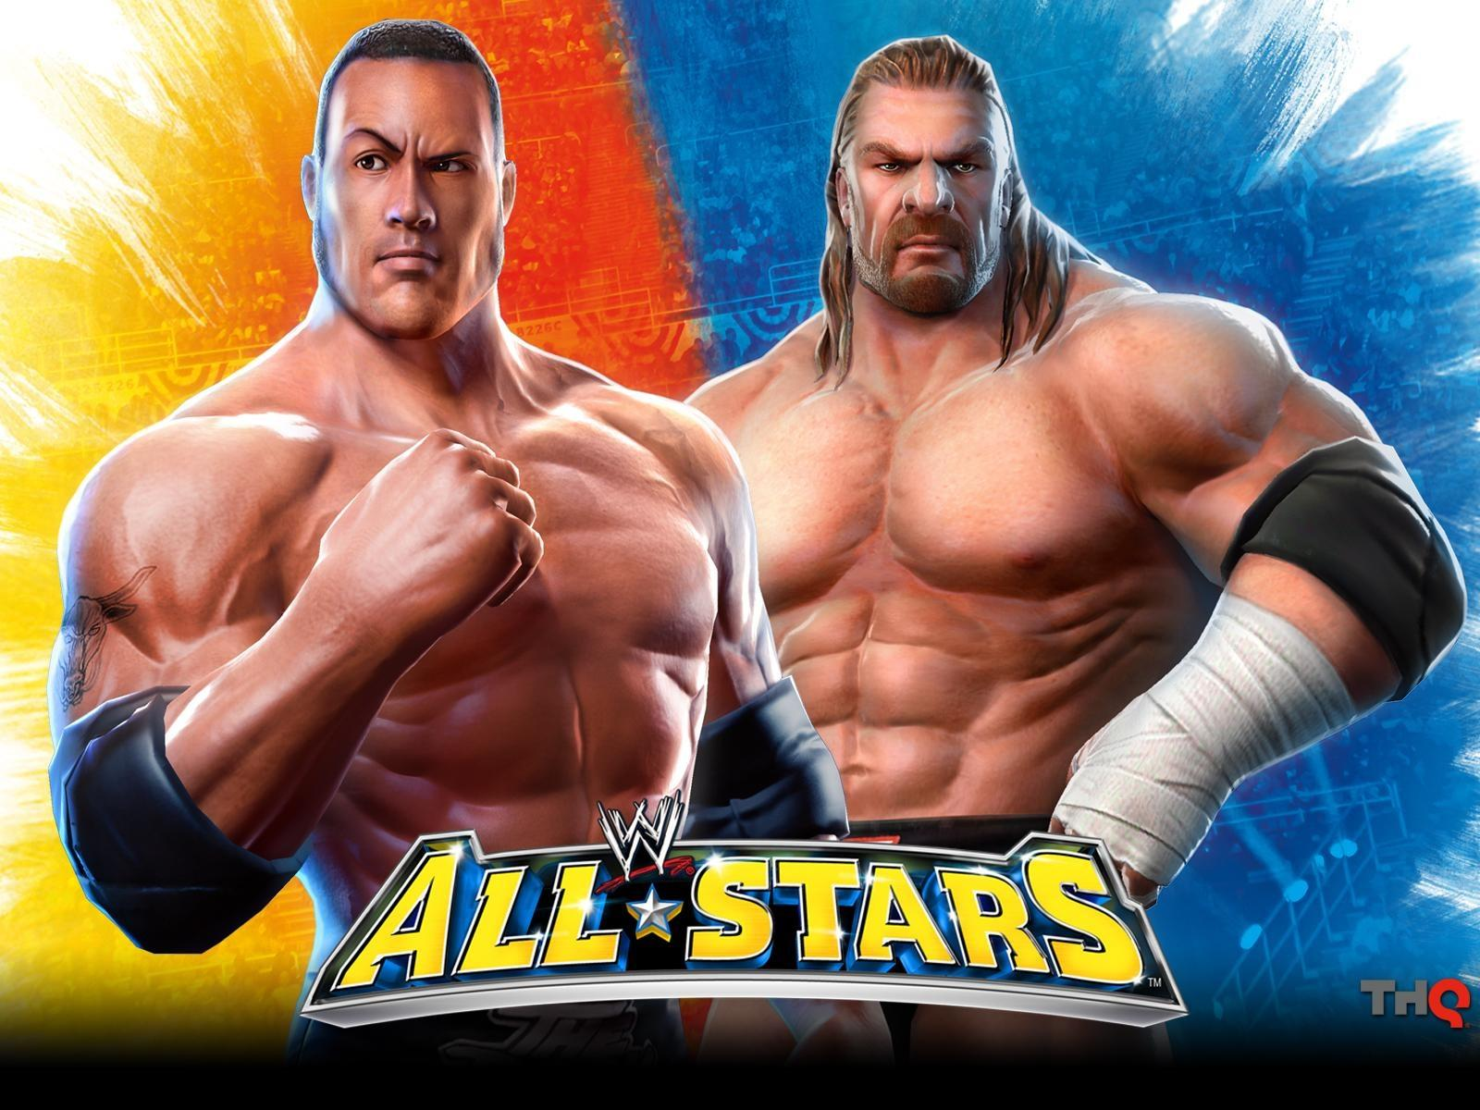
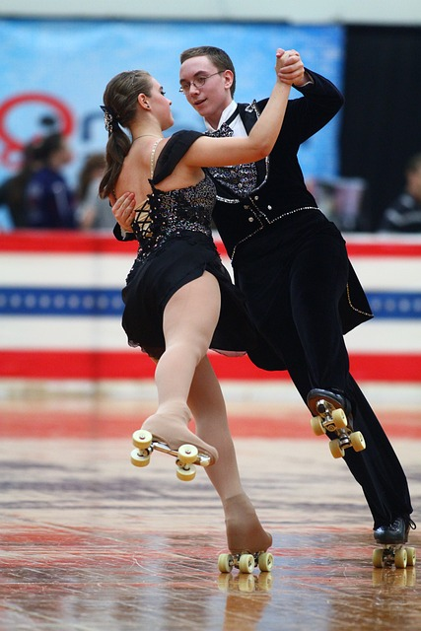
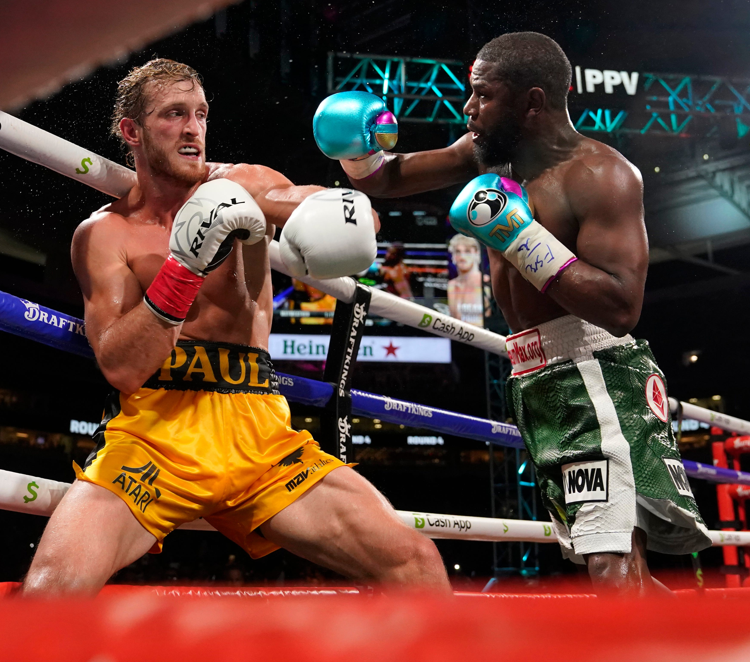
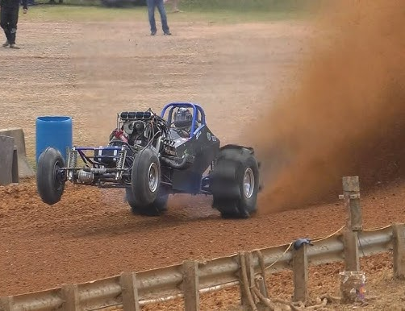
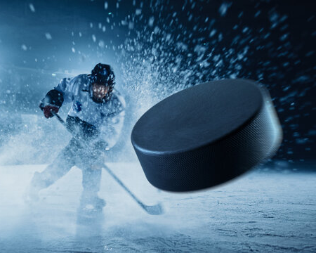
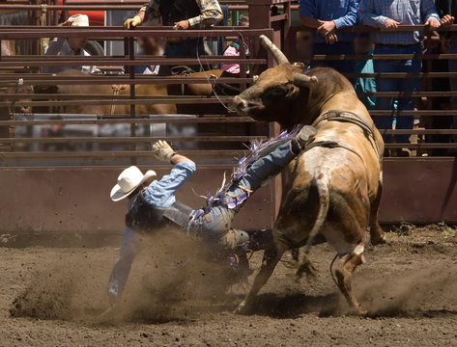
….And some more unconventional sports! Folks came to see the action…..and I was always there to greet them!!
Pro World Wrestling
The National Roller Skating Championships
The World’s Toughest Rodeo
Professional Ice Hockey
Mud Drag Racing
Boxing

Slide 20
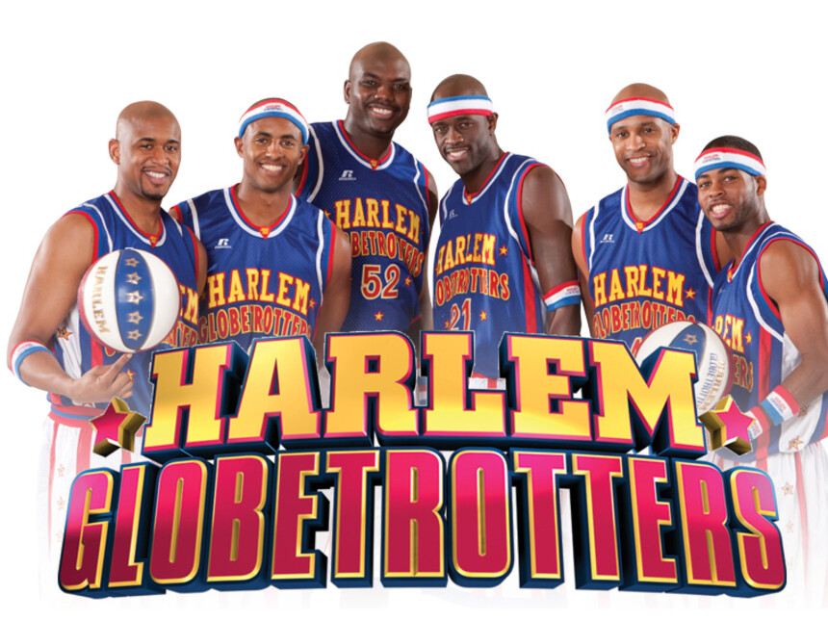
And we were ALWAYS up for the antics of the Harlem Globetrotters who came to visit me often!!!

Slide 21
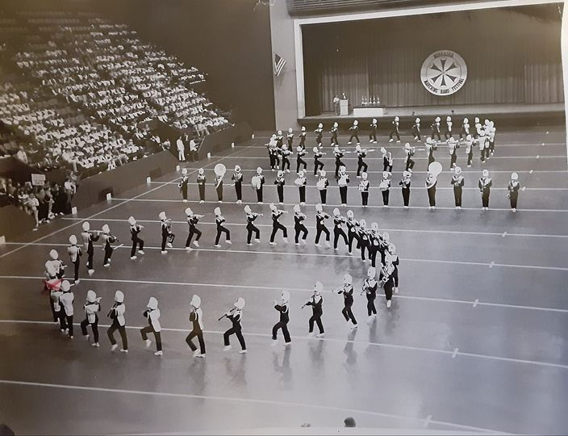
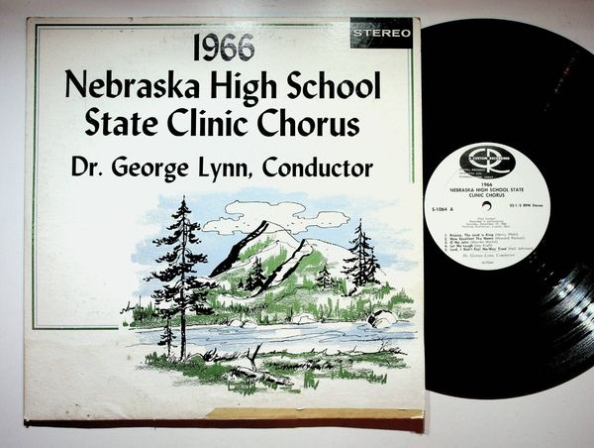
We loved to watch the kids perform in the Nebraska Marching Band Festival and hear them raise their voices in the Nebraska High School State Clinic Chorus.

Slide 22
And as a community, they came for….
Sock Hops
The Annual Square Dance Festival
Public Ice Skating
Czech Heritage Festivals
Lincoln Community Concerts
Business Trade Shows
Ball Room Dancing
Auto Rama Car Shows
Cat Shows
Lincoln Gem and Mineral Club Shows
Star City Symphony Orchestra
Arts and Crafts Festivals
Capitol City Ribfest
Yule Parties
My home was no place to be bored!!!

Slide 23
I had lots of celebrity “friends” stop in for a visit with me and to entertain my friends. Not to be a name dropper, but a few of my closest friends included:
ZZ Top
Goo Goo Dolls
The Lumineers
The Oak Ridge Boys
Three Dog Night
Celtic Thunder
Larry the Cable Guy
Marilyn Manson
Blake Shelton
Miranda Lambert
Justin Moore
Jeff Dunham
Jason Aldean
Jake Owens
Doobie Brothers
Arlo Guthrie
Zach Brown Band
Flo Rida
John Cougar
Kelly Clarkson
Poison
Trace Adkins
Sugarland
Pink Floyd
Oak Ridge Boys
Billy Currington
Bob Dylan
Billy Joel
Rascal Flatts
Brad Paisley
Rod Steward
Frank Zappa
Ludacris
Grateful Dead
50 Cent
Moody Blues
Crosby, Stills, Nash
Styx
James Taylor
Nelly
Destiny’s Child
Kenny Chesney
Lee Ann Womack
REO Speed Wagon
Creed
Martina McBride
CCR
Bread
Ozzy Osbourne
Nine Inch Nails
REM
Alice Cooper
Beastie Boys
Cheap Trick
Joan Jett
Adam Ant
Neil Young
Pat Benator
Fleetwood Mac
Blue Oyster Cult
Van Halen
AC/DC
The Doors
Jefferson Starship
Jimmy Buffet
Black Sabbath
Boston
Uriah Heap
Kansas
Chicago
Aerosmith
Lynrd Skynrd
Jethro Tull
America
Gordan Lightfoot
Beach Boys
Deep Purple
Snoop Dogg

Slide 24
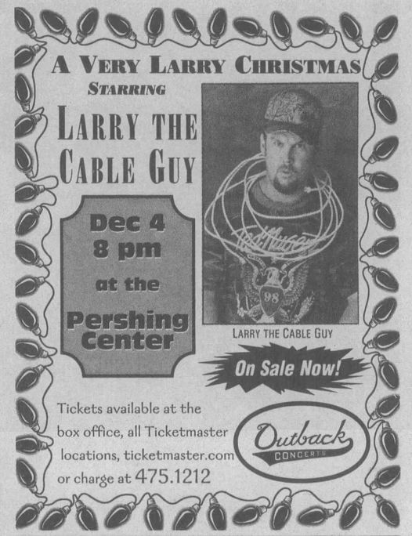
Larry knows how to Git ‘er Done!
My good bud, Nebraska-raised Dan Whitney,
AKA Larry the Cable Guy,
dropped in several times. He had ‘em rolling in the aisles!

Slide 25
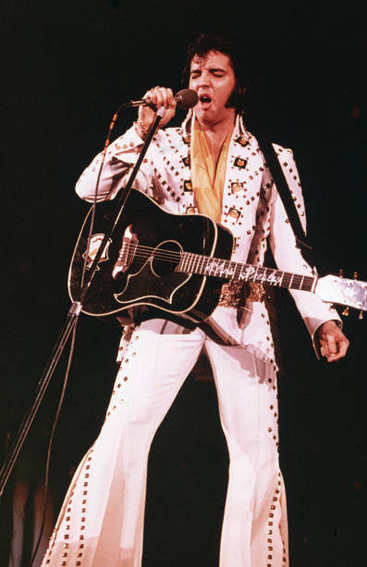
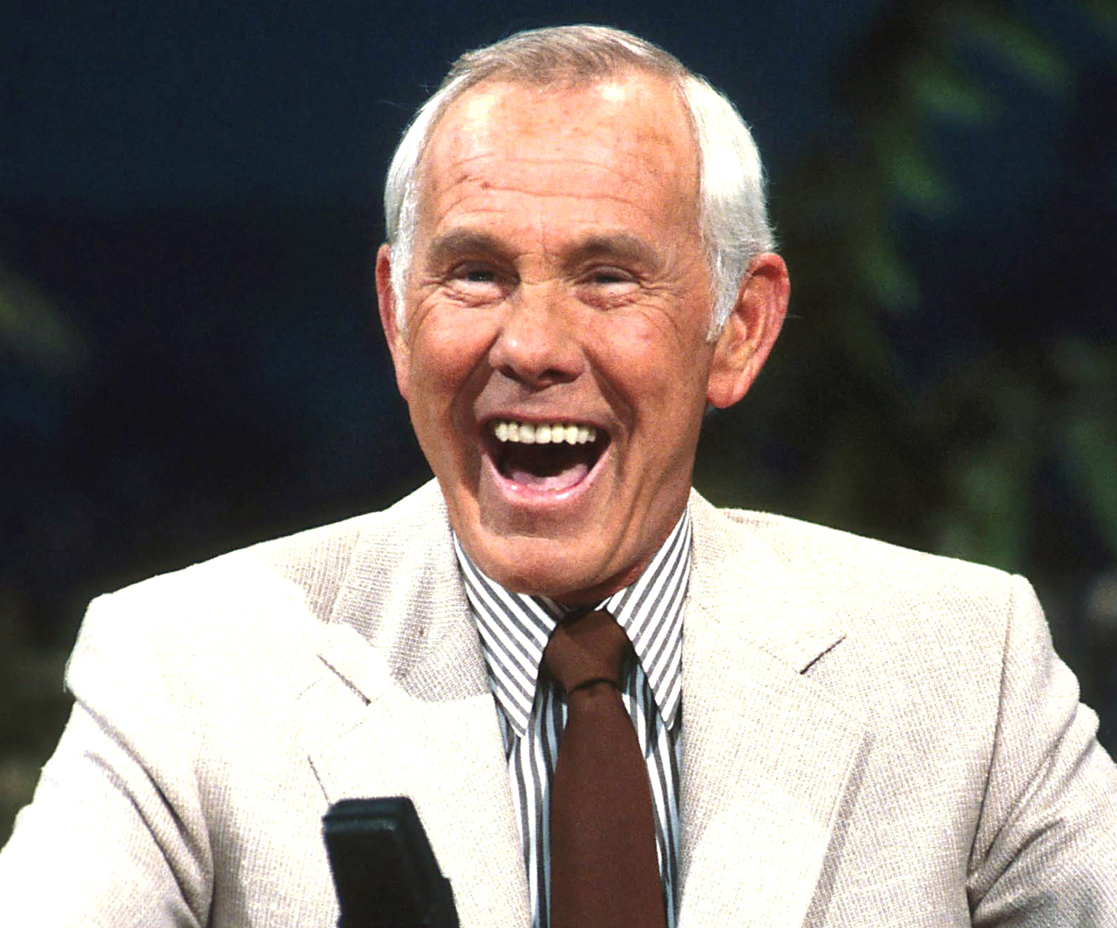
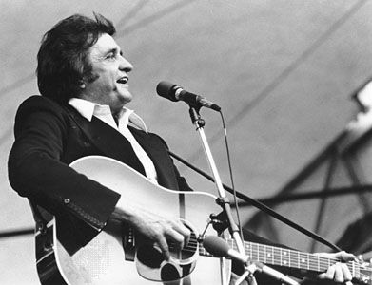
And three of my closest “peeps” who hung out with me were….
Johnny Carson, Johnny Cash, and Elvis Presley

Slide 26
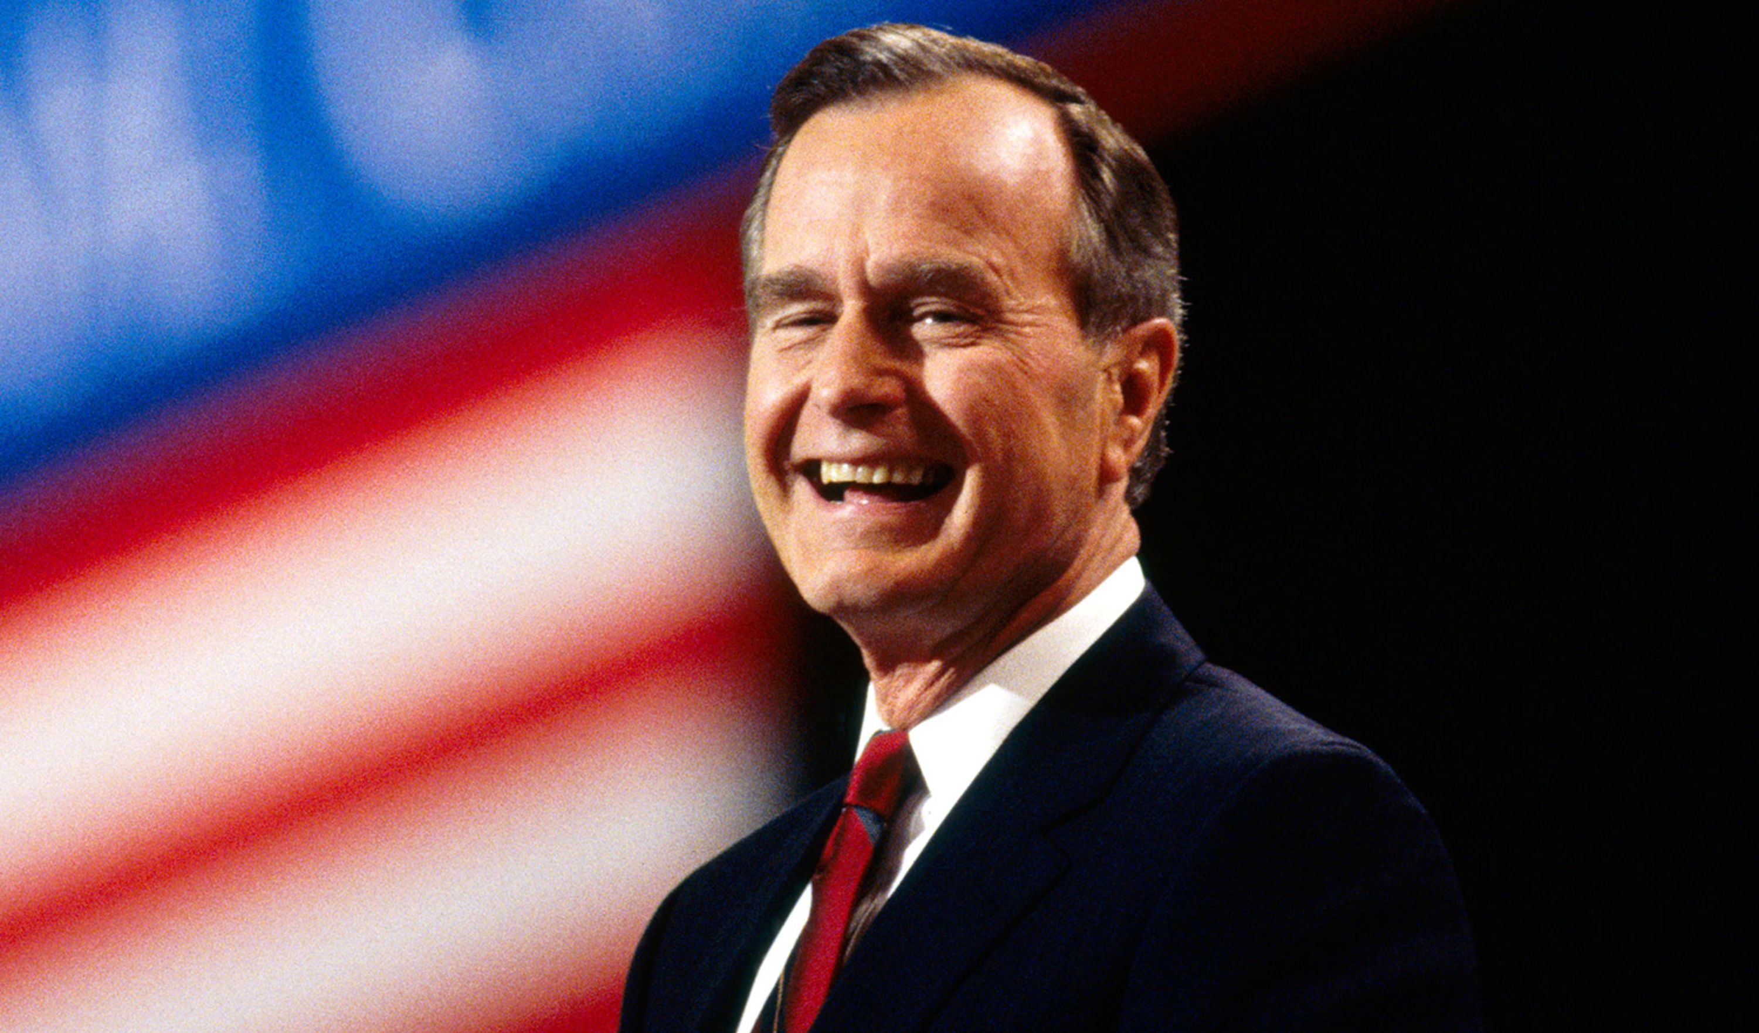
We even had a future President pop in for a visit in 1981.
Hello, George H. W. Bush!

Slide 27
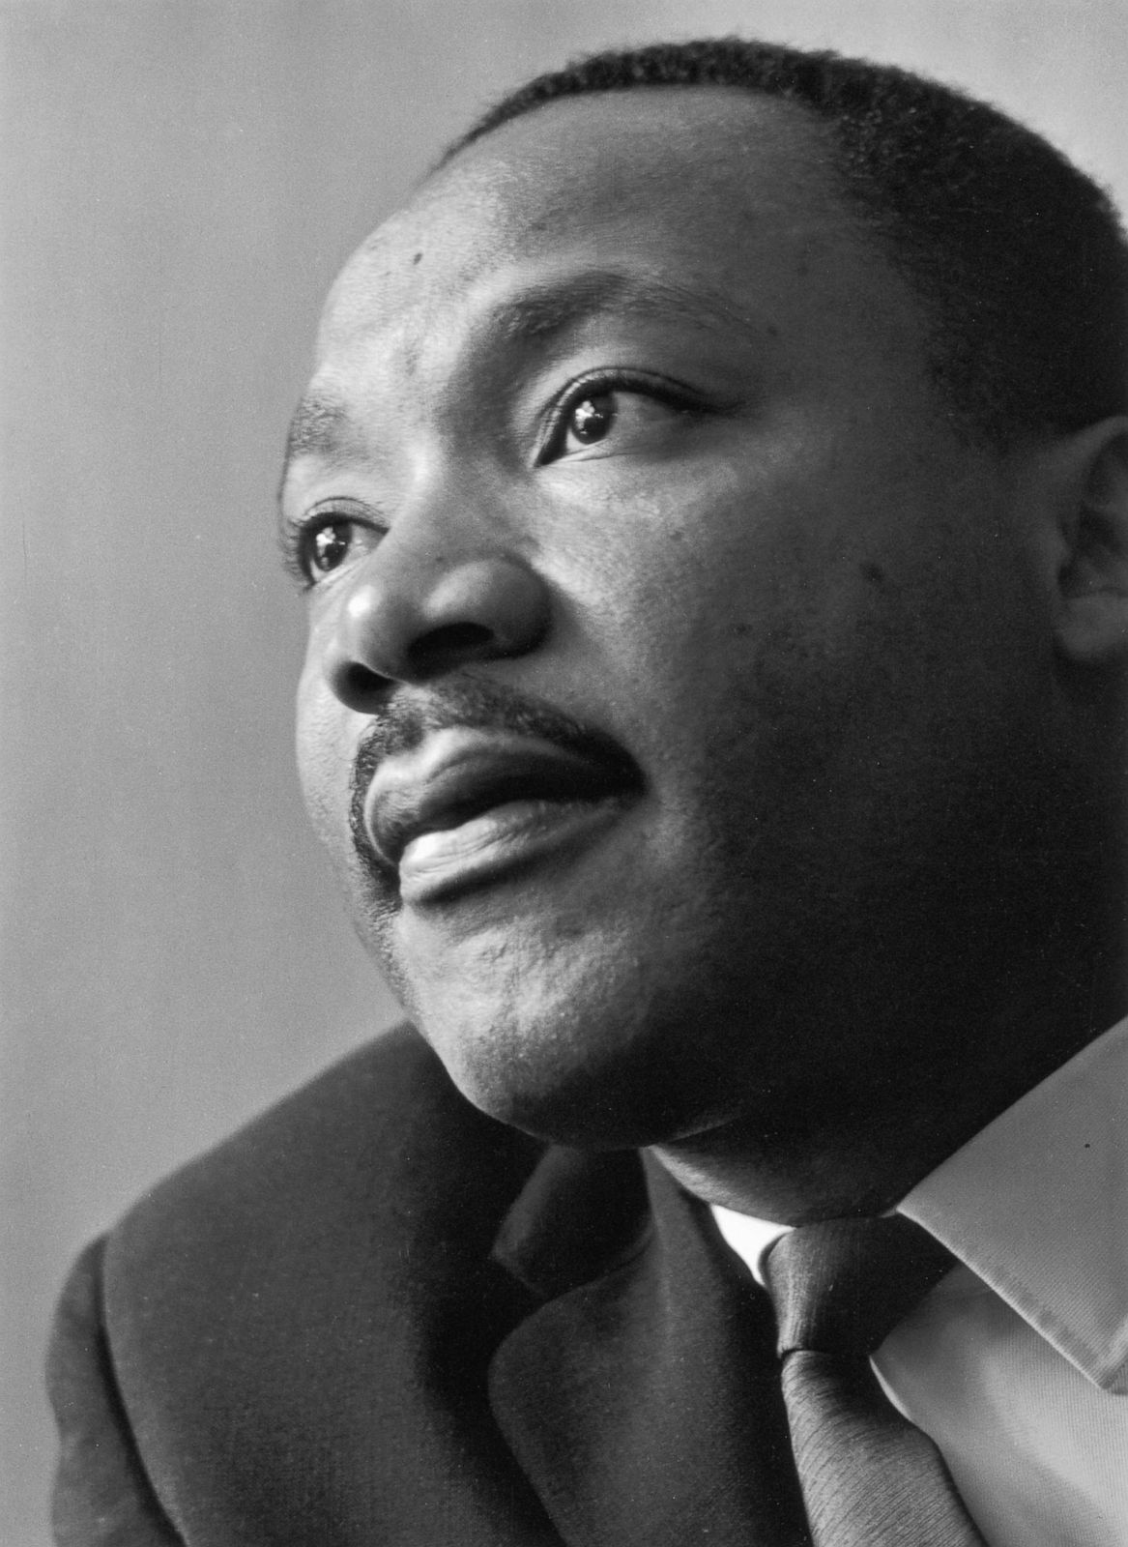
But I think I was most moved by a visit from MLK.
On December 30th, 1964, Martin Luther King, Jr. visited Lincoln and spoke at the Methodist Student Movement Conference at Pershing Auditorium.

Slide 28
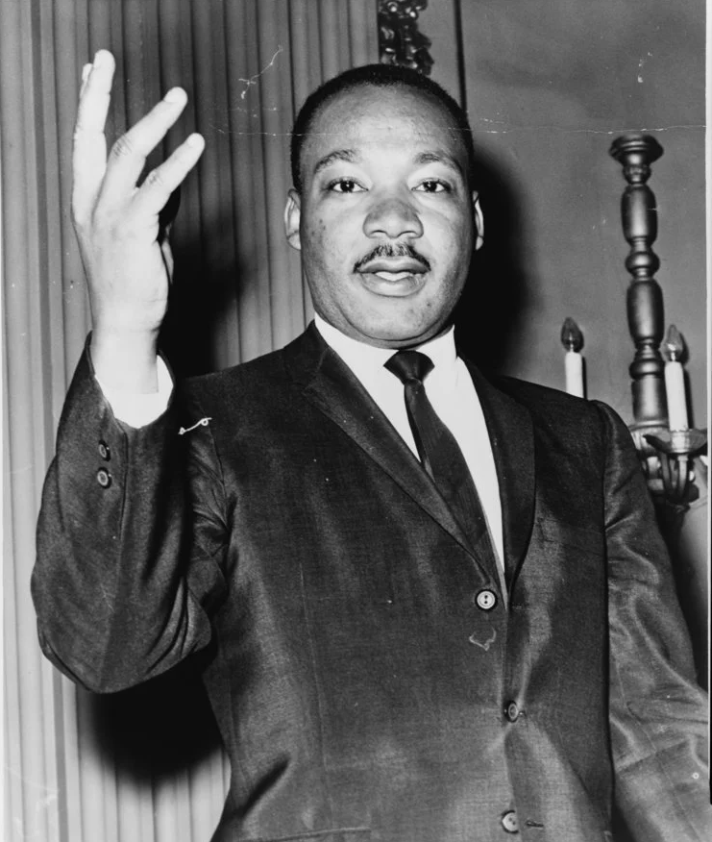
Approximately 5,000 people were in attendance to hear King’s speech, titled “Christian Responsibility in the Racial Revolution.”
“We must all learn to live together as brothers or we will all perish together as fools. This is a great challenge facing our nation and our world today. No nation can live alone. No individual can live alone.”

Slide 29
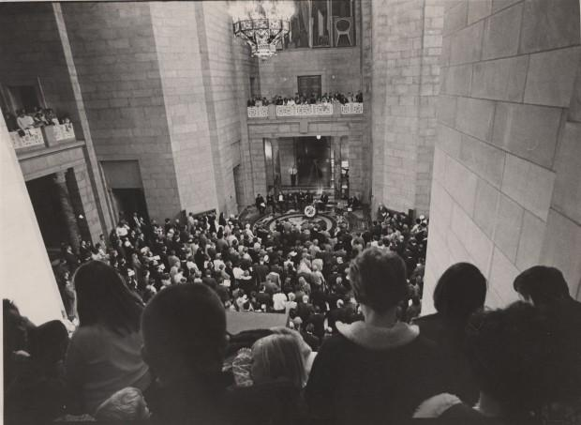
A little over three months later this great man would fall from an assassin’s bullet.
The State Capitol Rotunda was full of mourners. I mourned with them from a distance.

Slide 30

Through all the games and concerts and activities, I faithfully guarded over my domain until in 2014, the doors to the Auditorium were locked for good and I was left alone to watch as my community passed me by.
Long, lonely years I waited to learn my fate when it was decided my home at Pershing Auditorium was to be demolished in 2023.
It wasn’t looking good for me, even though I had been a landmark everyone looked up to for all those years!!!

Slide 31
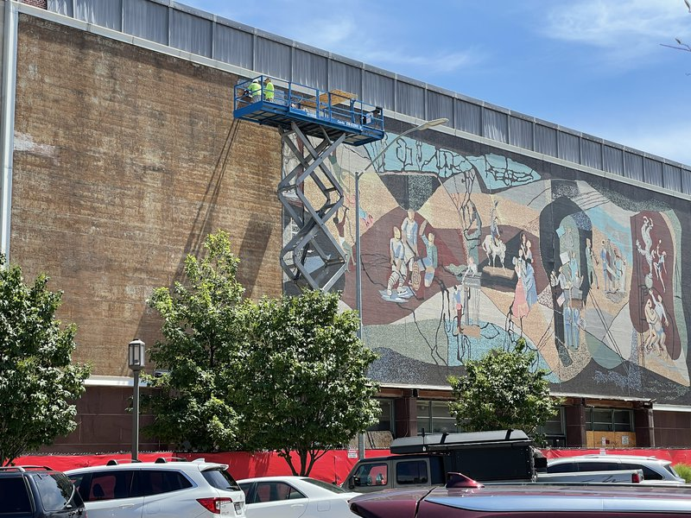
Thank goodness my friends remembered I was special and formed the Pershing Mural Preservation Committee! They saved my bacon!
In the nick of time, my friends raised the funds to save and carefully remove me from the building!

Slide 32
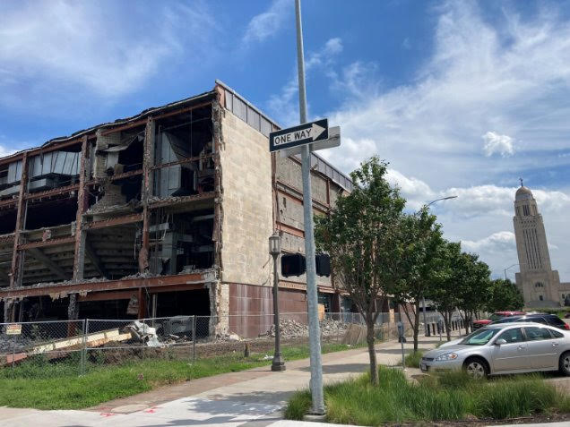
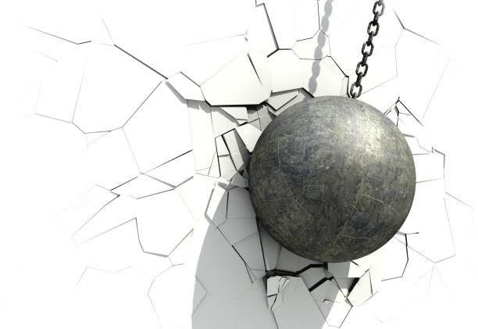
A short time later the Pershing Auditorium was history but I was safe!

Slide 33
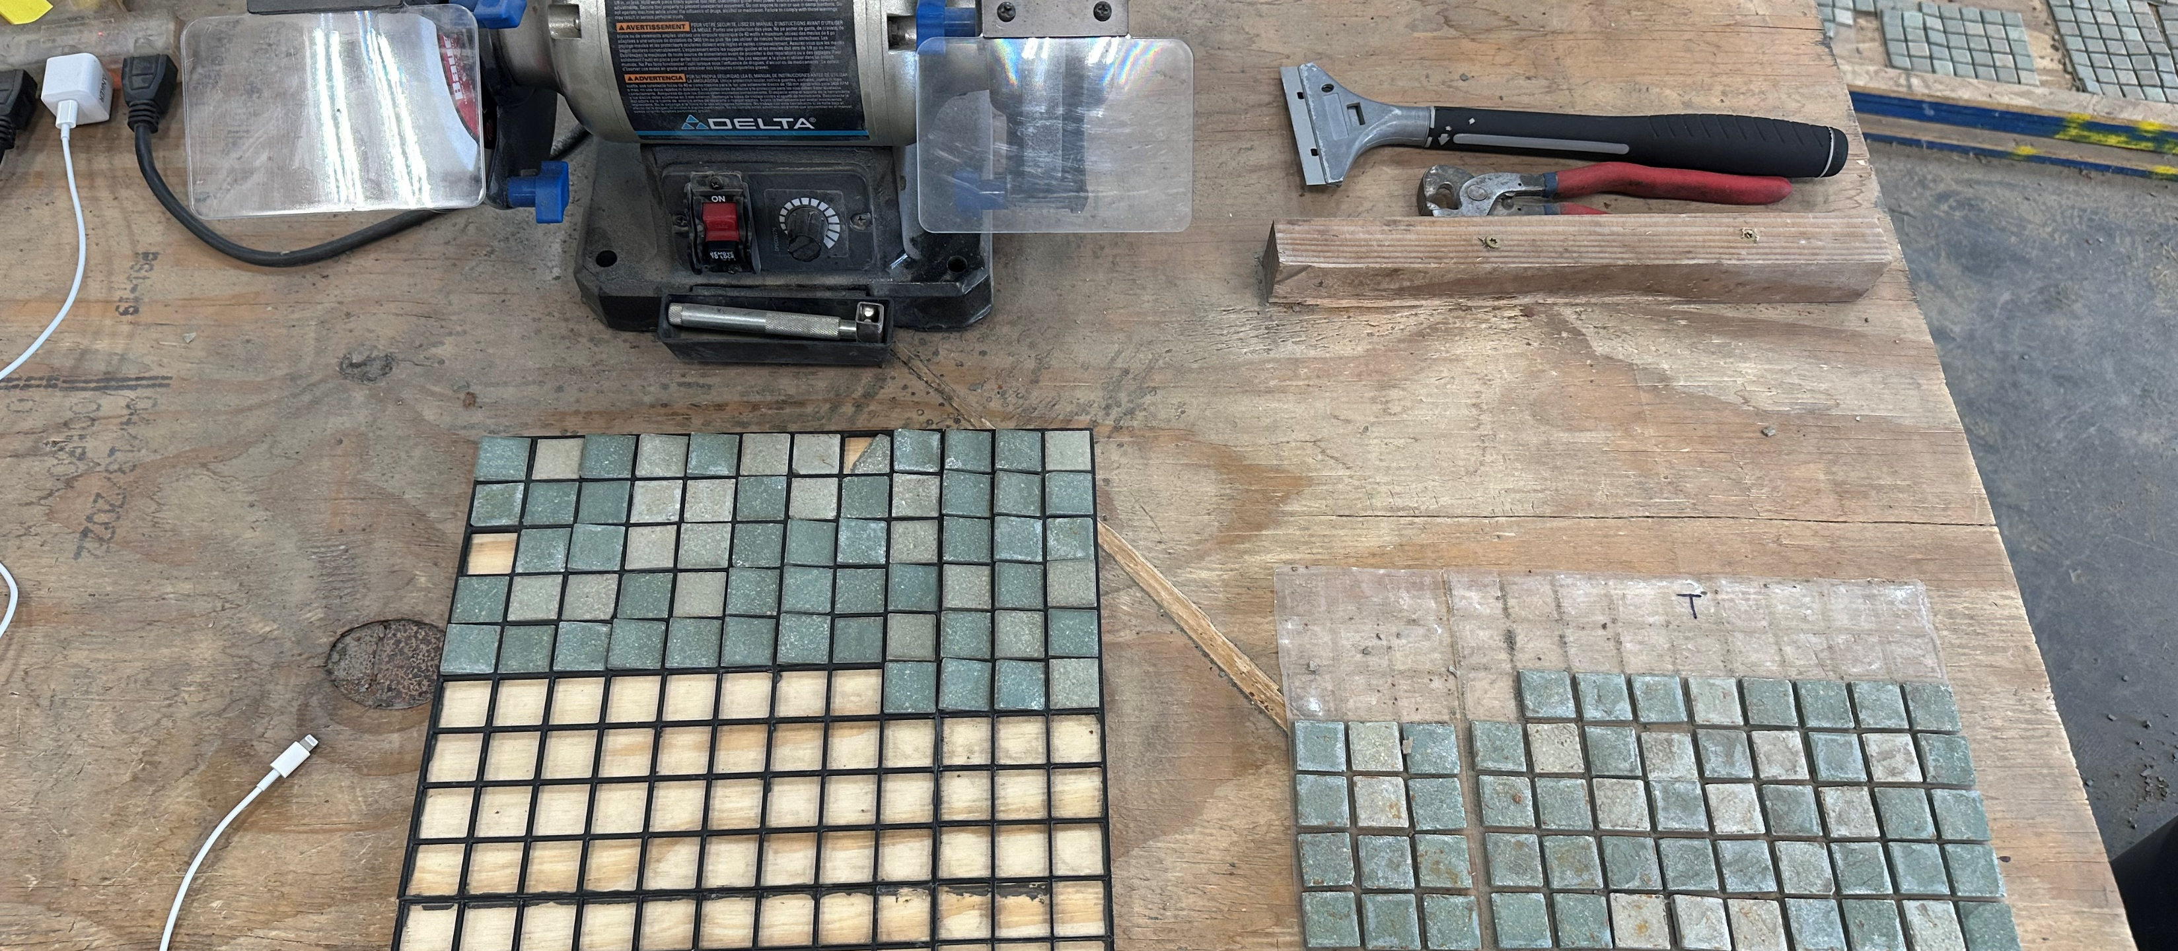
I was moved to storage where I was carefully cleaned and numbered.
It felt so good to get all those years of grime removed!!

Slide 34
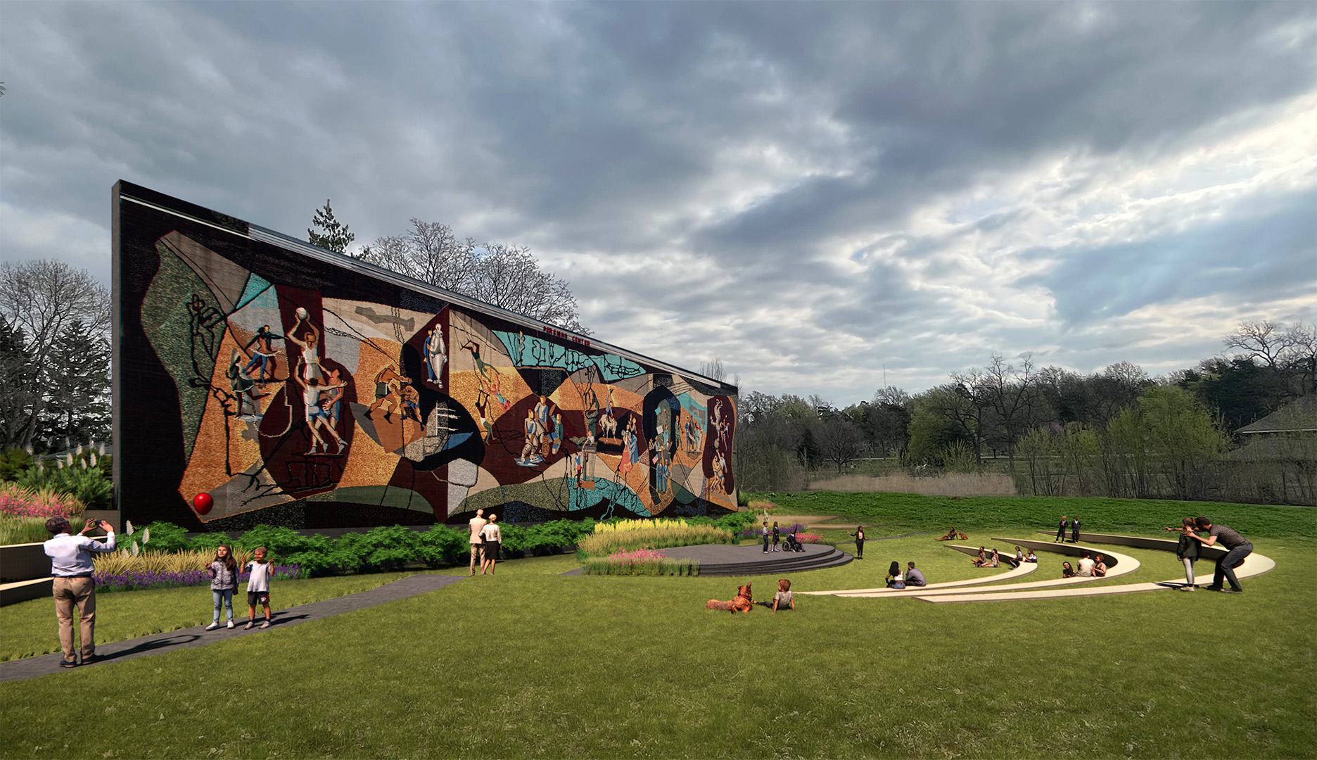
When I am installed at my new home, I will be surrounded by all my friends again!

Slide 35
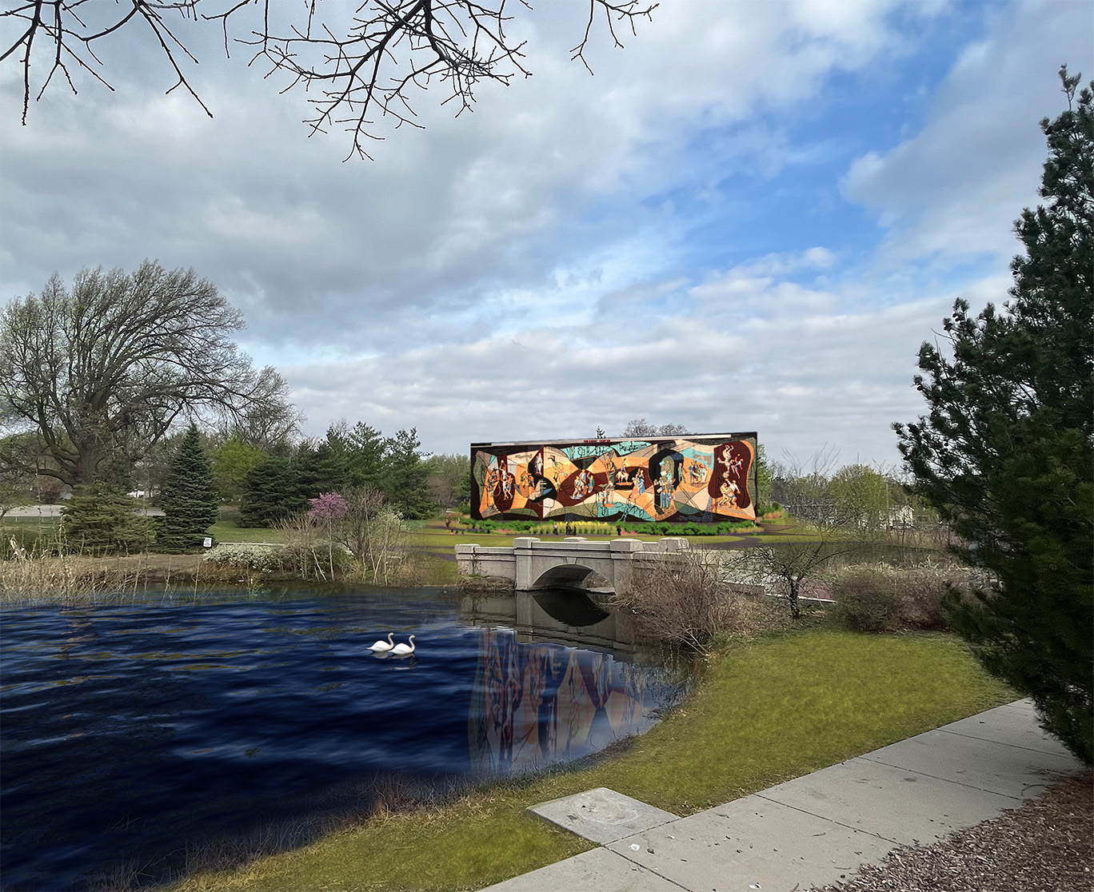







It will be so nice to be part of the action again! Please come see me soon so we can have a nice visit!
We have a lot of catching up
to do!!

