Slide 1
Pershing Mural
Creating Didactic Cinquain Poems

Slide 2

“A really perfect poem has an infinitely small vocabulary”—Jack Spicer
You are going to write a poem using only eleven words!!!!

Slide 3

First, what exactly is a “Didactic Cinquain?”
Pronounced Sin Cane, this poetry form dictates both the number of words per line and the types of words used in each line.

Slide 4

The Didactic Cinquain is a poem that consists of only eleven words.
This form is inspired by the ancient poetic forms of Japanese Tanka and Haiku.

Slide 5
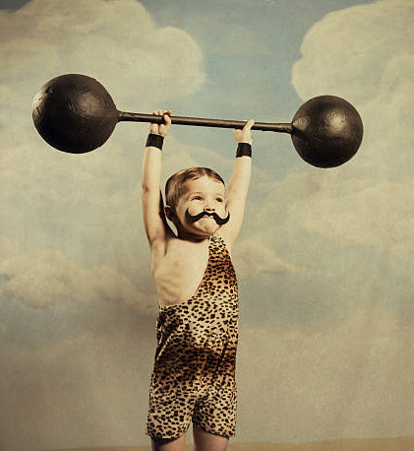
Cinquains focus on what you, as the poet, see and feel and experience.
Didactic Cinquains can be very powerful despite being so small!

Slide 6

Here is an example:
dog
happy, playful
chasing, running, jumping
tail doesn’t stop wagging
friend

Slide 7

Let’s review the parts of a Didactic Cinquain:
Line 1: One noun
Line 2: Two adjectives
Line 3: Three “–ing” words (verbs)
Line 4: Four feeling words (or a feeling phrase with four words)
Line 5: Another word for the noun

Slide 8
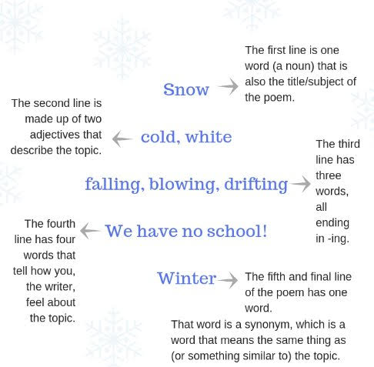
Here is a good example of a Didactic Cinquain about snow,
With a reminder of what the words in each line do.

Slide 9
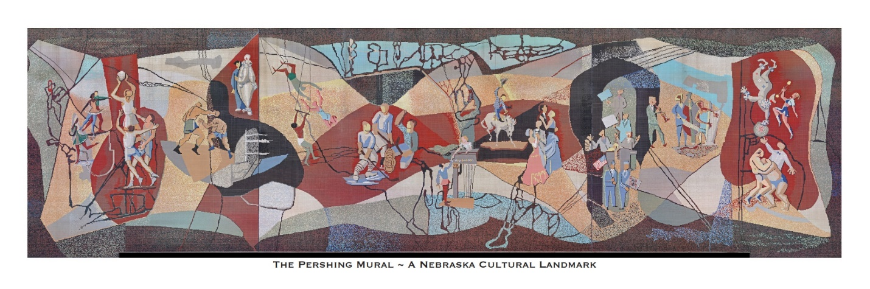
Study the Pershing Mural to see what interests you as the subject for your poem.
Let’s get started!
Brainstorm! Jot down any words, phrases
or brief thoughts that come to mind as you consider the Mural.

Slide 10

Once you have your list, get organized!!

Slide 11

First, choose a noun for your title.
What will it be?

Slide 12

A Noun is a Person, Place, or Thing!
Friend
Rider
Brother Clown
Teacher Athlete
Dancer
Singer
Actor
Barista
Chef
Plumber
President
Parent
Skater
Acrobat
Artist
Writer
Grandma
Home
Circus
School
Playground
Tent
Park
Rink
Court
Stage
City
Store
Cabin
Lake
Mountain
Capitol
Lincoln
Kitchen
Street
Hospital
Horse
Bicycle
Computer
Ball
Apple
Book
Letter
Cup
Television
Tutu
Shoe
Rope
Handle
Star
Light
Sun
Cloud
Tree
Snow
What noun do you
Want to use to start
Your poem?

Slide 13
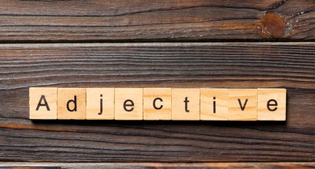
Now think of Adjectives: They give more information about a noun
Soft
Cuddly
Prickly
Sharp
Hard
Lazy
Fast
Attractive
Bald
Plain
Chubby
Clean
Dazzling
Drab
Elegant
Fancy
Fit
Flabby
Long
Witty
Wicked
Confusing
Rich
Hairy
Strange
Smart
Grumpy
Helpful
Graceful
Scary
Safe
Stiff
Muscular
Dainty
Royal
Arrogant
Efficient
Youthful
Fickle
Mild
Expensive
Rude
Huge
Generous
Courageous
Zany
Round
Unselfish
Which two adjectives describe the subject of our poem?

Slide 14

Let’s find three –ing words (verbs) that show action…
Jumping…skipping….singing….riding….acting….playing….throwing….leaping
….drinking….sleeping….dancing….hanging….watching….clinging….screaming
buzzing….burping….hollering….learning….holding….sinking….throwing….
Sewing….toiling….working….sawing….chipping….dunking….chopping….flying
coasting….smelling….feeling….washing….stinking….petting….feeding….
digging….falling….swimming….rushing….drilling….fixing….breaking….asking
laughing….joking….poking….teasing….slipping….sliding….gliding….tripping
crying….crashing….falling….stepping….crawling….coaching….winning….
losing….popping….stopping….sassing….blasting….tooting….boosting
What three “ing” words creatively describe the subject of your poem?

Slide 15
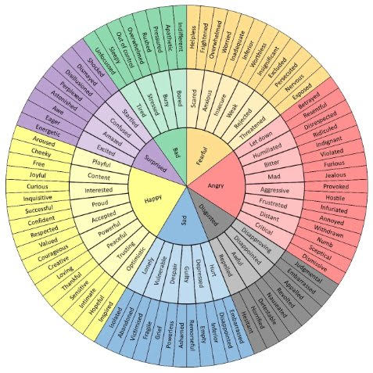
…and some “feeling” words or phrases for your poem?
What four individual
words (or four-word
phrase) do you think best describe(s)
emotions related to the subject or your poem?
-- emotional word wheel” by Geoffrey Roberts

Slide 16

Finally, find another word that is a synonym for your Title.
Ability - capability, competence, skill.
Achieve - attain, accomplish, realize, reach.
Angry - furious, irate, livid.
Appreciate - cherish, treasure, value.
Baffle - bewilder, confuse, perplex, puzzle.
Beautiful - attractive, pretty, lovely, stunning.
Bossy - controlling, domineering, overbearing.
Bad: awful, terrible, horrible.
Good: fine, excellent, great.
Hot: burning, fiery, boiling.
Cold: chilly, freezing, frosty.
Easy: Simple, effortless, straightforward.
Hard: difficult, challenging, tough.
Big: large, huge, giant.
Small: tiny, little, mini.

Slide 17

What do you do after you have written your first draft?
Don’t be surprised but sometimes first drafts of your writing are as messy as bedhead!!!

Slide 18

Check your Poem for Flow and Rhythm.
Review your word choices and think of changes.
Read your poem aloud.
Get feedback and advice and then listen to your own heart and head.
Let it sit and ferment for a little while and then finish.

Slide 19

Time for reflection………
What did you learn from writing your poem?
How did you decide what to write about from the mural?
What do you feel when you read your poem?
Have you used some new words and ideas in your writing?
How does a poem communicate differently than an essay or a novel?
What will your next poem be about?

Slide 20

Congratulations!!!
You’re a Poet….
….And now you know it!!

