Slide 1
Architecture and Interior Design
Terms to Know!

Slide 2

Project Architect:
Responsible for overseeing the architectural aspects of the development of a design including the production of construction documents (plans).

Slide 3

Interior Designer:
An individual who creates pleasing, harmonious safe, practical indoor spaces that reflect the client’s personality.

Slide 4
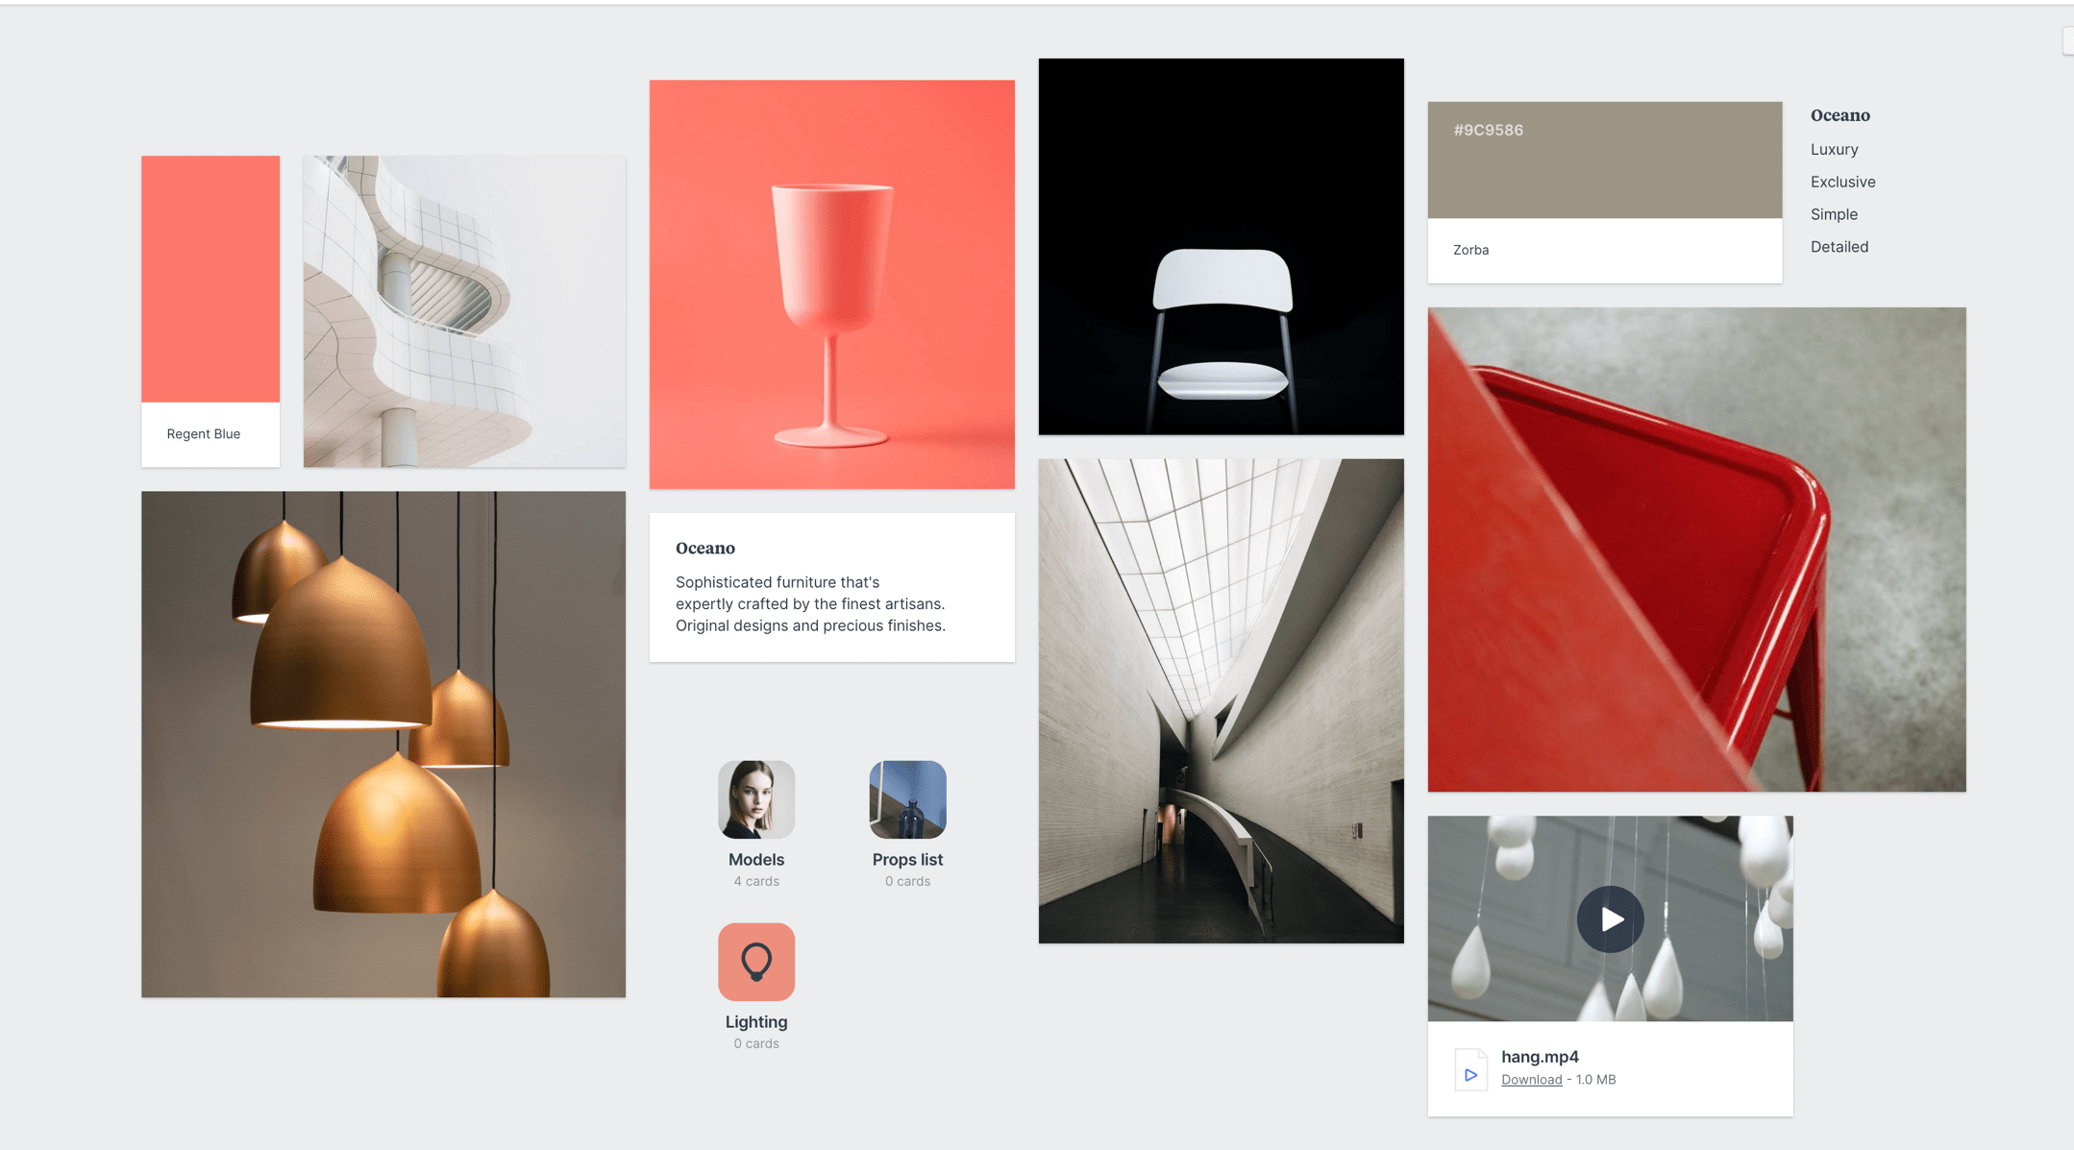
Mood Board:
Collection of design elements (color palette, fabrics, and furniture) considered for a project to help visualize the design in advance.
Ultimately, it’s all about seeing a variety of ideas, deciding how they work together, and providing a jumping off point for the finished design.

Slide 5

Aesthetics:
Creating a design that is well balanced, creating visual harmony, making it beautiful, pleasing and interesting in appearance.
It takes into consideration the visual relationship determined by light,
shadow, and contrast.

Slide 6


ADA (Americans Disability Act):
Is a federal civil rights law that prohibits discrimination against people with disabilities in everyday activities.
ADA guarantees that people with disabilities have the same opportunities as everyone else.

Slide 7

Client:
A person who employs (commissions) the services of an individual in a professional field for guidance or advice.

Slide 8

Commission:
A professional is hired by a client (employer) to create something specific with a deadline for completion.
A commission often begins with a detailed drawing (cartoon) or Mood Board which the Architect or Interior Designer shares with their employer who may make changes.

Slide 9

Cartoon:
Refers to a full-scale, detailed drawing on paper.

Slide 10

Balance:
A unifying principle of design; distributing the apparent weight of the elements so that the work does not appear about to topple over from being heavier on one side than the other.

Slide 11
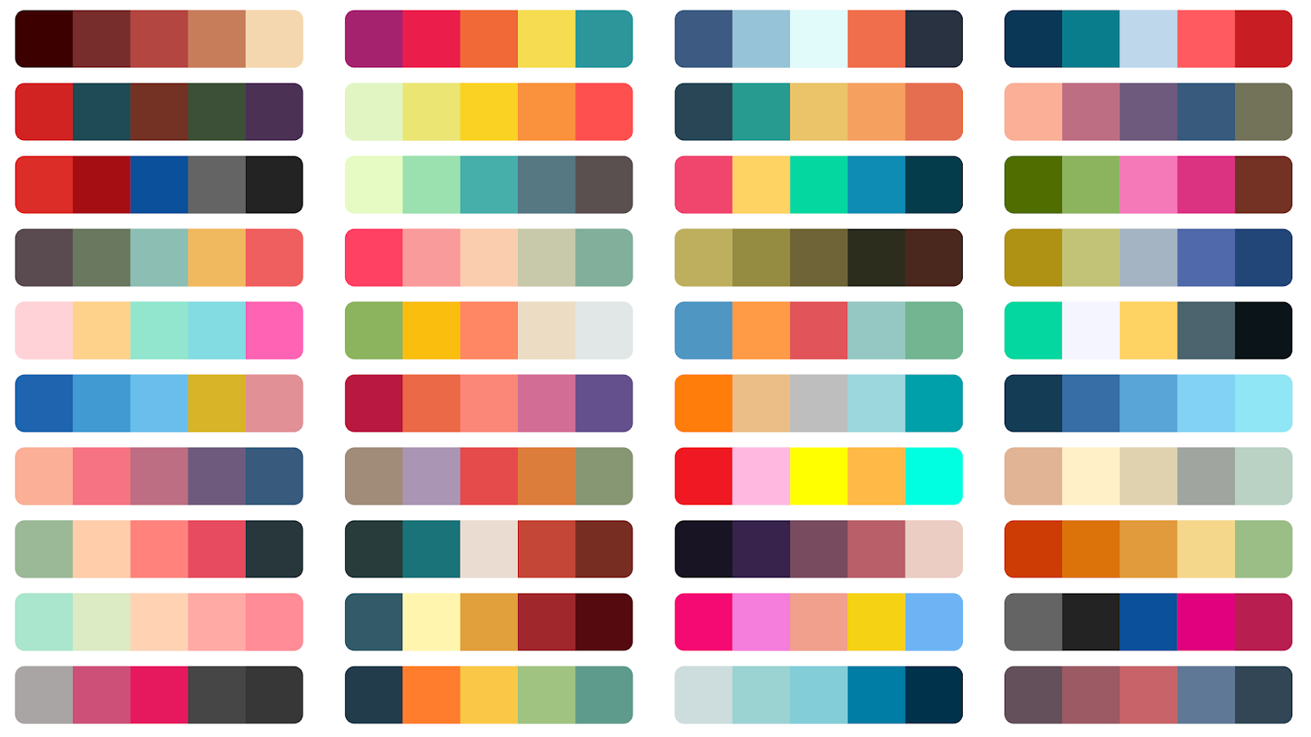
Color Palette:
In design, it refers to a particular range, quality, or use of color.

Slide 12
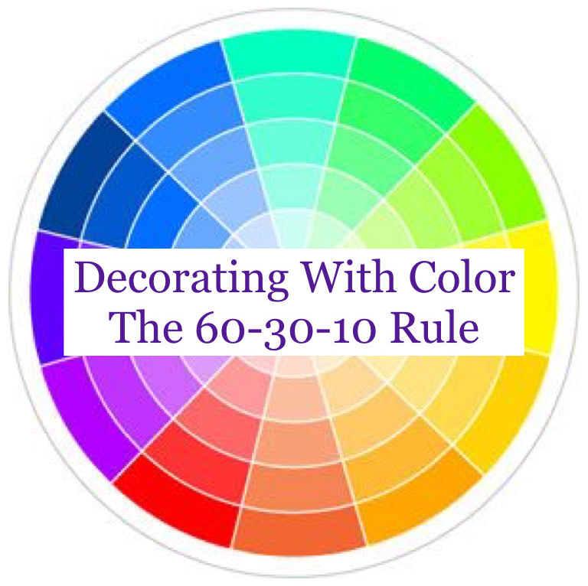
Balance in Color:
60% main color
30% secondary color 10% accent color

Slide 13

Cutting Edge:
The very latest, most stylish, invigorating, or advanced.

Slide 14

State of the Art:
The most recent stage of technological development.

